Slide 1
Chapter 6
Crafting Messages
for
Electronic Media

Slide 2
Learning Objectives
After studying this chapter, you will be able to:
Identify the major electronic media used for brief business messages and name some of the compositional modes needed for electronic media
Describe the use of social networks in business communication
Describe the evolving role of e-mail in business communication and explain how to adapt the three-step writing process to e-mail messages
Describe the business benefits of instant messaging (IM) and identify guidelines for effective IM in the workplace
6-2

Slide 3
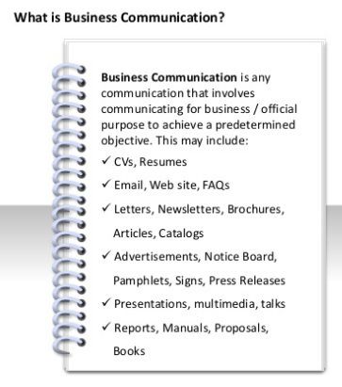
Benefits of Printed Messages
Making a formal impression
Standing out from electronic messages
Obeying laws requiring printed documents
Providing unchangeable, secure records
Reaching certain audiences
6-3

Slide 4
Electronic Media for Business Communication
Social networks
Information and media sharing sites
E-mail
Instant messaging (IM)
Text messaging
Media Choices for Brief Messages

Slide 5
Creating Content for
Conversation – not lecture
Informal but not careless
Concise, specific, informative
Get involved – stay involved
Promote, but indirectly
Be transparent and honest
Think before you post!

Slide 6
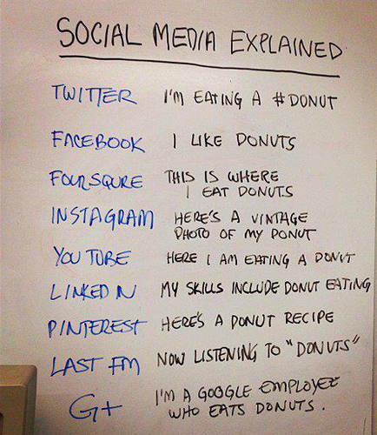
Explaining Social Media in an Unusual Way

Slide 7
E-mail

Slide 8
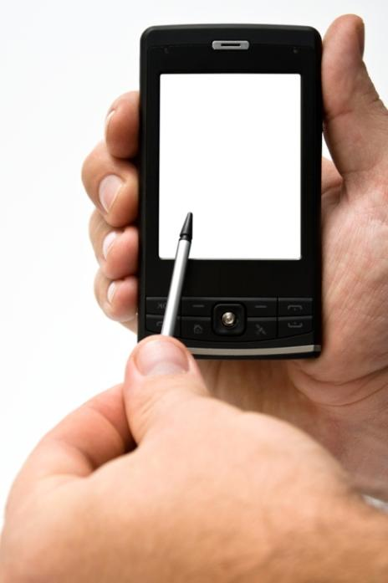
Writing Business
E-mail Messages
More formal than personal e-mails
Writing quality needs to be higher
Consequences of bad writing or poor judgment can be much more serious

Slide 9
Optimizing Content for
Mobile Devices
Mobile Specific Options
Location Based Services
Wearable Technology
Cloud-Based Services

Slide 10
Using Email in the Workplace
•Availability of Alternatives
Availability of Alternatives
•Indiscriminate Use
Indiscriminate Use
Disadvantages
Disadvantages
•Low-Value Messages
Low-Value Messages

Slide 11
Using Email in the Workplace
Accessing Messages
Sending Messages
Advantages
Scheduling Messages

Slide 12
Planning Email Messages
Analyzing the Situation
Gathering Information
Advantages
Organizing the Message

Slide 13
Writing Email Messages
Expectations for Message Quality
Importance of Subject Lines
Business Communication
Importance of Opening Words
Use of Emoticons

Slide 14
Completing Email Messages
Simplicity with an easily readable, black font
E-mail signature block – full name, title, company, contact info
Don’t forget these steps
Revising and Proofreading
Distributing

Slide 15
Instant Messaging and Text Messaging
IM in stand-alone systems
Embedded in online meeting and collaboration systems, social networks
Replacing e-mail and voice mail in many situations
Basic chat and video chat
Presence awareness
Remote display

Slide 16
Rapid response
Lower cost
Resembles conversation better than e-mail
Used on a wide range of devices
Doesn’t get misused as a “one-to-many” broadcast as often as e-mail
Understanding the
BENEFITS of IM

Slide 17
Understanding the RISKS IM
Not enough oversight
Diminished employee productivity
Disregard of compliance/legal issues
Frustration due to the number of conversations that a person can handle
Seen as a permanent work interruption
DON’T use instant messaging to deal with conflicts
http://mattdsimpson.com/8-risks- associated-with-instant-messaging/
Understanding the
RISKS of IM

Slide 18
Using Workplace IM Effectively
Use Instant Messaging Courteously
Use “Away” status while working
Be cautious with private information
Avoid sending personal messages
Don’t Send Long, Complex Messages
Avoid Multiple IM Conversations
Observe All Security Guidelines

Slide 19
Learning Objectives: Check Your Progress
Identify the major electronic media used for brief business messages and name some of the compositional modes needed for electronic media
Describe the use of social networks in business communication
Describe the evolving role of e-mail in business communication and explain how to adapt the three-step writing process to e-mail messages
Describe the business benefits of instant messaging (IM) and identify guidelines for effective IM in the workplace

Slide 20
https://www.youtube.com/watch?v=HTgYHHKs0Zw

