Slide 1
Dirichlet Mixtures, the Dirichlet Process, and the Topography of Amino Acid Multinomial Space
Stephen Altschul
National Center for Biotechnology Information
National Library of Medicine
National Institutes of Health
Bethesda, Maryland

Slide 2
Why Multiple Alignment?

Slide 3
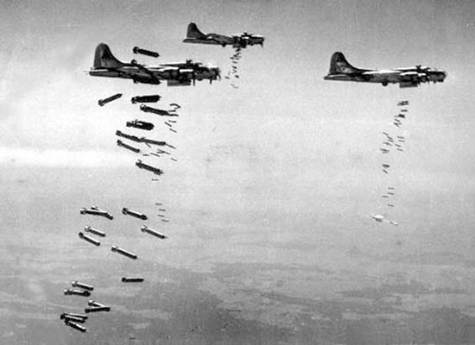
Why Multiple Alignment?
British and American bombers, WWII

Slide 4

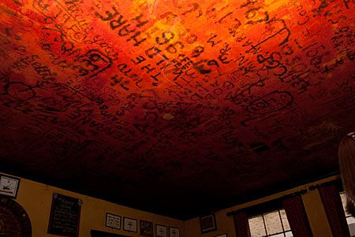
The Eagle Pub, Cambridge
Graffiti on ceiling, written by members of the RAF and the US 8th Airforce

Slide 5
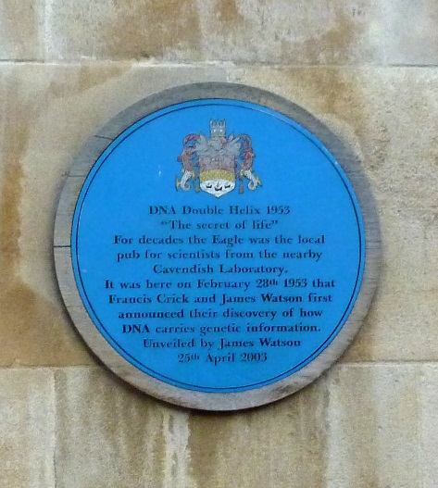
The Eagle Pub, Cambridge
Graffiti on ceiling, written by members of the RAF and the US 8th Airforce

Slide 6
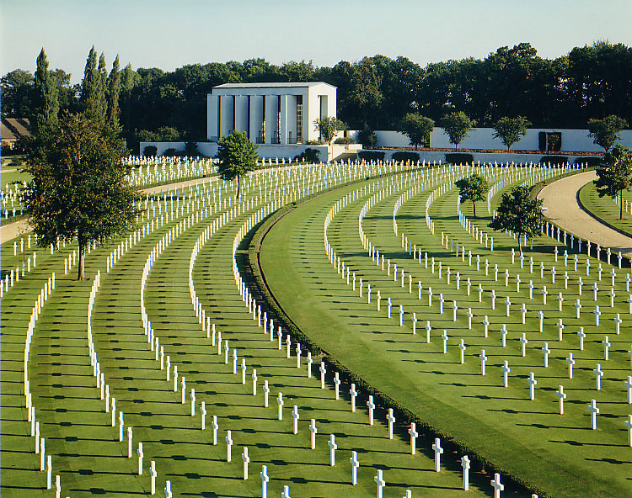
American military cemetery, Cambridge, England

Slide 7
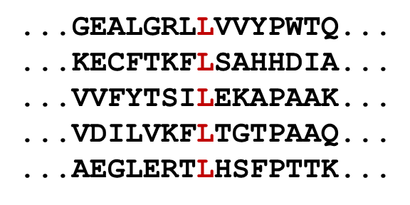
A portion of a multiple alignment

Slide 8
Motivational Problem
How should one score the alignment of a single letter to a column of letters from a multiple alignment?
V
F
V
L
M

Slide 9
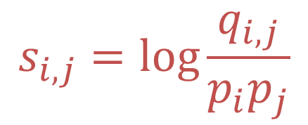
Pairwise Substitution Scores
A 4
R -1 5
N -2 0 6
D -2 -2 1 6
C 0 -3 -3 -3 9
Q -1 1 0 0 -3 5
E -1 0 0 2 -4 2 5
G 0 -2 0 -1 -3 -2 -2 6
H -2 0 1 -1 -3 0 0 -2 8
I -1 -3 -3 -3 -1 -3 -3 -4 -3 4
L -1 -2 -3 -4 -1 -2 -3 -4 -3 2 4
K -1 2 0 -1 -3 1 1 -2 -1 -3 -2 5
M -1 -1 -2 -3 -1 0 -2 -3 -2 1 2 -1 5
F -2 -3 -3 -3 -2 -3 -3 -3 -1 0 0 -3 0 6
P -1 -2 -2 -1 -3 -1 -1 -2 -2 -3 -3 -1 -2 -4 7
S 1 -1 1 0 -1 0 0 0 -1 -2 -2 0 -1 -2 -1 4
T 0 -1 0 -1 -1 -1 -1 -2 -2 -1 -1 -1 -1 -2 -1 1 5
W -3 -3 -4 -4 -2 -2 -3 -2 -2 -3 -2 -3 -1 1 -4 -3 -2 11
Y -2 -2 -2 -3 -2 -1 -2 -3 2 -1 -1 -2 -1 3 -3 -2 -2 2 7
V 0 -3 -3 -3 -1 -2 -2 -3 -3 3 1 -2 1 -1 -2 -2 0 -3 -1 4
A R N D C Q E G H I L K M F P S T W Y V
Log-odds scores
Karlin, S. & Altschul, S.F. (1990) Proc. Natl. Acad. Sci. USA 87:2264-2268.
Henikoff, S. & Henikoff, J.G. (1992) Proc. Natl. Acad. Sci. USA 89:10915-10919.

Slide 10
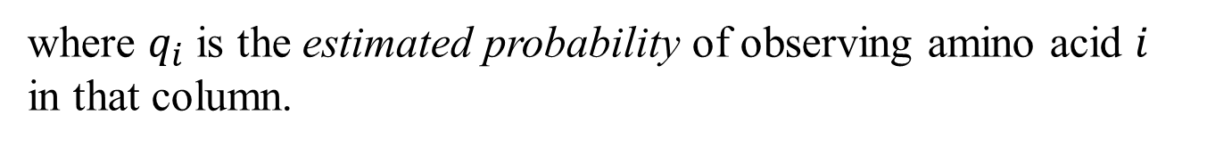
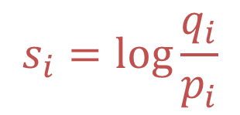
Generalization of Log-Odds Scores
Score for aligning amino acid i to a multiple alignment column:
$$s_{i}=\log{\frac{q_{i}}{p_{i}}}$$
where $q_{i}$ is the estimated probability of observing amino acid $i$ in that column.

Slide 11
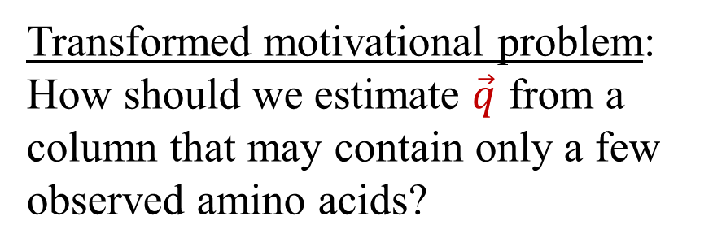
Generalization of Log-Odds Scores
Score for aligning amino acid i to a multiple alignment column:
$$s_{i}=\log{\frac{q_{i}}{p_{i}}}$$
where $q_{i}$ is the estimated probability of observing amino acid $i$ in that column.
Transformed motivational problem: How should we estimate $\vec{q}$ from a column that may contain only a few observed amino acids?
V
F
V
L

Slide 12
Generalization of Log-Odds Scores
Score for aligning amino acid i to a multiple alignment column:
$$s_{i}=\log{\frac{q_{i}}{p_{i}}}$$
where $q_{i}$ is the estimated probability of observing amino acid $i$ in that column.
Transformed motivational problem: How should we estimate $\vec{q}$ from a column that may contain only a few observed amino acids?
V
F
V
L
Enter Bayes…

Slide 13
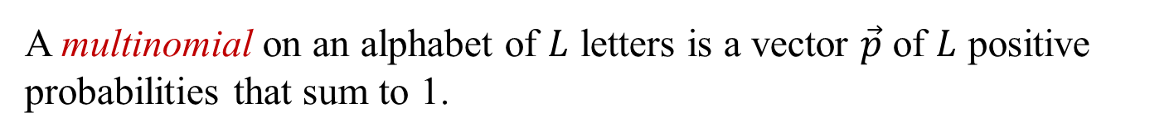
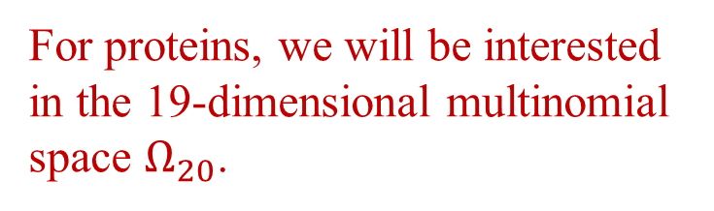
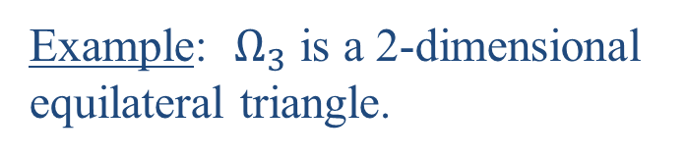
Multinomial Space
A multinomial on an alphabet of $L$ letters is a vector $\vec{p}$ of $L$ positive probabilities that sum to 1.
The multinomial space $Ω_{L}$ is the space of all multinomials on $L$ letters.
$Ω_{L}$ is $L−1$ dimensional because of the constraints on $\vec{p}$.
Example: $Ω_{3}$ is a 2-dimensional equilateral triangle.
(0,0,1)
(0,1,0)
(1,0,0)
For proteins, we will be interested in the 19-dimensional multinomial space $Ω_{20}$.

Slide 14
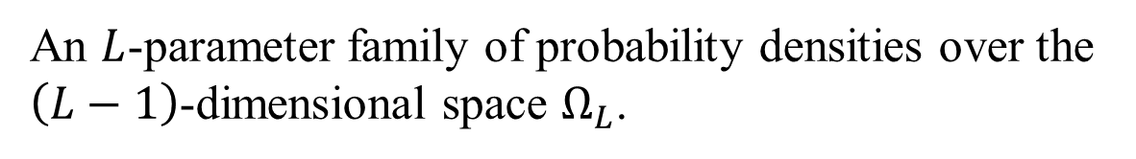
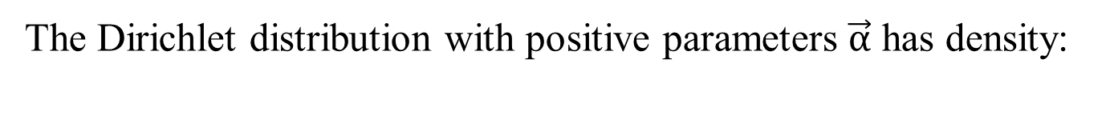
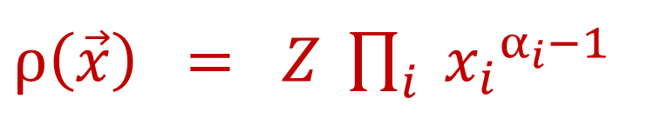
The Dirichlet Distribution
An $L$-parameter family of probability densities over the $\left(L−1\right)$-dimensional space $Ω_{L}$.
The Dirichlet distribution with positive parameters $\vec{α}$ has density:
$ρ\left(\vec{x}\right) = Z \prod_{i}{ {x_{i}}^{α_{i}−1}}$,
where $Z$ is a constant chosen so that $ρ(\vec{x})$ integrates to 1.

Slide 15
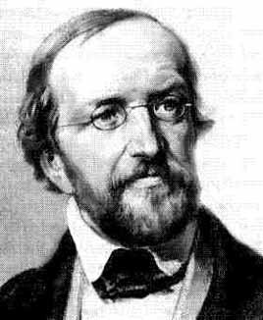
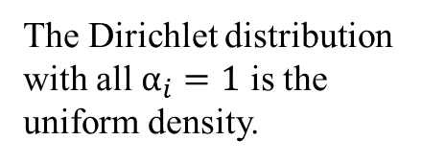
The Dirichlet Distribution
An $L$-parameter family of probability densities over the $\left(L−1\right)$-dimensional space $Ω_{L}$.
The Dirichlet distribution with positive parameters $\vec{α}$ has density:
$ρ\left(\vec{x}\right) = Z \prod_{i}{ {x_{i}}^{α_{i}−1}}$,
where $Z$ is a constant chosen so that $ρ(\vec{x})$ integrates to 1.
Johann Peter Gustav Lejeune Dirichlet
The Dirichlet distribution with all $α_{i}=1$ is the uniform density.
1805-1859
The Dirichlet distribution is the conjugate prior for the multinomial distribution.

Slide 16

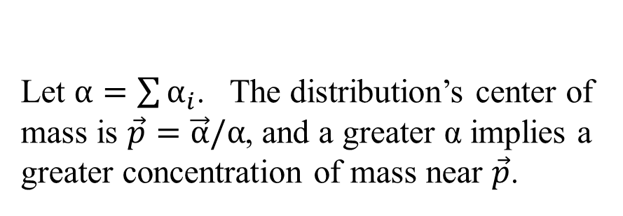
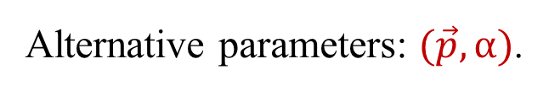
How to Think About Dirichlet Distributions
Let $α=\sum{α_{i}}$. The distribution’s center of mass is $\vec{p}=\vec{α}/α$, and a greater α implies a greater concentration of mass near $\vec{p}$.
.
$$\vec{p}$$
Alternative parameters: $(\vec{p},α)$.

Slide 17
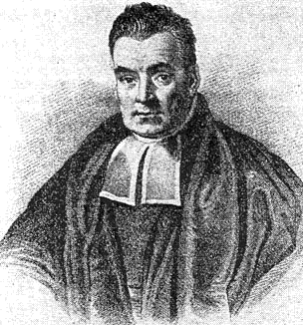
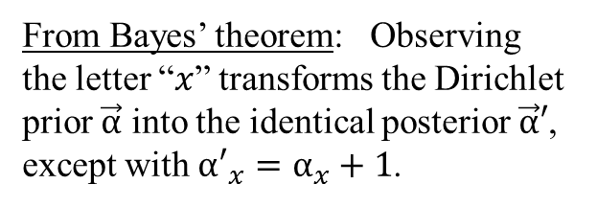
How to Think About Dirichlet Distributions
Let $α=\sum{α_{i}}$. The distribution’s center of mass is $\vec{p}=\vec{α}/α$, and a greater α implies a greater concentration of mass near $\vec{p}$.
.
$$\vec{p}$$
Alternative parameters: $(\vec{p},α)$.
Thomas Bayes
From Bayes’ theorem: Observing the letter “$x$” transforms the Dirichlet prior $\vec{α}$ into the identical posterior $\vec{α}′$, except with ${α′}_{x}=α_{x}+1$.
1701-1761

Slide 18
Bayes at Work
Here, we begin with the uniform Dirichlet prior (1,1) for the probability of “heads”.

Slide 19
Bayes at Work
Here, we begin with the uniform Dirichlet prior (1,1) for the probability of “heads”, and observe its transformation, after the observation H, into the posterior (2,1).

Slide 20
Bayes at Work
Here, we begin with the uniform Dirichlet prior (1,1) for the probability of “heads”, and observe its transformation, after the successive observations HT, into the posteriors (2,1), (2,2).

Slide 21
Bayes at Work
Here, we begin with the uniform Dirichlet prior (1,1) for the probability of “heads”, and observe its transformation, after the successive observations HTHHTHTH, into the posteriors (2,1), (2,2), (3,2), etc.

Slide 22


Bayes at Work
Here, we begin with the uniform Dirichlet prior (1,1) for the probability of “heads”, and observe its transformation, after successive observations HTHHTHTH, into the posteriors (2,1), (2,2), (3,2), etc.
At any given stage, the center of mass (i.e. the expected probability of heads) is given by:
$\frac{\#\left(H\right)+1}{\left[\#\left(H\right)+1\right] + [\#\left(T\right)+1]}$
Note: The 2-parameter Dirichlet distributions, which take the form $Zx^{α−1}{(1−x)}^{β−1}$, are also called Beta distributions.

Slide 23
Is the Dirichlet distribution appropriate for proteins?
This distribution does not capture well our prior knowledge concerning proteins.
.
$$\vec{p}$$

Slide 24
Is the Dirichlet distribution appropriate for proteins?
This distribution does not capture well our prior knowledge concerning proteins.
.
$$\vec{p}$$
Enter the Dirichlet mixture…
Brown, M., et al. (1993) “Using Dirichlet mixture priors to derive hidden Markov models for protein families.” In: Proc. First Int. Conf. Intelligent Systems for Mol. Biol., L. Hunter, D. Searls & J. Shavlik, Eds. AAAI Press, Mento Park, CA, pp. 47-55.

Slide 25
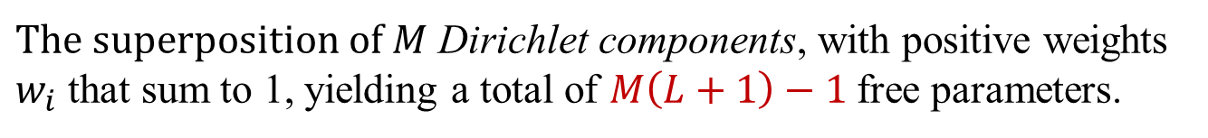
Dirichlet Mixtures
$The superposition of M$ Dirichlet components, with positive weights $w_{i}$ that sum to 1, yielding a total of $M\left(L+1\right)−1$free parameters.
We may visualize a Dirichlet mixture (DM) as a collection of probability hills in multinomial space.

Slide 26
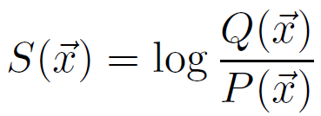
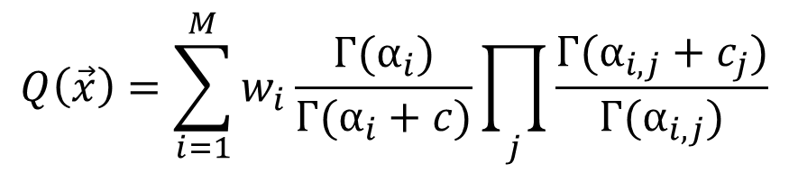

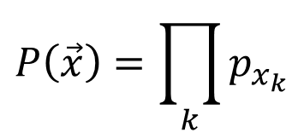
Multiple Alignment Substitution Scores
Log-odds scores
“Bayesian Integral Log-odds” or “BILD” scores
The construction of column scores from Dirichlet mixture priors
$$Q\left(\vec{x}\right)=\sum_{i=1}^{M}{w_{i}\frac{Г(α_{i})}{Г(α_{i}+c)}\prod_{j}{\frac{Г(α_{i,j}+c_{j})}{Г(α_{i,j})}}}$$
$$P\left(\vec{x}\right)=\prod_{k}{p_{x_{k}}}$$
where $\vec{c}$ is the amino acid count vector implied by $\vec{x}$
Assuming uniform Dirichlet priors, $S\left(\text{"}\text{AAACC}\text{"}\right)=\log\left(1.83\right)= 0.87$ bits
$S\left(\text{"}\text{AAACT}\text{"}\right)=\log\left(0.91\right)=−0.13$ bits
Altschul, S.F., et al. (2010) "The construction and use of log-odds substitution scores for multiple sequence alignment." PLoS Comput. Biol. 6:e1000852.

Slide 27
Dirichlet Mixtures
$The superposition of M$ Dirichlet components, with positive weights $w_{i}$ that sum to 1, yielding a total of $M\left(L+1\right)−1$free parameters.
We may visualize a Dirichlet mixture (DM) as a collection of probability hills in multinomial space.
No one knows how to construct a DM prior from first principles.

Slide 28
Dirichlet Mixtures
$The superposition of M$ Dirichlet components, with positive weights $w_{i}$ that sum to 1, yielding a total of $M\left(L+1\right)−1$free parameters.
We may visualize a Dirichlet mixture (DM) as a collection of probability hills in multinomial space.
No one knows how to construct a DM prior from first principles. So we invert the problem….
Given a set of properly aligned columns, what is the maximum-likelihood DM?

Slide 29
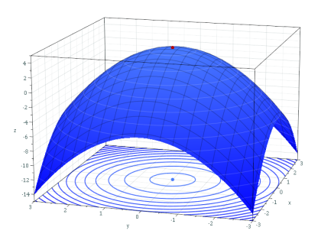
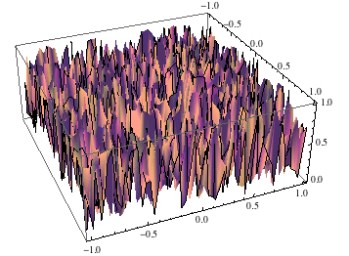
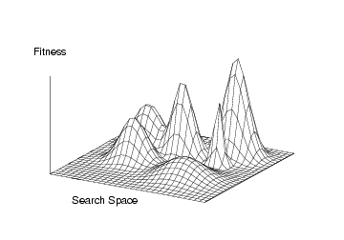
Optimization in High-Dimensional Space
Smooth and simple landscapes
Relatively easy and fast to find optimum.
Algorithms: Newton’s method; gradient descent.
Random landscapes
Finding optimal solution intractable.
Algorithms: Brute force enumeration.
Rough but correlated landscapes
Difficult to find provably optimum solution.
Fairly effective heuristic methods available.
Algorithms: Simulated annealing; EM; Gibbs sampling.
Difficulties: Local optima.

Slide 30
Gibbs Sampling for Dirichlet Mixtures
Given: A large set of multiple-alignment columns
Find: The $M$-component DM maximizing the likelihood of the data
Algorithm
1) Initialize: Assign columns to components
2) Derive $(\vec{p},α, w)$ for each component from its columns
3) In turn, sample columns into new components, using iiii probabilities proportional to implied likelihoods
4) Iterate
But: How many Dirichlet components should there be?
Ye, X., et al. (2011) J. Comput. Biol. 18:941-954.

Slide 31
A model that is too simple underfits the data
A simple model, i.e. one with few parameters, will have low complexity but will not fit the data well.
From: “A tutorial introduction to the minimum description
length principle” by Peter Grünwald

Slide 32
A model that is too complex overfits the data
A complex model will fit the data well, but is itself long to describe.

Slide 33
A model with an appropriate number of parameters
Everything should be made as simple as possible, but not simpler. – Albert Einstein
A model should be as detailed as the data will support, but no more so. – MDL principle

Slide 34
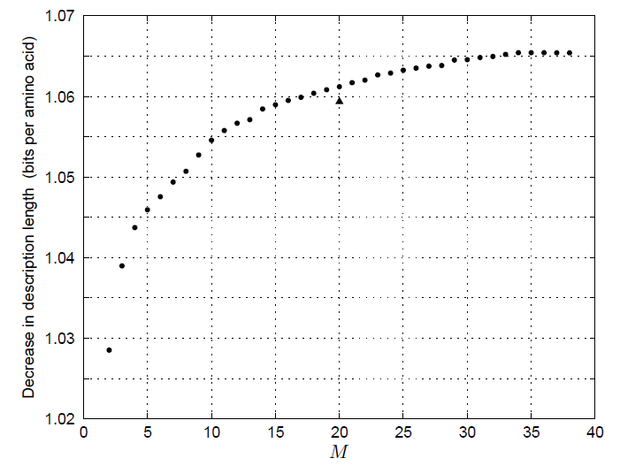
The Optimal Number of Dirichlet Components (estimated using Gibbs sampling algorithm)
Data set: “diverse-1216-uw”, containing 315,585 columns with an average of 76.0 amino acids per column, from: https://compbio.soe.ucsc.edu/dirichlets/index.html
Decrease in total description length:
Solution found by EM
1.0654 bits/a.a.
using a 35-component Dirichlet mixture
Problem: How effective is the algorithm at finding a maximum-likelihood DM?
Ye, X., et al. (2011) J. Comput. Biol. 18:941-954.

Slide 35
The Dirichlet Process
The DP models mixtures of an underlying distribution with an unknown and unbounded number of components.
(0,0,1)
(0,1,0)
It generalizes the Dirichlet distribution to infinitely many dimensions, as a model of component weights.
Component weights
(1,0,0)

Slide 36
The Dirichlet Process
The DP models mixtures of an underlying distribution with an unknown and unbounded number of components.
(0,0,1)
(0,1,0)
It generalizes the Dirichlet distribution to infinitely many dimensions, as a model of component weights.
Component weights
(1,0,0)
A DP is specified by:
A prior H for the parameters of the underlying distribution
A parameter γ defining a prior for the component weights
The smaller γ, the greater the concentration of weight in a few components.
Antoniak, C.E. (1974) Ann. Stat. 2:1152-1174.

Slide 37
The Chinese Restaurant Process
A restaurant with infinitely many tables, which can each seat infinitely many people.
As people enter, they sit at tables randomly, but prefer company:
They choose occupied tables with probability proportional to the number of people already seated there;
They choose a new, unoccupied table, with probability proportional to γ.

Slide 38
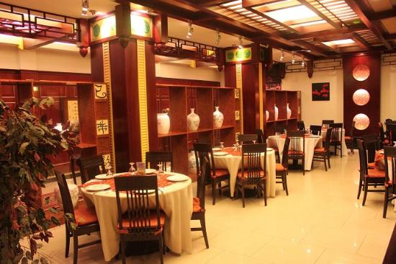


The Chinese Restaurant Process
A restaurant with infinitely many tables, which can each seat infinitely many people.
As people enter, they sit at tables randomly, but prefer company:
They choose occupied tables with probability proportional to the number of people already seated there;
They choose a new, unoccupied table, with probability proportional to γ.
Example: 8 people already seated; $γ=2$
Probability: 0.3 0.5 0.2
Ferguson, T.S. (1973) Ann. Stat. 1:209-230.

Slide 39
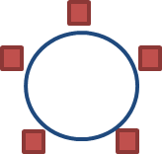
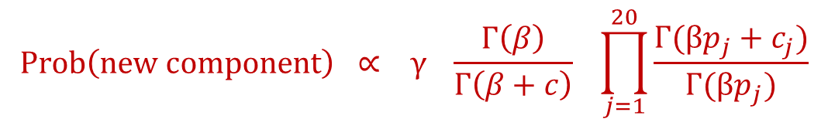


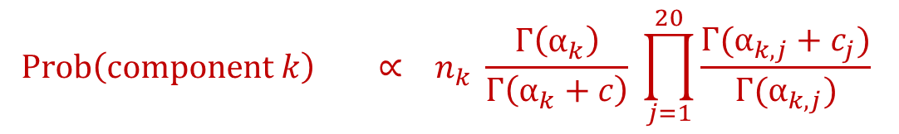
Dirichlet-Process Modifications to Gibbs Sampling
When sampling a column $C$ into a component:
If $C$ was the only column in its old component, abolish that component.
Allow $C$ to seed a new component, with probability proportional to γ:
$$Prob\left(component k\right) ∝ n_{k} \frac{Γ\left(α_{k}\right)}{Γ\left(α_{k}+c\right)} \prod_{j=1}^{20}{\frac{Γ(α_{k,j}+c_{j})}{Γ(α_{k,j})}}$$
To calculate Dirichlet parameters for the component:
Sample from the posterior implied by $H$ and the component’s columns.
Nguyen, V.-A., et al. (2013) J. Comput. Biol. 20:1-18.

Slide 40
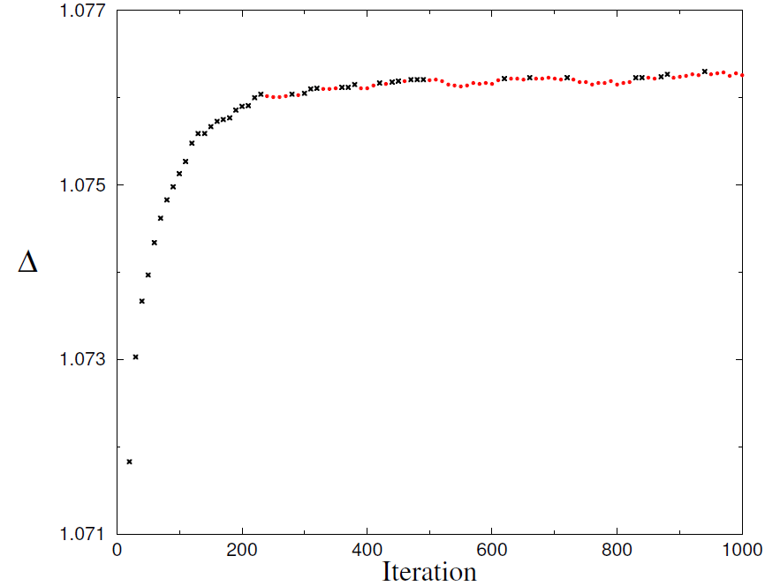

Decrease in Total Description Length as a Function of DP-Sampler Iteration ($β=400$; $γ=100)$

Slide 41
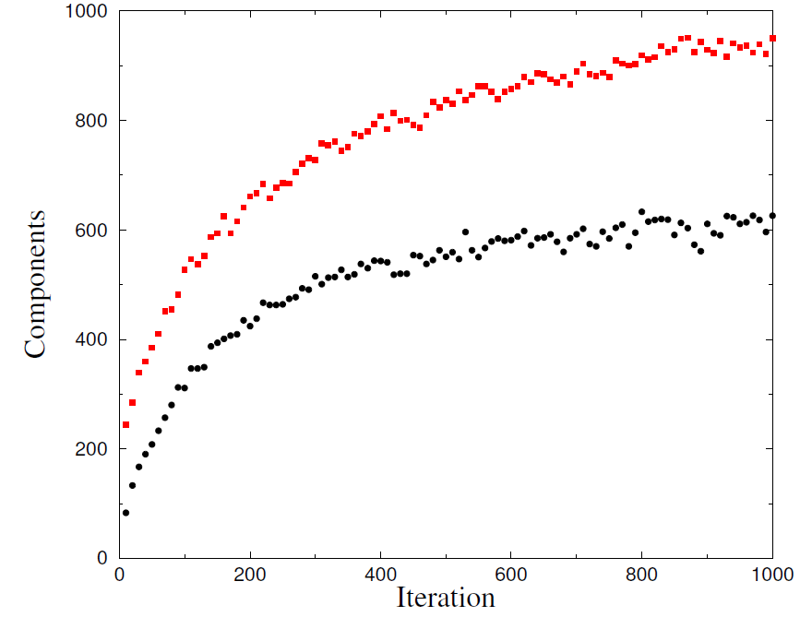
Total Number of Components, and Number Supported by the MDL Principle, as a Function of DP-Sampler Iteration

Slide 42
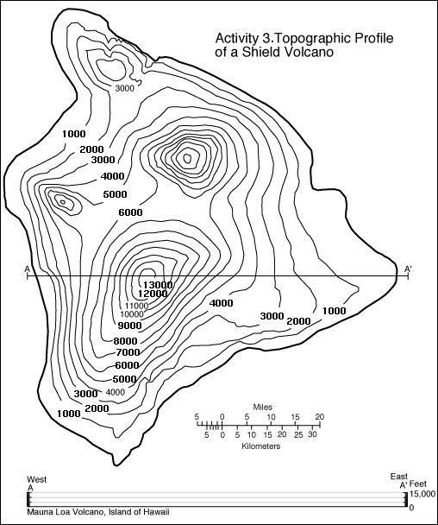
Topographic Map of the Big Island of Hawai’i
Kohala
A
A
A
A
A
A
A
A
A
A
A
A
A
A
A
A
A
A
A
A
A
A
A
A
A
A
A
A
A
A
A
A
Mauna Kea
Hualalai
Mauna Loa
Kilauea
A

Slide 43
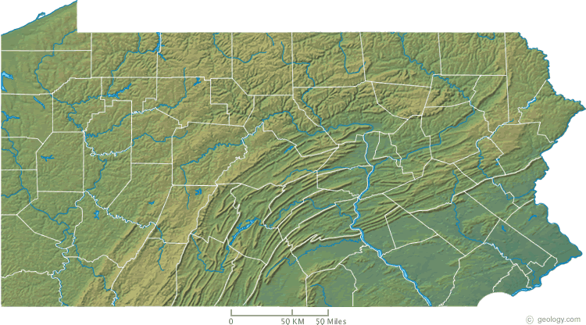
Topographic Map of Pennsylvania

Slide 44
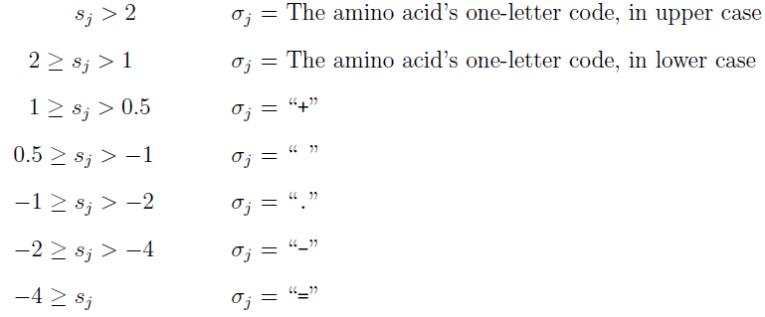
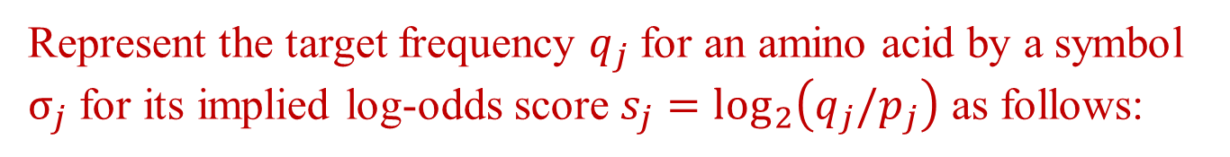
Visualizing Dirichlet Mixture Components
Reorder the amino acids:
RKQEDNHWYFMLIVCTSAGP
Represent the target frequency $q_{j}$for an amino acid by a symbol $σ_{j}$ for its implied log-odds score $s_{j}=\log_{2}\left(q_{j}/p_{j}\right)$ as follows:

Slide 45
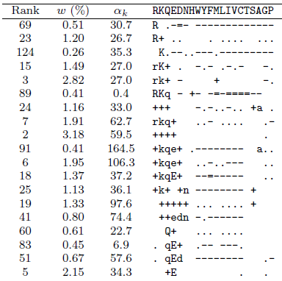
A Reordered Subset of a 134-Component Dirichlet Mixture

Slide 46
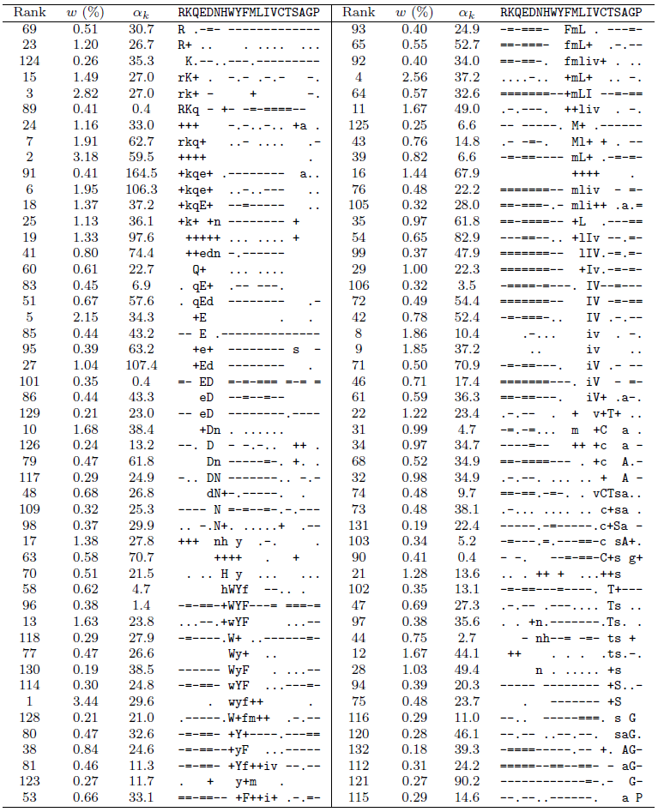
The Topography of Amino Acid Multinomial Space
Group A:
The main ridge

Slide 47
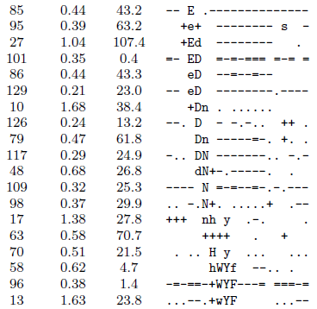
Another Section of the Main Ridge

Slide 48
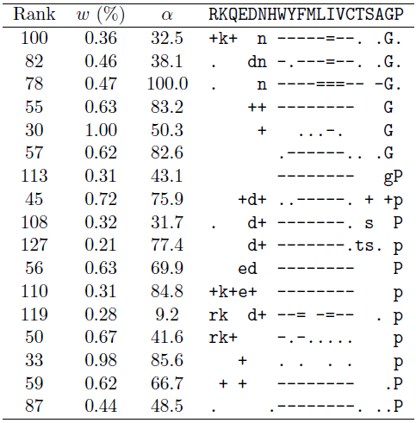
Group B: Hydrophylic Positions Favoring Glycine or Proline

Slide 49
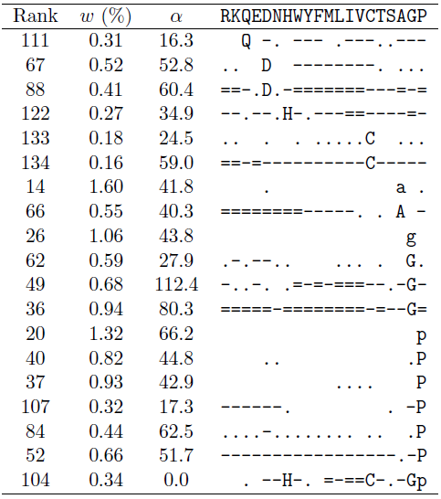
Group C: Positions Favoring Single Amino Acids

Slide 50
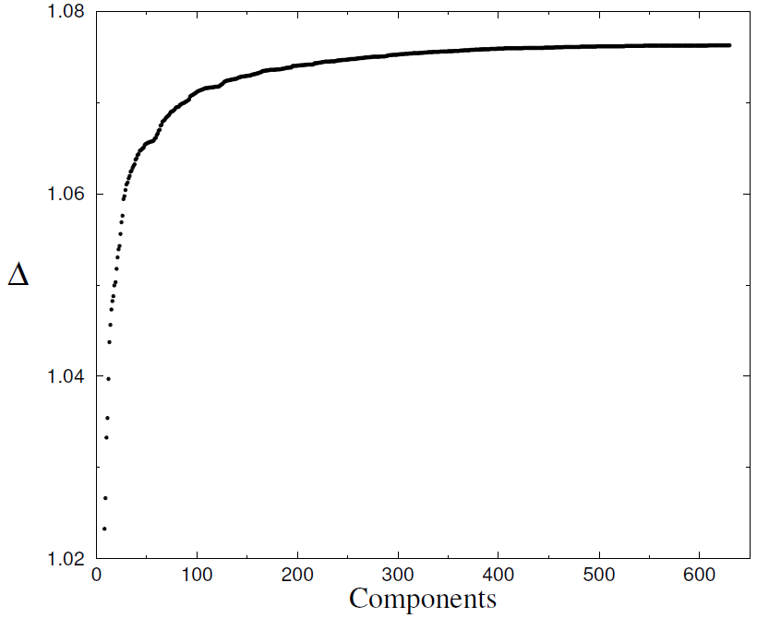
Tradeoff Between Number of Dirichlet Components and Decrease in Total Description Length per Amino Acid

Slide 51
Collaborators
National Center for Biotechnology Information
Xugang Ye
Yi-Kuo Yu
University of Maryland, College Park
Viet-An Nguyen
Jordan Boyd-Graber

