Slide 1
Gap Scores
Stephen Altschul
National Center for Biotechnology Information
National Library of Medicine
National Institutes of Health

Slide 2
Length-Dependent Gap Scores
The Biological Issue: A single mutational event can insert or delete multiple letters at one time. Therefore, an alignment containing a single gap of length 6, for example, may be more biologically plausible than one containing three gaps of length 1. Assigning a score of $g$ to each indel does not capture this fact.
Fitch, W.M. & Smith, T.F. (1983) Proc. Natl. Acad. Sci. USA 80:1382-1386.
Definitional change: A gap is a run of nulls in one sequence aligned with letters in the other.
Scoring system change: The score for a gap of length $k$ is $g(k)$.
Algorithmic change: The basic Needleman-Wunsch and Smith-Waterman algorithms need to be modified to deal with length-dependent gap scores.

Slide 3
Dynamic Programming with Length-Dependent Gap Scores
$$⋮$$
At node $(i,j)$, one must consider paths from nodes $\left(0,j\right)$, $\left(1,j\right)$, … , $(i−1,j)$, from nodes $(i,0)$, $(i,1)$, … , $(i,j−1)$, and from node $(i−1,j−1)$.
$$⋮$$
$$g(k)$$
For sequences of length $m$ and $n$, with $m≤n$, the time complexity is $O(mn^{2})$.
$$g(3)$$
$$g(2)$$
$$s(i,j)$$
$$g(1)$$
$$⋯$$
$$⋯$$
$$i,j$$
$$g(1)$$
$$g(k)$$
$$g(3)$$
$$g(2)$$

Slide 4
Affine Gap Scores
Time complexity $O(mn^{2})$ is very burdensome even for two sequences of relatively moderate length, and is completely impractical when many sequences must be compared, such as in a database search.
However, consider gap scores of the form $g\left(k\right)=−(a+bk)$. When $a>0$, these affine gap scores favor alignments with fewer total gaps, not just alignments with a smaller number of indels.
Fortunately, a relatively simple modification of the Needleman-Wunsch and Smith-Waterman algorithms permits one to use affine gap costs with only a constant factor more computation, so that the algorithms remain $O(mn)$.

Slide 5
Gotoh Algorithm for Affine Gap Scores
The key idea is to store at each node $\left(i,j\right)$ the best score $H(i,j)$ for entering the node from the left, the best score $V(i,j)$ for entering the node from above, as well as the best score $SIM(i,j)$ for entering the node by any path. For the Needleman-Wunsch algorithm, with affine gap scores of the form $g\left(k\right)=−(a+bk)$, one then has these recursions:
$H\left(i,j\right)=$ $max⁡[ H\left(i,j−1\right)−b , SIM\left(i,j−1\right)−a−b]$
$V\left(i,j\right)=$ $max⁡[ V\left(i−1,j\right)−b , SIM\left(i−1,j\right)−a−b]$
$SIM\left(i,j\right)=$ $max⁡[ H\left(i,j\right) , V\left(i,j\right) , SIM\left(i−1,j−1\right)+s\left(x_{i},y_{j}\right) ]$
Gotoh, O. (1982) “An improved algorithm for matching biological sequences.” J. Mol. Biol. 162:705-708.
Note: The traceback procedure has a few subtleties, and Gotoh’s published procedure is incorrect. A correct procedure is described in: Altschul S.F. & Erickson, B.W. (1986) Bull. Math. Biol. 48:603-616.

Slide 6
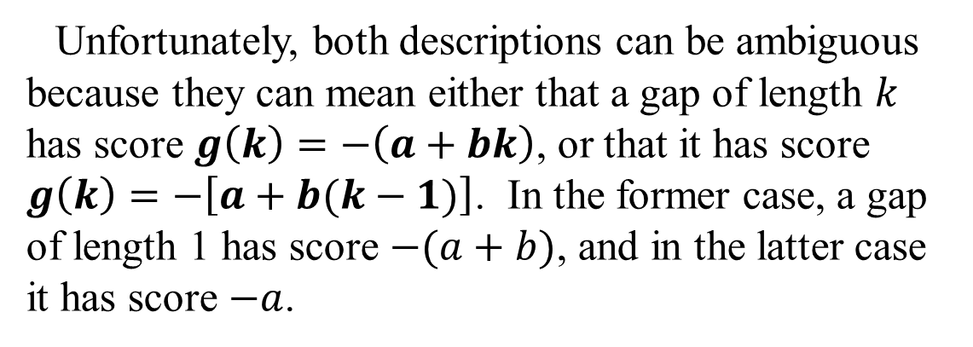
Affine Gap Score Nomenclature
Sometimes a set of affine gap costs are described as having an “opening cost” a and an “extension cost” $b$, or by the ordered pair $(a,b)$.
Unfortunately, both descriptions can be ambiguous because they can mean either that a gap of length $k$ has score $g\left(k\right)=−\left(a+bk\right)$, or that it has score $g\left(k\right)=−\left[a+b(k−1)\right]$. In the former case, a gap of length 1 has score $−(a+b)$, and in the latter case it has score $−a$.
Be sure to read a paper carefully to understand which convention is being used, and be explicit when describing affine gap scores. We will use the convention that $g\left(k\right)=−(a+bk)$.

Slide 7
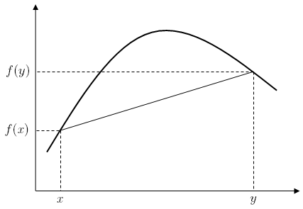
Concave Gap Scores
Gap scores that are not as simple as affine, but still not completely general, have been proposed. For example, logarithmic gap scores of the form
$$g\left(k\right)=−[a+b\log\left(k\right)]$$
have sometimes been advocated. Gap scores of this form, and of many others, are called concave, because $|g|$ is a concave function.
A concave function $f(x)$ is one for which
$$f\left[tx+\left(1−t\right)y\right]≥tf\left(x\right)+\left(1−t\right)f(y)$$
for all $x$, $y$ in $f$’s domain, and all $t∊\left[0,1\right]$.
Algorithms with time complexity $O(mn)$ have been described for concave gap scores, although the algorithms themselves are somewhat complicated. In practice, almost all alignment programs in common use employ affine gap costs.
Miller, W. & Myers, E.W. (1988) “Sequence comparison with concave weighting functions.” Bull. Math. Biol. 50:97-120.

Slide 8
Other Generalizations
Letter-dependent gap scores
Most of the algorithms we have considered allow the score for inserting or deleting a letter to depend on the letter, with no change in time complexity.
Generalized affine gap scores
Once a gap has been opened, one may allow diagonal “gap steps” through the path graph, as well as horizontal or vertical ones. Such diagonal steps may be interpreted as leaving letters inside the alignment unaligned. This can be useful for distantly related proteins, where certain regions may have diverged beyond reliable alignment. There is no increase in time complexity.
Altschul, S.F. (1998) “Generalized affine gap costs for protein sequence alignment.” Proteins 32:88-96.

Slide 9
The Effect of Changing Gap Scores
Three optimal local protein alignments produced using BLOSUM-62 substitution scores in conjunction with various gap scores.
Gap scores
49 CERTLKYFLGIAGGKWVVSYFWVTQSIKERKMLNEHDFEVRGDVVNGRNHQGPKRARESQDRK-IFRGLEICCYG 122
C RT KYFL +A G VS+ WV S ++ N ++ + + G + + +R + Q R+ F+ L++
865 C-RTRKYFLCLASGIPCVSHVWVHDSCHANQLQNYRNY-L---LPAGYSLE-EQRILDWQPRENPFQNLKVLLVS 933
123 PFTNMPTDQLEWM-VQLC-GASVVKE-LSS-FT--LGTGVHPIVVVQPDAWTEDNGFHAIGQMCEAPVVTREWVL 191
+L W + + GA+ VK+ SS + GV +VV P + + + PVV++EWV+
934 D-QQQNFLEL-WSEILMTGGAASVKQhHSSAHNKDIALGVFDVVVTDPSC-PA-SVLKC-AEALQLPVVSQEWVI 1003
(0, 6)
51 RTLKYFLGIAGGKWVVSYFWVTQSIKERKMLNEHDFEVRGDVVNGRNHQGPKRARESQDRK-IFRGLEICCYG 122
RT KYFL +A G VS+ WV S ++ N ++ ++ +R + Q R+ F+ L++
866 RTRKYFLCLASGIPCVSHVWVHDSCHANQLQNYRNY-----LLPAGYSLEEQRILDWQPRENPFQNLKVLLVS 933
123 PFTNMPTDQLEWMVQLCGASVVKELSSFT----LGTGVHPIVVVQPDAWTEDNGFHAIGQMCEAPVVTREWVL 191
+ ++ GA+ VK+ S + GV +VV P + + PVV++EWV+
934 DQQQNFLELWSEILMTGGAASVKQHHSSAHNKDIALGVFDVVVTDPSC---PASVLKCAEALQLPVVSQEWVI 1003
(11, 1)
51 RTLKYFLGIAGGKWVVSYFWVTQSIKERKMLNEHDFevrgdvvngrnhqgpKRARESQDRKi-FRGLEIccyg 122
RT KYFL +A G VS+ WV S ++ N ++ +R + Q R+ F+ L++
866 RTRKYFLCLASGIPCVSHVWVHDSCHANQLQNYRNYllpagyslee-----QRILDWQPREnpFQNLKVllvs 933
123 pftnmptdqlewmvqlcGASVVKELSSft----LGTGVHPIVVVQPDawtedngfhaiGQMCEAPVVTREWVL 191
GA+ VK+ S ++ GV +VV P ++ + PVV++EWV+
934 dqqqnflelwseilmtgGAASVKQHHSsahnkdIALGVFDVVVTDPScpasvlkc---AEALQLPVVSQEWVI 1003
(12, 1, 0.3)

