Slide 1
Global Sequence Alignment
Stephen Altschul
National Center for Biotechnology Information
National Library of Medicine
National Institutes of Health

Slide 2
DNA and Protein Sequence Comparison
Mutations in a DNA sequence cause the protein sequences it encodes to change over evolutionary time. Individual amino acids may be inserted, deleted or change into other amino acids.
By comparing related sequences, we can learn about species relationships, about which positions in proteins are the most important, and about the causes of certain diseases.
Given two DNA or protein sequences, how can we define the distance between the sequences, or alternatively their similarity?

Slide 3
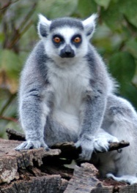
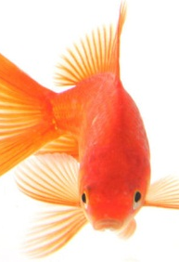
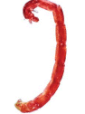
Alignments of Human Beta-Globin to Globins from Other Species
Human beta-globin VHLTPEEKSAVTALWGKVNVDEVGGEALGRLLVVYPWTQRFFESFGDLSTPDAVMGN ------------------------------- --LTPEE VT LWGKVNV VGGEALGRLLVVYPWTQRFFESFGDLS PDA MGN Ring-tailed lemur beta-globin TFLTPEENGHVTSLWGKVNVEKVGGEALGRLLVVYPWTQRFFESFGDLSSPDAIMGN -----------------------------------------------------------------------------------------PKVKAHGKKVLGAFSDGLAHLDNLKGTFATLSELHCDKLHVDPENFRLLGNVLVCVLAHHFGKEFTPPVQAAYQKVVAGVANALAHKYH PKVKAHGKKVL AFS GL HLDNLKGTFA LSELHC LHVDPENF LLGNVLV VLAHHFG F P QAA QKVV GVANALAHKYH PKVKAHGKKVLSAFSEGLHHLDNLKGTFAQLSELHCVALHVDPENFKLLGNVLVIVLAHHFGNDFSPQTQAAFQKVVIGVANALAHKYH
Human beta-globin VHLTPEEKSAVTALWGKVNVDEVGGEALGRLLVVYPWTQRFFESFGDLSTPDAVMGNP -------------------------------V T E SA LWGK N DE G AL R L VYPWTQR F FG LS P A MGNP Goldfish beta-globin VEWTDAERSAIIGLWGKLNPDELGPQALARCLIVYPWTQRYFATFGNLSSPAAIMGNP -----------------------------------------------------------------------------------------KVKAHGKKVLGAFSDGLAHLDNLKGTFATLSELHCDKLHVDPENFRLLGNVLVCVLAHHFG-KEFTPPVQAAYQKVVAGVANALAHKYH KV AHG V G DN K T A LS H KLHVDP NFRLL A FG F VQ A QK V AL YH KVAAHGRTVMGGLERAIKNMDNIKATYAPLSVMHSEKLHVDPDNFRLLADCITVCAAMKFGPSGFNADVQEAWQKFLSVVVSALCRQYH
Human beta-globin VHLTPEEKSAVTALW----GKVNVDEVGGEALGRLLVVYPWTQRFFESFGDLSTPDAVMGNPKVKA -------------------------L V W G N VG E L F F S P V Bloodworm globin IV MGLSAAQRQVVASTWKDIAGSDNGAGVGKECFTKFLSAHHDIAAVF-GFSGAS-------DPGVAD -----------------------------------------------------------------------------------------HGKKVLGAFSDGLAHL-DNLKGTFATLSELHCDK----LHVDPENFRLLGNVLVCVLAHHFGKEFTPPVQAAYQKVVAGVANALAHKYH –G KVL D HL D K K H E F LG L H G T A A AL LGAKVLAQIGVAVSHLGDEGKMVAEMKAVGVRHKGYGYKHIKAEYFEPLGASLLSAMEHRIGGKMTAAAKDAWAAAYADISGALISGLQ
Human beta-globin VHLTPEEKSAVTALWG--KVNVDEVGGEALGRLLVVYPWTQRFFESFGDLSTPDAVMGNPK ----------------------------V T V K N L P F P NPK Soybean leghemoglobin VAFTEKQDALVSSSFEAFKANIPQYSVVFYTSILEKAPAAKDLFSFLANGVDPT----NPK -----------------------------------------------------------------------------------------VKAHGKKVLGAFSDGLAHLDNLKGTFA--TLSELHCDKLHVDPENFRLLGNVLVCVLAHHFGKEFTPPVQAAYQKVVAGVANALAHKYH - H K D L A L H K DP F L G A A A LTGHAEKLFALVRDSAGQLKASGTVVADAALGSVHAQKAVTDPQ-FVVVKEALLKTIKAAVGDKWSDELSREWEVAYDELAAAIKKA--

Slide 4
A Formal Problem
Given: Two protein or DNA sequences
$$X ≡ {x_{1}x}_{2}x_{3}…x_{m}$$
$${Y ≡ y}_{1}y_{2}y_{3}…y_{n}$$
where the $x_{i}$ and $y_{i}$ are chosen from a finite alphabet $𝓐$, e.g. $\left\{A,C,G,T\right\}$.
How can one define the distance between the sequences $X$ and $Y$, or alternatively their similarity?
We shall adopt the somewhat more flexible formalism of similarity, with higher values considered better.
Although there are other possibilities, similarity is generally defined with reference to a sequence alignment, in which individual letters from each sequence are placed into correspondence.

Slide 5
Examples of Sequence Alignment
groan |||:| grown
colo-r |||| | colour
theatre |||||:: theater
theatre ||||| theater
×
elephant |||: ||| eleg-ant
vermiform ::||::::: formation
vermiform----- about|||| -----formation
disestablishment ||| | ||| dis-------s--ent
disestablishment ||| :||| dis---------sent

Slide 6
Applications
Sequence alignment arises in many fields:
Molecular biology
Inexact text matching (e.g. spell checkers; web page search)
Speech recognition
In general:
The precise definition of what constitutes an alignment may vary by field, and even within a field.
Many different alignments of two sequences are possible, so to select among them one requires an objective (score) function on alignments.
The number of possible alignments of two sequences grows exponentially with the length of the sequences. Good algorithms are required.

Slide 7
Central Issues in Biological Sequence Comparison
Definitions: What are you trying to find or optimize?
Algorithms: Can you find the proposed object optimally and in reasonable time?
Statistics: Can your results be explained by chance?
In general there is a tension between questions. A definition that is too simple may allow efficient algorithms, but may not yield results of biological interest. However, a definition that includes most of the relevant biology may entail intractable algorithms and statistics. The most successful approaches find a balance between these considerations.

Slide 8
What Makes a Good Alignment?

Slide 9
What Makes a Good Alignment?
Lots of matching letters
Few mismatching letters
Few insertions or deletions (indels)

Slide 10
What Makes a Good Alignment?
Lots of matching letters
Few mismatching letters
Few insertions or deletions
Idea:
Each match gets a score: $+A$
Each mismatch gets a score: $−B$
Each indel gets a score: ii $−C$
Define the score of an alignment to be the sum of its match, mismatch and indel scores.

Slide 11
What Makes a Good Alignment?
Lots of matching letters
Few mismatching letters
Few insertions or deletions
Idea:
Each match gets a score: $+A$
Each mismatch gets a score: $−B$
Each indel gets a score: ii $−C$
Define the score of an alignment to be the sum of its match, mismatch and indel scores.
Define the similarity of two sequences to be the score of their best alignment.

Slide 12
Formal Elements of Global Sequence Alignment
No crossings allowed. For algorithmic reasons, it is fortunate that, although there are natural mechanisms (mutations) that lead to amino acid or nucleotide substitutions, insertions and deletions, there are none that yield transpositions, unlike with keyboard-produced text. In contrast, when analyzing RNA folding, one may choose for algorithmic reasons to exclude “pseudoknots”, which do in fact occur naturally.
Gaps. An arbitrary number of null characters (represented by dashes) may be placed into either sequence, and aligned with letters in the other sequence. Two nulls may not be aligned. Depending upon one’s perspective, the alignment of a letter with a null may be understood as the insertion of a letter into one sequence, or the deletion of a letter from the other. Therefore, a letter aligned with a null is sometimes called an indel.
Alignment scores. The score for an alignment is taken to be the sum of scores for aligned pairs of letters, and scores for letters aligned with nulls. Each such pairing is called an alignment column.
Substitution scores. Scores for aligned pairs of letters are called substitution scores, whether the letter aligned are identical or not. Most simply, substitution scores may take the form of match scores and mismatch scores.
Gap scores. The score for a letter aligned with a null is called a gap score. Usually gap scores are letter-independent.
Global alignment. All letters and nulls in each sequence must be aligned.

Slide 13
Sequence Similarity
Define the similarity of two sequences as the score of their highest-scoring (optimal) alignment.
How do we find the an optimal alignment of two sequence, and its score?
Brute force enumeration is impractical, because the number of possible alignments becomes astronomically large for even fairly short sequences.
Fortunately, the problem is soluble efficiently using a technique called dynamic programming.

Slide 14
What Makes a Good Alignment?
Lots of matching letters
Few mismatching letters
Few insertions or deletions
Idea:
Each match gets a score: $+A$
Each mismatch gets a score: $−B$
Each indel gets a score: ii $−C$
Define the score of an alignment to be the sum of its match, mismatch and indel scores.
Define the similarity of two sequences to be the score of their best alignment.
Problem: How can one find the optimal alignment?

Slide 15
Path graphs
A global alignment may be viewed as a path through a directed path graph which begins at the upper left corner and ends at the lower right. Diagonal steps correspond to substitutions, while horizontal or vertical steps correspond to indels. Scores are associated with each edge, and the score of an alignment is the sum of the scores of the edges it traverses. Each alignment corresponds to a unique path, and vice versa.
Start
$$x_{1}$$
$$x_{2}$$
$$⋮$$
$$x_{m}$$
End
$$y_{1}$$
$$y_{2}$$
$$⋯$$
$$y_{n}$$

Slide 16
What alignment is this? What is its score?
A
C
G
C
G
A
C
T
A
C
Scores: Match +1 Mismatch 0 Indel -1

Slide 17
How can one find the optimal alignment?
A
C
G
C
G
A
C
T
A
C
Scores: Match +1 Mismatch 0 Indel -1

Slide 18
There are at most three ways to enter a node

Slide 19
Each edge has an associated score
$A$ or -B
-C
-C

Slide 20
How can one find the optimal alignment?
A
C
G
C
G
A
C
T
A
C
Scores: Match +1 Mismatch 0 Indel -1

Slide 21
Fill in the nodes…
0
-1
-2
-3
-4
-5
-6
A
0
1
-1
-1
-1
-1
0
-1
0
C
G
C
G
A
C
T
A
C
Scores: Match +1 Mismatch 0 Indel -1

Slide 22
The completed path graph
0
-1
-2
-3
-4
-5
-6
A
-1
0
0
-1
-2
-3
-4
C
-2
-1
0
1
0
-1
-2
G
-3
-1
-1
0
1
0
-1
C
-4
-2
-1
0
0
1
1
G
A
C
T
A
C
Scores: Match +1 Mismatch 0 Indel -1

Slide 23
But… What is the optimal alignment?
0
-1
-2
-3
-4
-5
-6
A
-1
0
0
-1
-2
-3
-4
C
-2
-1
0
1
0
-1
-2
G
-3
-1
-1
0
1
0
-1
C
-4
-2
-1
0
0
1
1
G
A
C
T
A
C
Scores: Match +1 Mismatch 0 Indel -1

Slide 24
Record the best path or paths into each node…
0
-1
-2
-3
-4
-5
-6
A
-1
0
0
-1
-2
-3
-4
C
-2
-1
0
1
0
-1
-2
G
-3
-1
-1
0
1
0
-1
C
-4
-2
-1
0
0
1
1
G
A
C
T
A
C

Slide 25
Follow traceback edges from the final node
0
-1
-2
-3
-4
-5
-6
A
-1
0
0
-1
-2
-3
-4
C
-2
-1
0
1
0
-1
-2
G
-3
-1
-1
0
1
0
-1
C
-4
-2
-1
0
0
1
1
G
A
C
T
A
C
-ACG-C GACTAC
-AC-GC GACTAC
Optimal alignments:
and

Slide 26
Dynamic Programming and Global Alignment
Dynamic programming is a method by which a larger problem may be solved by first solving smaller, partial versions of the problem. We demonstrate here how it may be applied to global sequence alignment, where at first we are interested only in the similarity of two sequences, and not the alignment that yields this score.
Definitions:
$s\left(a,b\right)$ the substitution score for aligning letters $a$ and $b$
$g$ the gap score for aligning any letter to a null
$X_{i}$ the partial sequence consisting of the first $i$ letters of $X≡x_{1}x_{2}…x_{m}$
$Y_{j}$ the partial sequence consisting of the first $j$ letters of $Y≡y_{1}y_{2}…y_{n}$
$SIM(i,j)$ the similarity of $X_{i}$ and $Y_{j}$
Consider the last column of an optimal alignment of $X_{i}$ and $Y_{j}$. This column either aligns $x_{i}$ to $y_{j}$, or $x_{i}$ to a null, or $y_{j}$ to a null. Because we do not allow “crossing”, there are no other possibilities. This observation yields the following recurrence:
$SIM\left(i,j\right)=max\left\{ \begin{matrix}SIM\left(i−1,j−1\right)+ {s(x_{i},y_{j})}_{ } \\ SIM\left(i−1, j\right)+g \\ SIM\left(i, j−1\right)+g\end{matrix}\right.$
In brief, we can solve for $SIM(m,n)$ by solving smaller versions of the problem first.
$x_{i}$ and $y_{j}$ aligned $x_{i}$ aligned with a null $y_{j}$ aligned with a null

Slide 27
Dynamic programming on path graphs
One may associate a partial similarity with each node of a path graph. If the values of $SIM\left(i−1,j−1\right), SIM\left(i−1,j\right)$ and $SIM\left(i,j−1\right)$ are known, the value of $SIM\left(i,j\right)$ may be calculated.
$$SIM(i−1,j−1)$$
$$SIM(i−1,j)$$
$$s(x_{i},y_{j})$$
$$g$$
$$SIM(i,j−1)$$
$$SIM(i,j)$$
$$g$$

Slide 28
Pseudocode for Finding Sequence Similarity
Similarity(X,Y):
For i = 0,...,m: SIM[i,0] = i*g
For j = 1,...,n: SIM[0,j] = j*g
For i = 1,...,m:
For j = 1,...,n:
SIM[i,j] = max(
SIM[i-1,j-1] + s(X[i],Y[j]),
SIM[i-1,j]+g,
SIM[i,j-1]+g
)
EndFor
EndFor
Return SIM[m,n]
Exercise: Generalize the code to include traceback information, and produce one optimal alignment.
Note: This is generally known as the Needleman-Wunsch algorithm, after the first paper in the field of computational molecular biology to apply dynamic programming to the global alignment problem. However, the paper actually describes a somewhat different algorithm which is almost never used.
Needleman, S.B. & Wunsch, C.D. (1970) “A general method applicable to the search for similarities in the amino acid sequences of two proteins.” J. Mol. Biol. 48:443-453.

Slide 29
Observations and Generalizations
The nodes can be expanded in a variety of orders, so long as all nodes that “feed into” a given node are expanded before that node. Possible expansion orders are:
The time complexity of the algorithm is $O\left(mn\right).$
If only the similarity is desired, the space complexity is $O\left[\min\left(m,n\right)\right]$; if an optimal alignment is sought, the space complexity is $O\left(mn\right)$, but as we shall see, this too can be reduced to $O[\min\left(m,n\right)]$.
It is possible to save time (but in general no more than a constant factor) by not expanding nodes that can not possibly participate in an optimal path.
Fickett, J.W. (1984) Nucl. Acids Res. 12:175-180; Spouge, J.L. (1989) SIAM J. Appl. Math. 49:1552-1566.

Slide 30
Global Alignment Scores
Multiplying all substitution and gap scores by a positive constant does not change the optimal alignment. Why?
Adding a constant $k$ to all substitution scores, and $k/2$ to all gap scores, does not change the optimal alignment. Why?
A global alignment scoring system with the three nominal parameters of match score $a$, mismatch score $b$, and gap score $g$, in fact has a single free parameter. For example, assuming $a>g$, one can always construct an equivalent scoring system with $a=1$ and $g=0$. What is the scoring system of this form equivalent to $(a=1, b=0, g=−1)$?
Modifying global alignment scores so that $g=0$ can speed up the inner loop of the dynamic programming algorithm.

Slide 31
What next?
Are there better substitution scores than match-mismatch scores?
elephant |||: ||| eleg-ant
disestablishment ||| | ||| dis-------s--ent
Are there better gap scores than scores for just individual indels?
disestablishment ||| :||| dis---------sent
Does changing the definition of an alignment’s score require a change to the algorithm? If so, does it slow down the algorithm, and by how much?

Slide 32
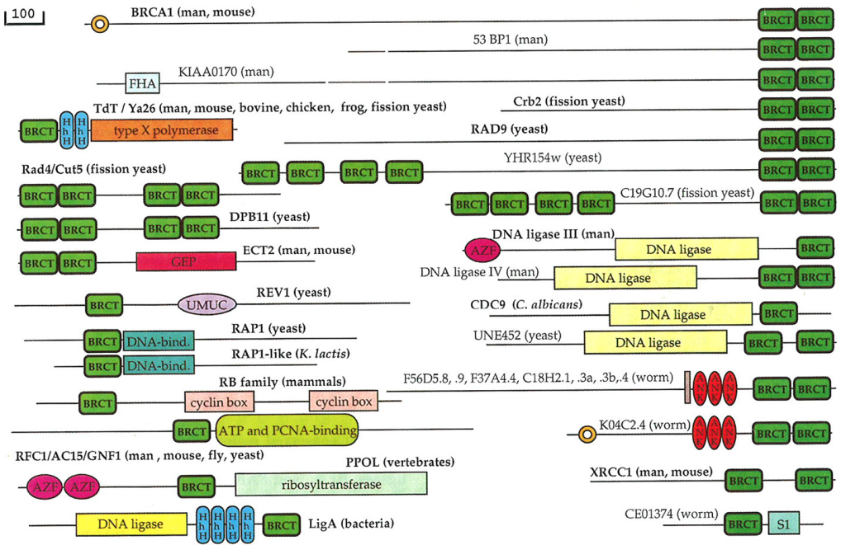
What next?
vermiform ::||::::: formation
How does one define a local alignment and its score?
How can one modify the algorithm to deal with local alignments?
vermiform----- about|||| -----formation

Slide 33
What next?
Can one speed up the algorithm?
How high an alignment score can one expect to find by chance?
How can one align multiple sequences?
How can one account for correlations between positions?

