Slide 1
Elements of Molecular Biology
Stephen Altschul
National Center for Biotechnology Information
National Library of Medicine
National Institutes of Health

Slide 2
The Structure of DNA
Watson, J.D. & Crick, F.H.C. (1953) “Molecular structure of nucleic acids –
A structure for deoxyribose nucleic acid.” Nature 171:737-738.
Watson, J.D. (1968) The Double Helix. Atheneum: New York, NY.
Judson, H.F. (1996) The Eighth Day of Creation. Cold Spring Harbor Laboratory Press: Cold Spring Harbor, NY.

Slide 3
The Structure of DNA in the Abstract
5’
3’
A
G
G
T
C
C
C
A
Replication
T
C
C
A
G
G
G
T
3’
5’
Information

Slide 4
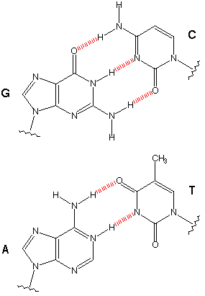
Watson-Crick Base Pairs
Purines
Guanine (G)
Adenine (A)
Pyrimidines
Cytosine (C)
Thymine (T)

Slide 5
DNA Informs Cells How to Make Proteins: The “Central Dogma”
Replication
Transcription
Translation
DNA
RNA
Protein
Reverse transcription

Slide 6
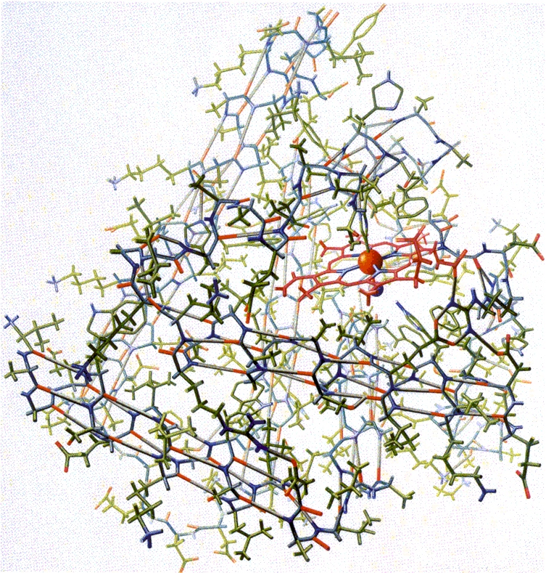
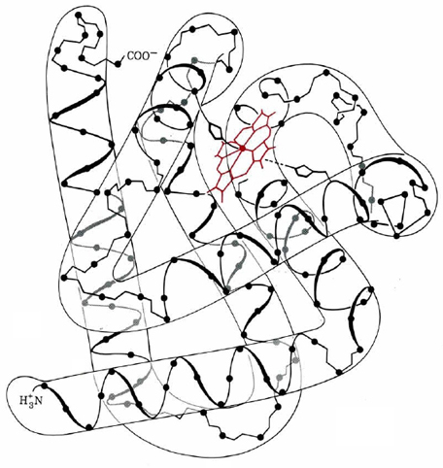
The Three-Dimensional Structure of Sperm Whale Myoglobin
Kendrew, J.C. et al. (1958) “A three-dimensional model of the myoglobin molecule obtained by x-ray analysis.” Nature 181: 662–666.

Slide 7
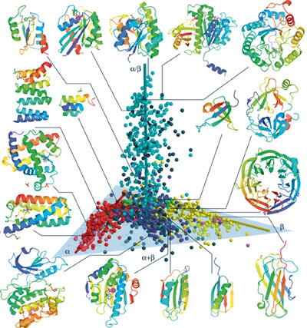
A Variety of Protein Three-Dimensional Structures
http://www.lbl.gov/Publications/Currents/Archive/Apr-01-2005.html

Slide 8
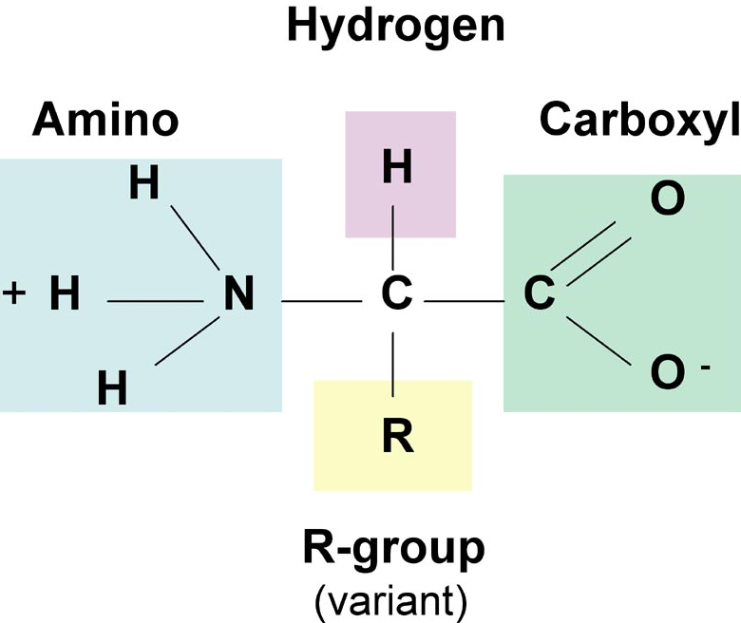
The Structure of an Amino Acid

Slide 9
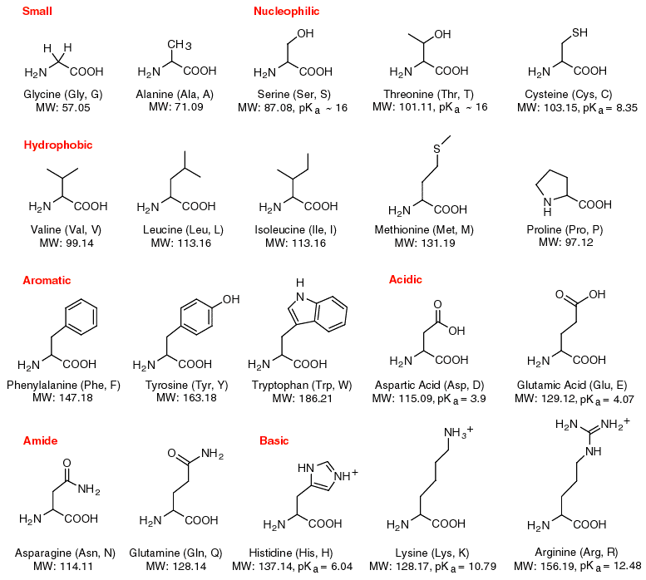
Chemical Structures of the Twenty Common Amino Acids

Slide 10
The Twenty Common Amino Acids
One-letter code
One-letter code
Name
Name
A
C
D
E
F
G
H
I
K
L
Alanine
Cysteine
Aspartic acid
Glutamic acid
Phenylalanine
Glycine
Histidine
Isoleucine
Lysine
Leucine
M
N
P
Q
R
S
T
V
W
Y
Methionine
Asparagine
Proline
Glutamine
Arginine
Serine
Threonine
Valine
Tryptophan
Tyrosine

Slide 11
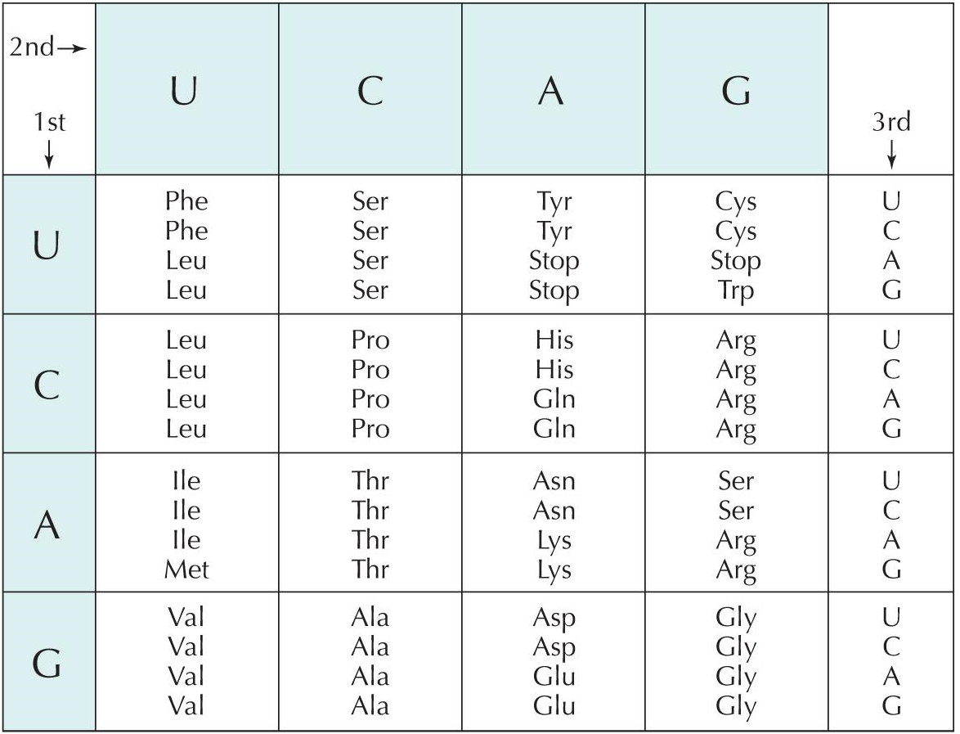
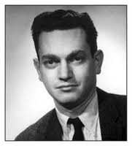
The Genetic Code
Marshall
Nirenberg
1927-2010

