Slide 1
PSI-BLAST Position-Specific Iterated BLAST
Stephen F. Altschul
National Center for Biotechnology Information
National Library of Medicine
National Institutes of Health

Slide 2
Protein and DNA “Profiles”
The idea behind DNA and protein “profiles” has a long history. These structures are also called “position-specific score matrices” or “PSSMs”, and they are closely related to “Hidden Markov Models” or “HMMs”.
McLachlan, A.D. (1977) “Analysis of periodic patterns in amino acid sequences: collagen.” Biopolymers 16:1271-1297.
Stormo, G.D., et al. (1982) “Use of the ‘perceptron’ algorithm to distinguish translational sites in E. coli.”
Nucl. Acids Res. 10:2997-3011.
McLachlan, A.D. (1983) “Analysis of gene duplication repeats in the myosin rod.” J. Mol. Biol. 169:15-30.
Staden, R. (1984) “Computer methods to locate signals in nucleic acid sequences.” Nucl. Acids Res. 12:505-19.
Schneider, T.S., et al. (1986) “Information content of binding sites on nucleotide sequences.” J. Mol. Biol. 188:415-431.
Taylor, W.R. (1986) “Identification of protein sequence homology by consensus template alignment.”
J. Mol. Biol. 188:233-258.
Berg, O.G. & von Hippel, P.H. (1987) “Selection of DNA binding sites by regulatory proteins. Statistical-mechanical theory and application to operators and promoters.” J. Mol. Biol. 193:723-750.
Dodd, I.B. & Egan, J.B. (1987) “Systematic method for the detection of potential lambda cro-like DNA-binding
regions in proteins.” J. Mol. Biol. 194:557-564.
Gribskov, M., et al. (1987) “Profile analysis: detection of distantly related proteins.”
Proc. Natl. Acad. Sci. USA 84:4355-4358.
Patthy, L. (1987) “Detecting homology of distantly related proteins with consensus sequences.”
J. Mol. Biol. 198:567-577.

Slide 3
Structure of a Profile
A profile of length $L$ is an $L×20$ (for proteins) or $L×4$ (for DNA) array $s_{i,j}$. An element $s_{i,j}$ of this array represents the score for aligning letter $j$ at position $i$.
A profile can be aligned to an individual sequence in exactly the same way that a sequence can be, using the Needleman-Wunsch or Smith-Waterman algorithm.
The scores of a profile may be derived from a multiple sequence alignment in a variety of ways.

Slide 4
Steps in Profile Analysis
1) Select a set of related sequences, often by running a database search with a query sequence.
2) Construct a multiple sequence alignment of the sequences.
3) Derive a profile from the multiple sequence alignment.
4) Compare the profile to a database of sequences.
5) Iterate, by returning to step 1).
In the mid-1990s, this process could involve running as many as four separate programs, some of which were fairly slow (i.e. steps 2 and 4 above). It generally required a fair amount of expertise, and was not accessible to most biologists.

Slide 5
Can Profile Analysis be Automated?
Requirements:
A way to collect a set of sequences.
Use the output of a BLAST search.
A way to define the length of a profile.
A fast way to construct a multiple alignment.
A way to derive profile scores from the multiple alignment.
A fast way to search the database with a profile.
Generalize BLAST.
For iteration, a way to assess the significance of profile-sequence alignments.
PSI-BLAST strategy:
Keep approach simple at first; consider refinements later.
Altschul, S.F., et al. (1997) "Gapped BLAST and PSI-BLAST: a new generation
of protein database search programs," Nucleic Acids Res. 25:3389-3402.

Slide 6
Profile Length
Here is one alignment returned by a BLAST protein database search:
>sp|Q99728.2|BARD1_HUMAN
Length=777
Score = 53.1 bits (126), Expect = 3e-07, Method: Composition-based stats.
Identities = 32/111 (29%), Positives = 55/111 (50%), Gaps = 15/111 (14%)
Query 24 THVVMKTDAEFVCERTLKYFLGIAGGKWVVSYFWVTQSIKERKMLNEHDFEVRGDVVNGR 83
THVV+ DA + TLK LGI G W++ + WV ++ + E +E+
Sbjct 605 THVVVPGDA---VQSTLKCMLGILNGCWILKFEWVKACLRRKVCEQEEKYEIP------- 654
Query 84 NHQGPKRARESQDR---KIFRGLEICCYGPFTNMPTDQLEWMVQLCGASVV 131
+GP+R+R ++++ K+F G +G F + P D L +V G ++
Sbjct 655 --EGPRRSRLNREQLLPKLFDGCYFYLWGTFKHHPKDNLIKLVTAGGGQIL 703
Some alignments will cover essentially the whole query sequence; some just small regions. Different alignments will have insertions and deletions in different places.
How long should the profile be, and what should each “column” correspond to?

Slide 7
PSI-BLAST Profile Length
The profile constructed by PSI-BLAST has exactly the same length as the query sequence. Insertions with respect to the query are simply ignored.
>sp|Q99728.2|BARD1_HUMAN
Length=777
Score = 53.1 bits (126), Expect = 3e-07, Method: Composition-based stats.
Identities = 32/111 (29%), Positives = 55/111 (50%), Gaps = 15/111 (14%)
Query 24 THVVMKTDAEFVCERTLKYFLGIAGGKWVVSYFWVTQSIKERKMLNEHDFEVRGDVVNGR 83
THVV+ DA + TLK LGI G W++ + WV ++ + E +E+
Sbjct 605 THVVVPGDA---VQSTLKCMLGILNGCWILKFEWVKACLRRKVCEQEEKYEIP------- 654
Query 84 NHQGPKRARESQDR---KIFRGLEICCYGPFTNMPTDQLEWMVQLCGASVV 131
+GP+R+R ++++ K+F G +G F + P D L +V G ++
Sbjct 655 --EGPRRSRLNREQLLPKLFDGCYFYLWGTFKHHPKDNLIKLVTAGGGQIL 703
These aligned letters are ignored.

Slide 8
Multiple Alignment
“True” multiple alignment algorithms generally try to take account of all sequences simultaneously when constructing a multiple alignment.
For speed and simplicity, PSI-BLAST simply collapses the pairwise alignments produced by BLAST into a multiple alignment, with each profile column corresponding to a single letter from the query sequence.
Query:
...THVVMKTDAEFVCERTLKYFL...
...THVVVPGDA---VQSTLKCML...
Query:
...THVVMKTDAEFVCERTLKYFL...
...TRVIVPGEG--VQSTTKCMLL...
$$⇓$$
Query:
...THVVMKTDAEFVCERTLKYFL...
...THVVVPGDA---VQSTLKCML...
...TRVIVPGEG--VQSTTKCMLL...

Slide 9
Sequence Weights
Different columns involve different sets of sequences. Thus the sequence weights may very from one profile column to another.
For a given column 𝓒, consider only those sequences that participate in 𝓒, and calculate sequence weights using the maximal extent of the subalignment containing all those sequences.

Slide 10
The Construction of Profile Scores
Sequence
weights
Multiple
alignment
column
$$⇒$$
“Observed”
letter counts
$$⇒$$
Data-dependent
pseudocounts
Predicted
amino acid
frequencies
Log-odds
scores
$$⇒$$

Slide 11
The BLAST Algorithm Applied to Profiles
query word (W = 3)
Query: ...GSVEDTTGSQSLAALLNKCKTPQGQRLVNQWIKQPLMDKNRIEERLNLVEAFVEDAELRQTLQEDL...
PQG 18 PEG 15 PKG 14 PRG 14 PDG 13 PHG 13 PMG 13 PNG 13 PSG 13 PQA 12 PQN 12 etc…
neighborhood words
neighborhood score threshold (T = 13)
Query: 325 SLAALLNKCKTPQGQRLVNQWIKQPLMDKNRIEERLNLVEA 365 a +LA++L+ TP G R++ +W+ P+ D + ER + A Subject: 290 TLASVLDCTVTPMGSRMLKRWLHMPVRDTRVLLERQQTIGA 330
With the query sequence replaced by a profile, one can still construct a list of neighborhood words, and proceed exactly as before.

Slide 12
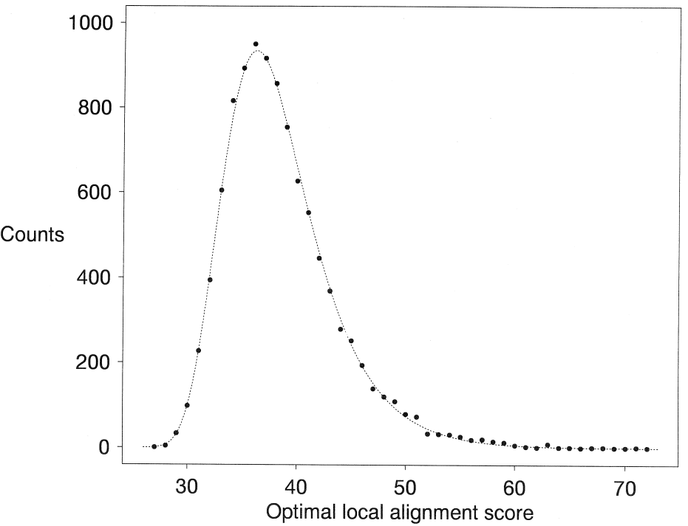
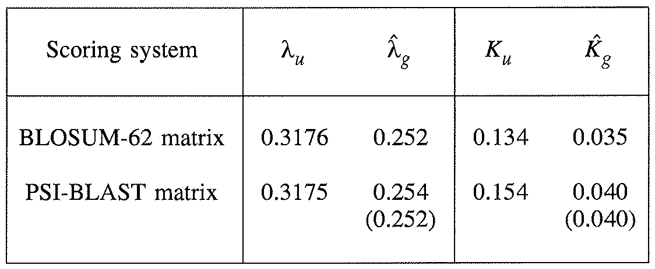
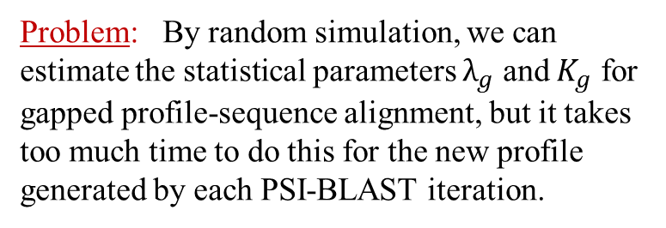
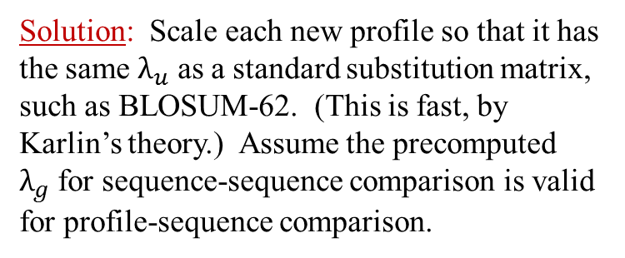
PSI-BLAST Statistics
Problem: By random simulation, we can estimate the statistical parameters $λ_{g}$ and $K_{g}$ for gapped profile-sequence alignment, but it takes too much time to do this for the new profile generated by each PSI-BLAST iteration.
PSI-BLAST profile derived from 128 significant local alignments from the comparison of inflenza A virus hemagglutinin precursor to SWISS-PROT.
(10,1) affine gap scores
However: By extending Karlin’s theory to profiles, we can calculate analytically, and rapidly, the ungapped statistical parameters $λ_{u}$ and $K_{u}$ for profile-sequence comparison.
10,000 random seq.
pairs of length 567
Hypothesis: If particular gap costs transform
a specific $λ_{u}$ to $λ_{g}$ for sequence-sequence comparison, they will do approximately the same for profile-sequence comparison.
Solution: Scale each new profile so that it has the same $λ_{u}$ as a standard substitution matrix, such as BLOSUM-62. (This is fast, by Karlin’s theory.) Assume the precomputed
$λ_{g}$ for sequence-sequence comparison is valid for profile-sequence comparison.

Slide 13
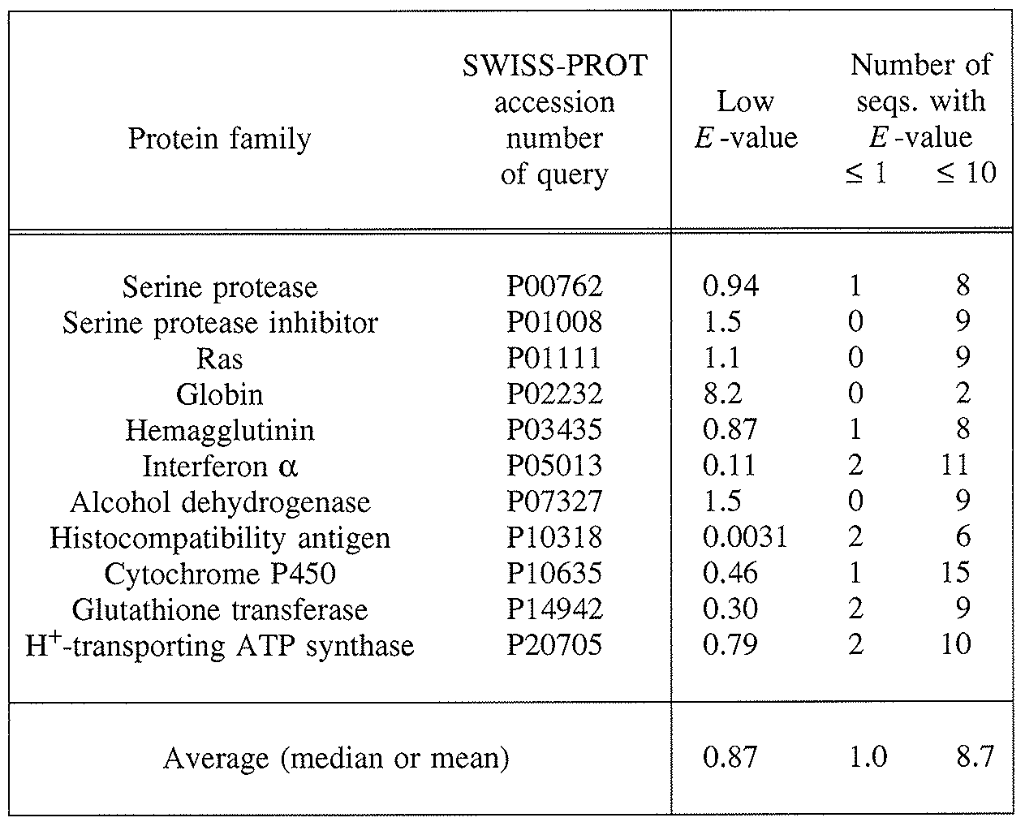
Accuracy of PSI-BLAST Statistics
Sequences compared to a shuffled version of SWISS-PROT

Slide 14
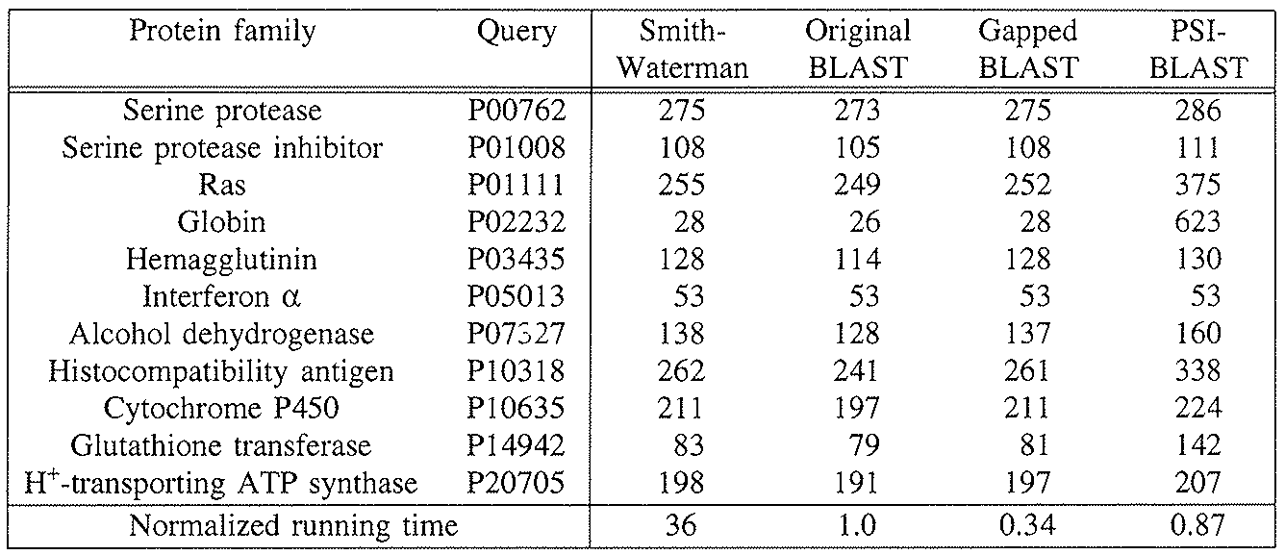
PSI-BLAST Search Results
Number of SWISS-PROT sequences with an $E$-value $≤0.01$.
By SWISS-PROT annotation, all but one are true positives.

Slide 15
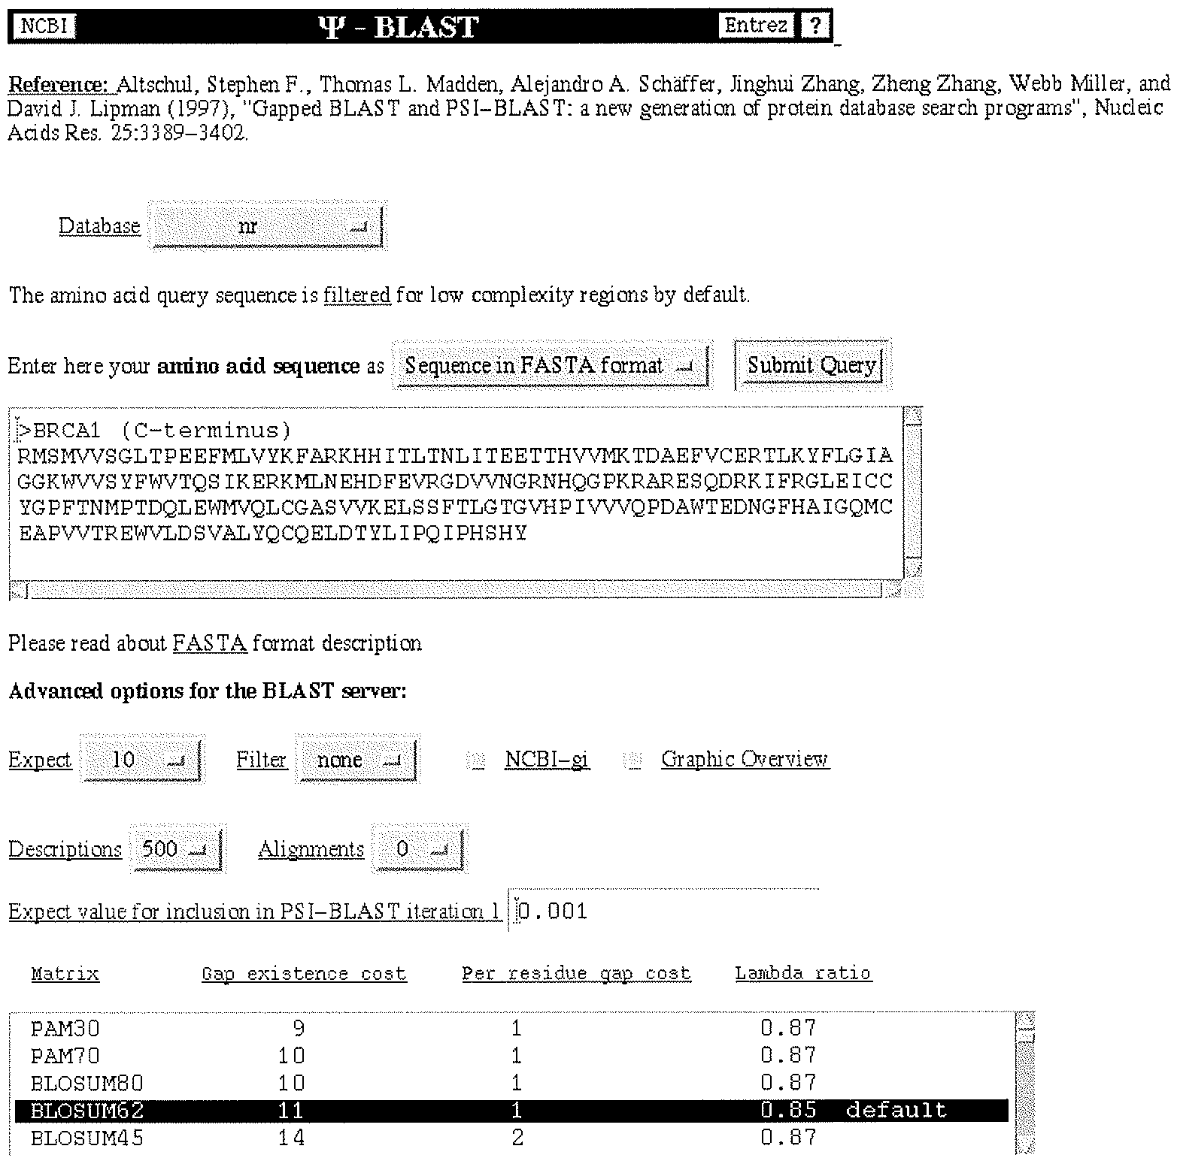
Running PSI-BLAST

Slide 16
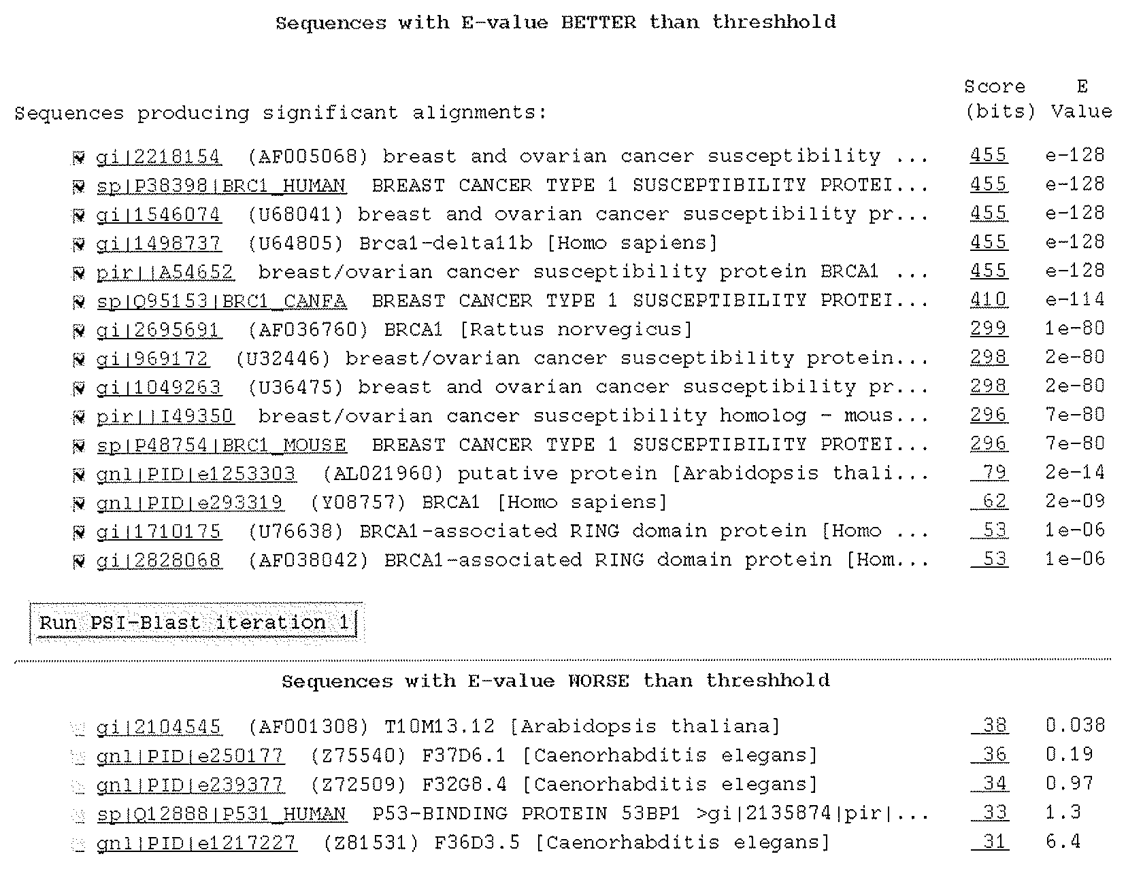
Results of Initial BLAST Run

Slide 17
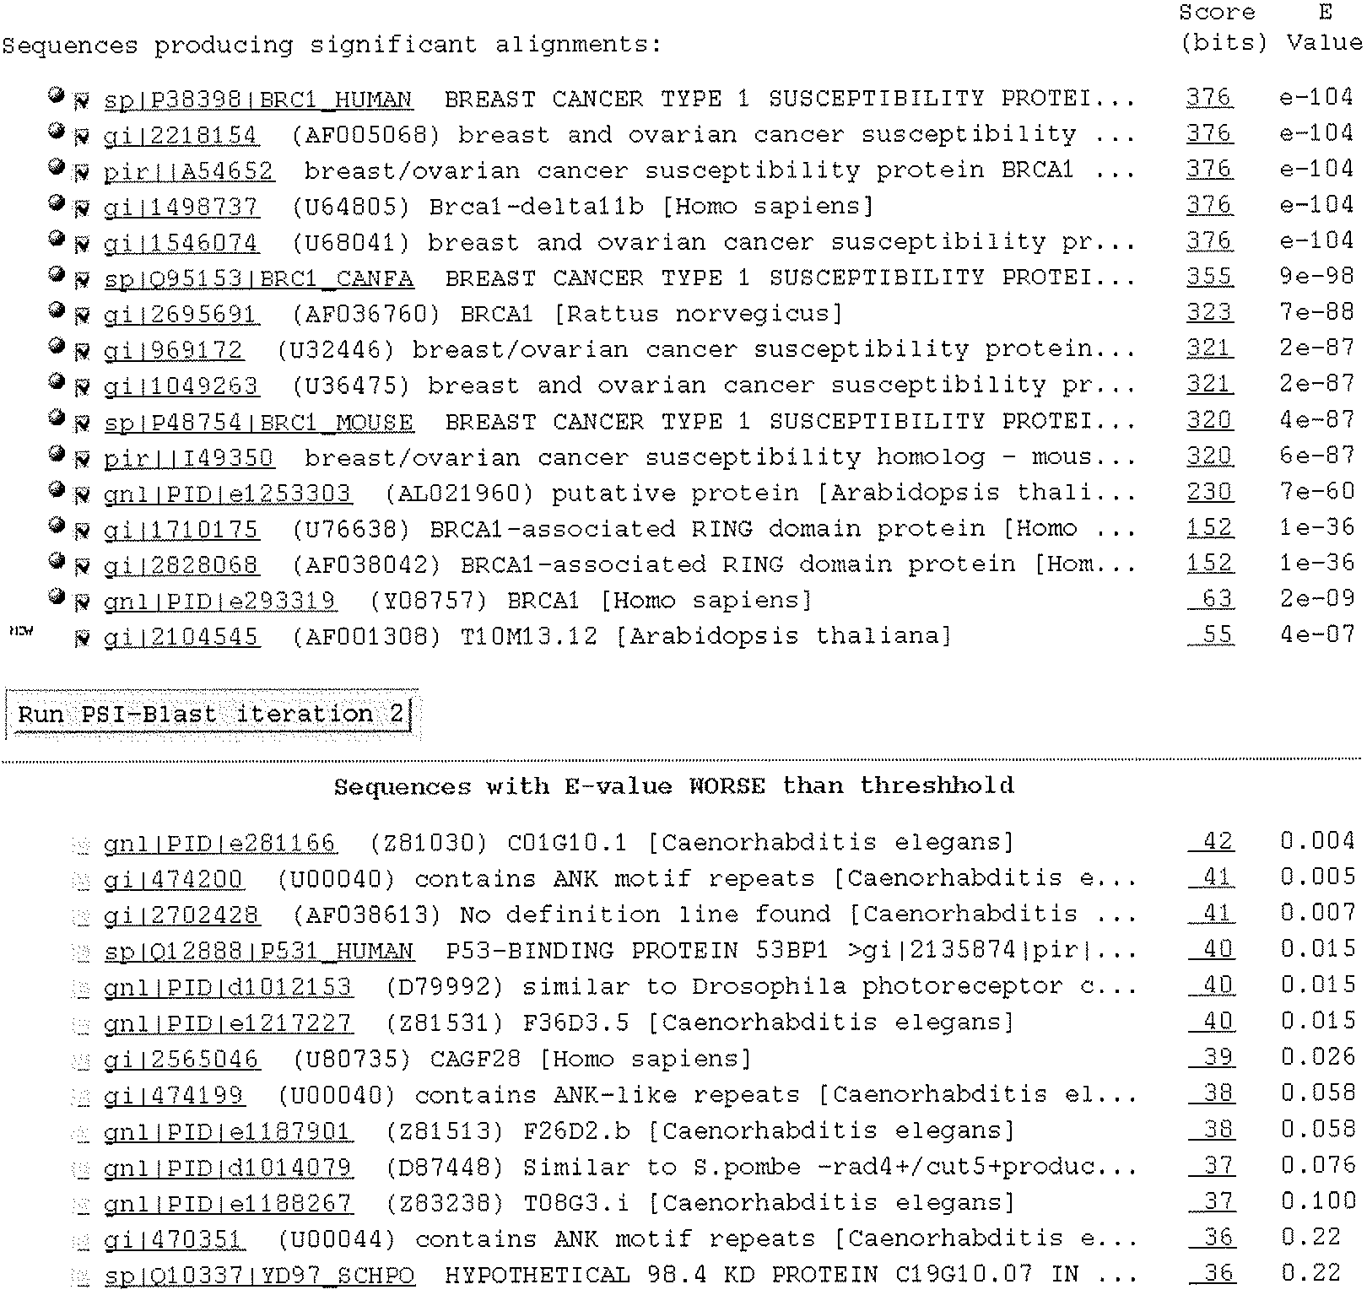
Results of First PSI-BLAST Iteration

Slide 18
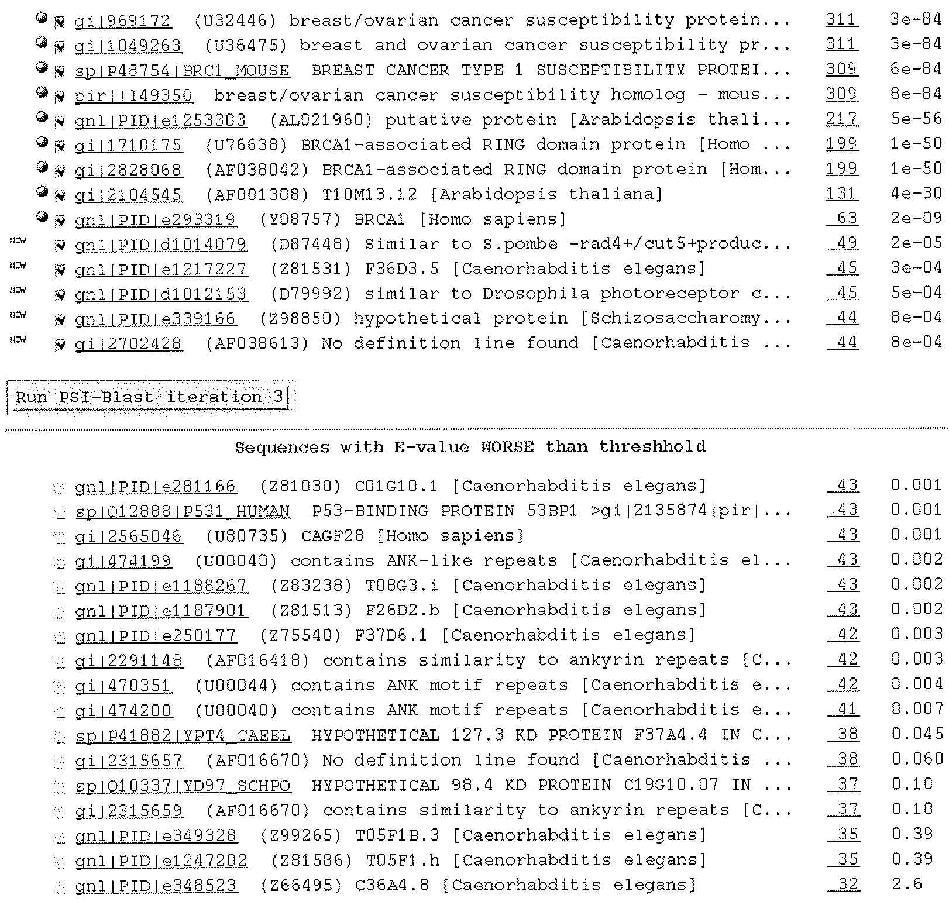
Results of Second PSI-BLAST Iteration

Slide 19
The Corruption of Profiles
PSI-BLAST $E$-values are calculated for the profiles PSI-BLAST produces, and can not be interpreted as referring to the original query sequence.
Once a sequence unrelated to the query is included in a PSI-BLAST multiple alignment, and thus in the construction of PSI-BLAST’s profile, it will bring in many of its “friends” on the next iteration, and this process can snowball.
Sequence weighting will exacerbate this process.
Profile corruption is a major problem for iterative approaches such as PSI-BLAST.

Slide 20
PSI-BLAST Refinements
Schäffer, A.A., et al. (2001) “Improving the accuracy of PSI-BLAST protein database searches with composition-based statistics and other refinements.” Nucleic Acids Res. 29:2994-3005.
Composition-based statistics;
Different treatment of indels in calculating predicted amino acid frequencies;
Optional use of Smith-Waterman algorithm in final stage;
Filter database sequences for low-complexity segments;
etc.
Altschul, S.F., et al. (2005) "Protein database searches using compositionally adjusted substitution matrices." FEBS J. 272:5101-5109.
In the initial BLAST search, the adjustment of substitution matrices for use with sequences having non-standard amino composition.
Altschul, S.F., et al. (2009) "PSI-BLAST pseudocounts and the minimum description length principle.“ Nucleic Acids Res. 37:815-824.
Refined calculation of the effective number of independent observations in a column;
Number of pseudocounts dependent on column entropy.
Possible future development:
Sequence trimming to avoid the over-extension of true alignments;
the problem was described in:
Gonzalez, M.W. & Pearson, W.R. (2010) “Homologous over-extension: a challenge for iterative similarity searches.” Nucleic Acids Res. 38:2177-2179.

