Slide 1
Red-Black Trees
CMSC 420

Slide 2
Intro – quiz!
Have you ever used a Red-Black Binary Search Tree before?
YES
NO

Slide 3
Intro – quiz!
Have you ever used a Red-Black Binary Search Tree before?
Thanks for the input!
YES
NO

Slide 4
Problems with 2-3 trees
Our issue with 2-3 trees is almost entirely one of implementation.
To deal with 2 different node types simultaneously leads to a very complicated polymorphic code base.
Also, whenever we split a node, we have to let an entire object be garbage-collected and go to the heap for two new objects.
Remember that we can fit any Comparable type in a dictionary, including our own classes, which can be huge!
If you think about it, all of our problems stem from the different dynamics between 2-nodes and 3-nodes.
Red-Black Binary Search Trees will help us with that.

Slide 5
Another quiz
Have you ever used a java.util.TreeMap before?
YES
NO

Slide 6
Another quiz
Have you ever used a java.util.TreeMap before?
Perhaps many of you answered YES because of 132 or other Java projects of your own.
But for those of you who said “YES” here and “NO” earlier….
YES
NO

Slide 7
RBBSTs? In my language?

Slide 8
RBBSTs? In my language?

Slide 9
Utility
We will implement 2-3 (and 2-3-4) trees with a binary tree!
So we won’t need to develop different node types which will cause us all the aforementioned grief.
Idea: We will use red links to represent 3-nodes, and black links to represent the links between the nodes in a B-Tree.
It helps Jason to imagine those as some sort of superglue.

Slide 10
Representation
2-3 Tree
Red-Black Tree
15, 30
10
20
32, 39

Slide 11
Representation
2-3 Tree
Red-Black Tree
15, 30
10
20
32, 39
10
20
2-nodes transferred as they were.

Slide 12
Representation
2-3 Tree
Red-Black Tree
15, 30
Pointers transferred as black pointers!
10
20
32, 39
10
20

Slide 13
Representation
2-3 Tree
Red-Black Tree
30
15, 30
15
While 3-nodes are implemented as left-leaning red links!
39
32
10
20
10
20
32, 39

Slide 14
Representation
2-3 Tree
Red-Black Tree
30
15, 30
15
While 3-nodes are implemented as left-leaning red links!
39
32
10
20
10
20
32, 39
The result is a binary tree over keys!

Slide 15
Representation
2-3 Tree
Red-Black Tree
30
15, 30
15
Oh, by the way, null links are also black (unlike in threaded BSTs)
39
32
10
20
10
20
32, 39

Slide 16
Representation
2-3 Tree
Red-Black Tree
root
root
30
15, 30
15
And the root of the tree is also black.
39
32
10
20
10
20
32, 39

Slide 17
An immediate benefit
Suppose that you are professional software developers.
So your time is, quite literally, money.

Slide 18
An immediate benefit
Suppose that you are professional software developers.
So your time is, quite literally, money.
What’s an immediate benefit of your using an RBBST as a 2-3 tree (besides the simpler implementation)?
You can use existing BST code with virtually no modification!
Particularly for searches!
In fact, it makes a lot of sense to override an existing BST class
You would then need to make any inner node classes in the BST class protected

Slide 19
An immediate drawback
Let’s come back to our current scenario now: you are excellent 420 students.
What’s an immediate drawback of representing 2-3 trees as RBBSTs?

Slide 20
An immediate drawback
Let’s come back to our current scenario now: you are excellent 420 students.
What’s an immediate drawback of representing 2-3 trees as RBBSTs?
Red links make our tree taller ☹.
Compared to AVL Trees, which have $≈1.44\log_{2}{n}$ height ALWAYS, Red-Black Trees have a height in $[\log_{2}{n}, 2⋅\log_{2}n]$
Best case: A 2-3 tree with only 2 nodes will lead to a perfectly balanced binary tree in the RBBST representation.
Not that we need a Red-Black Tree for this…
Worst case: A 2-3 tree whose left links are all 3-nodes.
That’ll lead to $2⋅\log_{2}n$.

Slide 21
Quiz for you
In a red-black tree, we are guaranteed at least one node $n$ who has two red links connected to it.
True
False
15, 30
30
15
39
32, 39
32
10
20
10
20

Slide 22
Quiz for you
In a red-black tree, we are guaranteed at least one node $n$ who has two red links connected to it.
In fact, we have the opposite guarantee: there are no nodes that are linked to by 2 red links.
True
False
15, 30
30
15
39
32, 39
32
10
20
10
20

Slide 23
Another quiz for you
In a red-black tree, it is guaranteed that at least one red link $ℓ$ is right-leaning instead of left-leaning
True
False
15, 30
30
15
39
32, 39
32
10
20
10
20

Slide 24
Another quiz for you
In a red-black tree, it is guaranteed that at least one red link $ℓ$ is right-leaning instead of left-leaning
No right-leaning red links in an RBBST!
True
False
15, 30
30
15
39
32, 39
32
10
20
10
20

Slide 25
Node structure
We need:
Links to our children
Data field (some Comparable type T)
A flag that tells us what the color of the link from our parent to the current node is!
For its implementation to be visible in subclasses

Slide 26
Node structure
We need:
Links to our children
Data field (some Comparable type T)
A flag that tells us what the color of the link from our parent to the current node is!
For its implementation to be visible in subclasses
protected enum Color{
RED, BLACK;
}
protected class Node {
Node left, right;
T data;
Color color;
}

Slide 27
Node structure
We need:
Links to our children
Data field (some Comparable type T)
A flag that tells us what the color of the link from our parent to the current node is!
For its implementation to be visible in subclasses
protected enum Color{
RED, BLACK;
}
protected class Node {
Node left, right;
T data;
Color color;
}
This could work! ☺

Slide 28
Implement a utility
During our operations, we will sometimes have some right-leaning red links temporarily.
$$r$$
private enum Color {
RED, BLACK;
}
protected class Node {
Node left, right;
T data;
Color color;
}
15
30
1

Slide 29
Implement a utility
During our operations, we will sometimes have some right-leaning red links temporarily.
$$r$$
$$r$$
30
private enum Color {
RED, BLACK;
}
protected class Node {
Node left, right;
T data;
Color color;
}
15
30
15
1
1
In your notes, write a private method called rotateLeft() such that when we call r = rotateLeft(r), the result is as shown on the right!

Slide 30
Implement a utility
$$r$$
$$r$$
private enum Color{
RED, BLACK;
}
protected class Node {
Node left, right;
T data;
Color color;
}
private Node rotateLeft(Node n){
Node temp = n.right;
n.right = temp.left; // How do I know that temp != null?
temp.left = n;
temp.left.color = RED;
return temp;
}
15
30
30
15
1
1

Slide 31
Implement a utility
$$r$$
$$r$$
private enum Color{
RED, BLACK;
}
protected class Node {
Node left, right;
T data;
Color color;
}
private Node rotateLeft(Node n){
Node temp = n.right;
n.right = temp.left; // How do I know that temp != null?
temp.left = n;
temp.left.color = RED;
return temp;
}
15
30
30
15
1
1
rotateRight() symmetric.

Slide 32
Implement another utility
Sometimes, during our operations, we will end up with a node connected to two red links.
$$r$$
protected enum Color{
RED, BLACK;
}
protected class Node {
Node left, right;
T data;
Color color;
}
15
1
30

Slide 33
Implement another utility
Sometimes, during our operations, we will end up with a node connected to two red links.
$$r$$
$$r$$
protected enum Color{
RED, BLACK;
}
protected class Node {
Node left, right;
T data;
Color color;
}
15
15
1
30
1
30
Write a void Java routine called flipColors which, when called as
flipColors(r), will transform the colors of the tree rooted at $r$ as shown above!

Slide 34
Implement another utility
Sometimes, during our operations, we will end up with a node connected to two red links.
$$r$$
$$r$$
protected enum Color{
RED, BLACK;
}
protected class Node {
Node left, right;
T data;
Color color;
} protected void flipColors(Node n){
n.left.color = n.right.color = BLACK; n.color = RED;
}
15
15
1
30
1
30

Slide 35
Insertion
2-3 tree
Red-Black tree

Slide 36
Insertion
2-3 tree
Red-Black tree
root
root
X
X

Slide 37
Insertion
2-3 tree
Red-Black tree
root
root
55
55

Slide 38
Insertion
2-3 tree
Red-Black tree
root
root
55
80
55, 80

Slide 39
Insertion
2-3 tree
Red-Black tree
root
root
Must rotate left!
55
80
55, 80

Slide 40
Insertion
2-3 tree
Red-Black tree
root
root
55
80
55, 80

Slide 41
Insertion
2-3 tree
Red-Black tree
root
root
55
80
55, 80, 90

Slide 42
Insertion
2-3 tree
Red-Black tree
root
root
55
80
55, 80, 90
90
We always connect fresh nodes to their parents with a red link!

Slide 43
Insertion
2-3 tree
Red-Black tree
root
root
55
80
80
90
55
90
flipcolors() is used to exchange the link colors to represent the new 2-nodes…

Slide 44
Insertion
2-3 tree
Red-Black tree
root
root
55
80
80
90
55
90
flipcolors() is used to exchange the link colors to represent the new 2-nodes… But the root node of an RBBST can never really be red, so we explicitly make it black at that level of the recursion.

Slide 45
Insertion
2-3 tree
Red-Black tree
root
root
55
80
80
90
55
90
flipcolors() is used to exchange the link colors to represent the new 2-nodes… But the root node of an RBBST can never really be red, so we explicitly make it black at that level of the recursion.

Slide 46
Insertion
2-3 tree
Red-Black tree
root
root
55
80
80
90
55
90
flipcolors() is used to exchange the link colors to represent the new 2-nodes… But the root node of an RBBST can never really be red, so we explicitly make it black at that level of the recursion.
public void insert(Key key){
root = insert(root, key);
root.color = BLACK;
}

Slide 47
Insertion
2-3 tree
Red-Black tree
root
root
80
80
55
90
55
85, 90
85

Slide 48
Insertion
2-3 tree
Red-Black tree
root
root
80
80
55
90
55
85, 90
85
3-node! That’s normal! ☺

Slide 49
Insertion
2-3 tree
Red-Black tree
root
root
80
80
55
90
55, 66
85, 90
85
66

Slide 50
Insertion
2-3 tree
Red-Black tree
root
root
80
80
55
90
55, 66
85, 90
85
66

Slide 51
Insertion
2-3 tree
Red-Black tree
root
root
80
80
55
90
55, 66
85, 90
85
66
Gotta rotate!

Slide 52
Insertion
2-3 tree
Red-Black tree
root
root
80
80
55
90
55, 66
85, 90
85
66
Gotta rotate!

Slide 53
Insertion
2-3 tree
Red-Black tree
root
root
80
80
66
90
55, 66
85, 90
55
85

Slide 54
Insertion
2-3 tree
Red-Black tree
root
root
80
80
66
90
55, 66
85, 90
55
85
Let’s examine three cases for an insertion on this 3-node!

Slide 55
Insertion
2-3 tree
Red-Black tree
Insert 70
root
root
80
80
66
90
55, 66
85, 90
55
85

Slide 56
Insertion
2-3 tree
Red-Black tree
Insert 70
root
root
80
80
66
90
55, 66, 70
85, 90
55
85
70

Slide 57
Insertion
2-3 tree
Red-Black tree
Insert 70
root
root
80
80
66
90
55, 66, 70
85, 90
55
85
70
Overflow! ☹
flipColors()! ☺

Slide 58
Insertion
2-3 tree
Red-Black tree
Insert 70
root
root
80
80
66
90
66
85, 90
55
85
55
70
70
Overflow
flipColors()!

Slide 59
Insertion
2-3 tree
Red-Black tree
Insert 70
root
root
66, 80
80
85, 90
66
90
55
70
55
85
70

Slide 60
Insertion
2-3 tree
Red-Black tree
Insert 70
root
root
66, 80
80
85, 90
66
90
55
70
55
85
70
So, this case, where we insert a key as the biggest key of a temporary 4-node, was rectified with one call to flipColors().
Notice the perfect black link balance of the Red-Black Tree?

Slide 61
Insertion
2-3 tree
Red-Black tree
Insert 40
root
root
80
80
66
90
55, 66
85, 90
55
85

Slide 62
Insertion
2-3 tree
Red-Black tree
Insert 40
root
root
80
80
66
90
40, 55, 66
85, 90
55
85
40

Slide 63
Insertion
2-3 tree
Red-Black tree
Insert 40
root
root
80
80
55
90
40, 55, 66
85, 90
85
40
66

Slide 64
Insertion
2-3 tree
Red-Black tree
Insert 40
root
root
80
55, 80
Color Flipping
55
40
90
66
85, 90
40
66
85

Slide 65
Insertion
2-3 tree
Red-Black tree
Insert 40
root
root
80
55, 80
Color Flipping
55
40
90
66
85, 90
40
66
85
So in this case (inserting as a temporary 4 node’s least key), we need 1 rotation and one color flipping!

Slide 66
Insertion
2-3 tree
Red-Black tree
Insert 60
root
root
80
80
66
90
55, 66
85, 90
55
85

Slide 67
Insertion
2-3 tree
Red-Black tree
Insert 60
root
root
80
80
66
90
55, 60, 66
85, 90
55
85
60

Slide 68
Insertion
2-3 tree
Red-Black tree
Insert 60
root
root
80
80
66
90
55, 60, 66
85, 90
60
55
85

Slide 69
Insertion
2-3 tree
Red-Black tree
Insert 60
root
root
80
80
66
90
60
85, 90
60
55
85
55
66

Slide 70
Insertion
2-3 tree
Red-Black tree
Insert 60
root
root
80
80
60
55
90
60
85, 90
85
66
55
66

Slide 71
Insertion
2-3 tree
Red-Black tree
Insert 60
root
root
Color flipping
80
60, 80
60
55
90
55
66
85, 90
85
66
In this final case (inserting as a temporary 4 node’s middle key), we need 2 rotations and one color flipping!

Slide 72
Exercise for you!
2-3 tree
Red-Black tree
root
root
60, 80
80
60
55
90
55
66
85, 90
85
66
Please go ahead and insert 87 for me please! ☺

Slide 73
Exercise for you!
2-3 tree
Red-Black tree
root
root
60, 80
80
60
90
55
66
85, 87, 90
55
66
85
87

Slide 74
Exercise for you!
2-3 tree
Red-Black tree
root
root
60, 80
80
60
55
90
55
66
85, 87, 90
66
87
85

Slide 75
Exercise for you!
2-3 tree
Red-Black tree
root
root
60, 80
80
60
55
87
55
66
87
66
85
90
85
90

Slide 76
Exercise for you!
2-3 tree
Red-Black tree
root
root
60, 80, 87
80
60
Color flip
55
87
55
66
85
90
66
85
90

Slide 77
Exercise for you!
2-3 tree
Red-Black tree
root
root
Color flip
80
80
60
60
87
55
87
66
85
90
55
66
85
90

Slide 78
Exercise for you!
2-3 tree
Red-Black tree
root
root
Don’t forget to
set the root to BLACK!
Color flip
80
80
60
60
87
55
87
66
85
90
55
66
85
90

Slide 79
Exercise for you!
2-3 tree
Red-Black tree
root
root
Don’t forget to
set the root to BLACK!
Color flip
80
80
60
60
87
55
87
66
85
90
55
66
85
90
public void insert(Key key){
root = insert(root, key);
root.color = BLACK;
}
Speaking of…

Slide 80
Fill-in the insertion subroutine!
private Node insert(Node n, Key key){
if(n == null) return new Node(key, RED);
if(key.compareTo(n.key) < 0)
n.left = insert(n.left, key);
else if(key.compareTo(n.key) > 0)
n. right = insert(n.right, key);
else return n;
if(isRed(n.right) && __________ ) n = rotateLeft(n);
if(isRed(n.left) && __________) n = rotateRight(n);
if(_______ && isRed(n.right)) __________;
}

Slide 81
Fill-in the insertion subroutine!
private Node insert(Node n, Key key){
if(n == null) return new Node(key, RED);
if(key.compareTo(n.key) < 0)
n.left = insert(n.left, key);
else if(key.compareTo(n.key) > 0)
n. right = insert(n.right, key);
else return n;
if(isRed(n.right) && _!isRed(n.left)___ ) n = rotateLeft(n);
if(isRed(n.left) && __isRed(n.left.left)____) n = rotateRight(n);
if(__isRed(n.left)_____ && isRed(n.right)) __flipColors(n)__;
}
boolean isRed(Node n){
if(n == null) return false;
else return (n.color == RED);

Slide 82
Insertion in 2-3-4 trees!
Recall: A 2-3-4 tree is like a 2-3 tree, except for the fact that we will allow 4-nodes to persist in the tree.
During insertion though, the search phase will be expanded.
We will be aggressively splitting 4-nodes if we encounter them, such that we are guaranteed space at the leaf level.
Note that this way, if my root is not a 4-node, I am guaranteed to not increase the height of my tree.

Slide 83
Insertion in 2-3-4 trees!
Which Red-Black tree property/ies I expect to have to adjust in a 2-3-4 tree?
Perfect Black Link Balance
No right-leaning red links
No node connected to two red links
Something else (what?)

Slide 84
Insertion in 2-3-4 trees!
Which Red-Black tree property/ies I expect to have to adjust in a 2-3-4 tree?
Perfect Black Link Balance
No right-leaning red links
No node connected to two red links
Something else (what?)
50
40, 50, 60
40
60

Slide 85
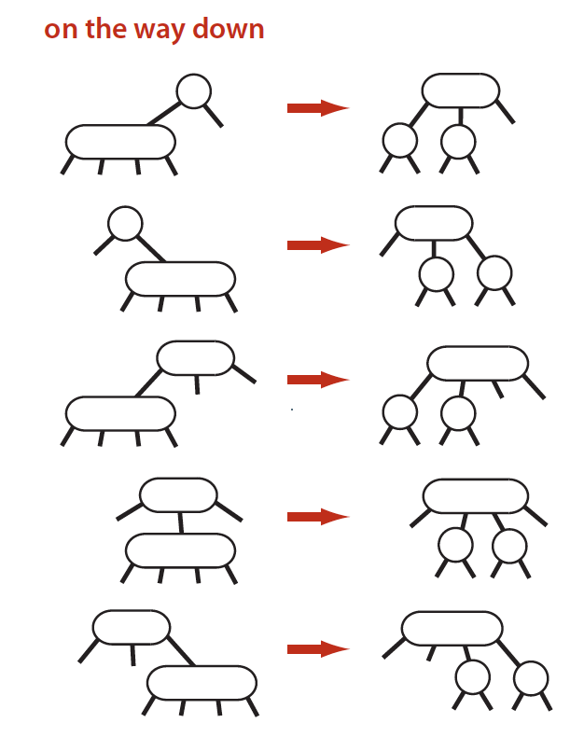
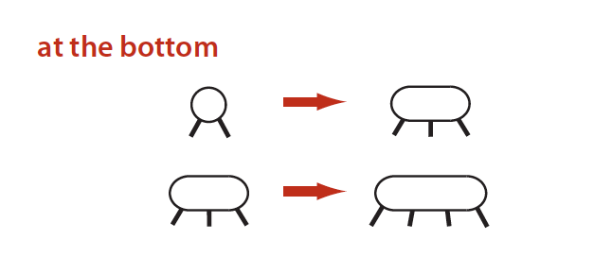
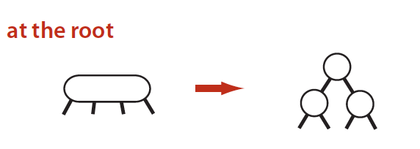
Pick your favorite, make the R-B transformations!

Slide 86
“Hard” Deletion
By “hard” Deletion we refer to a process that actually removes the key’s wrapper, the node, from the tree.
We’ve already seen how to do this in threaded and non-threaded BSTs, AVL, Splay, 2-3 (conceptually).

Slide 87
“Hard” Deletion
By “hard” Deletion we refer to a process that actually removes the key’s wrapper, the node, from the tree.
We’ve already seen how to do this in threaded and non-threaded BSTs, AVL, Splay, 2-3 (conceptually).
Hard deletion in RBBSTs is way too hard and we will not cover it.
It relies on subroutines for deleting the minimum and maximum of a subtree.
If you’re interested in finding more, tell me in Piazza and I can share a source.

Slide 88
“Soft” deletion (Mark – and – Sweep)
Instead, in practice, we perform a Mark-and-Sweep step.
A key deletion does not lead to immediate freeing of the key’s node and re-placement of links.
Instead, a bit is set to indicate that the relevant object can be safely garbage – collected
Note that since it can be garbage-collected, it can also be replaced!
As long as we are sure we can place a node with our new key exactly where the old node used to be…
Every $T$ ms, a “sweeping” phase runs, collecting only the objects with unset bits.
Those objects are re-inserted in another tree and the root reference is assigned to that new tree so the old one can be garbage collected.

Slide 89
Some theory behind RBBSTs
Red-Black Trees have perfect black link balance
All paths from the root to a null pointer dereference the same # black pointers!
So, if we somehow could ignore red links (we really shouldn’t, we’d miss keys), then we’d have excellent search all the time!
Remember: in classic BSTs, search can be as bad as $𝒪(n)$, for $n$ keys and unit cost that of a pointer dereferencing.
In RBBSTs, you are guaranteed $𝒪(\log_{2}{n})$ irrespective of insertion order.

Slide 90
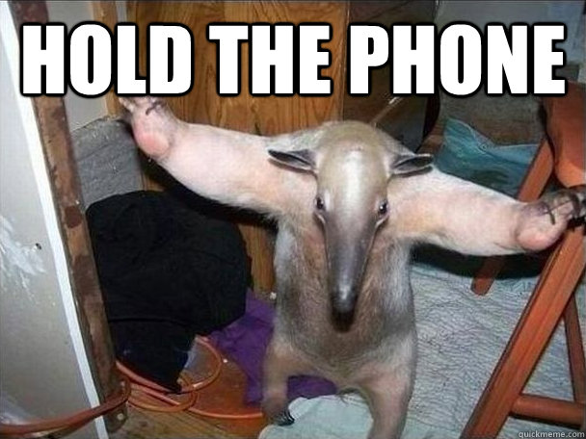
Some theory behind RBBSTs
Red-Black Trees have perfect black link balance
All paths from the root to a null pointer dereference the same # black pointers!
So, if we somehow could ignore red links (we really shouldn’t, we’d miss keys), then we’d have excellent search all the time!
Remember: in classic BSTs, search can be as bad as $𝒪(n)$, for $n$ keys and unit cost that of a pointer dereferencing.
In RBBSTs, you are guaranteed $𝒪(\log_{2}{n})$ irrespective of insertion order.

Slide 91
Some theory behind RBBSTs
Red-Black Trees have perfect black link balance
All paths from the root to a null pointer dereference the same # black pointers!
So, if we somehow could ignore red links (we really shouldn’t, we’d miss keys), then we’d have excellent search all the time!
Remember: in classic BSTs, search can be as bad as $𝒪(n)$, for $n$ keys and unit cost that of a pointer dereferencing.
In RBBSTs, you are guaranteed $𝒪(\log_{2}{n})$ irrespective of insertion order.
DIDN’T WE ALSO HAVE THIS IN AVL TREES?

Slide 92
Some theory behind RBBSTs
It turns out that it is only rarely that RBBSTs will have anything close to $2\log_{2}{n}$ height!
To minimize the height, we need to minimize the red links.

Slide 93
Some theory behind RBBSTs
It turns out that it is only rarely that RBBSTs will have anything close to $2\log_{2}{n}$ height!
To minimize the height, we need to minimize the red links.
Sounds as if we should be splitting aggressively…
Isn’t that expensive?

Slide 94
Some theory behind RBBSTs
It turns out that it is only rarely that RBBSTs will have anything close to $2\log_{2}{n}$ height!
To minimize the height, we need to minimize the red links.
Sounds as if we should be splitting aggressively…
Isn’t that expensive?
Not in RBBSTs it isnt!

Slide 95
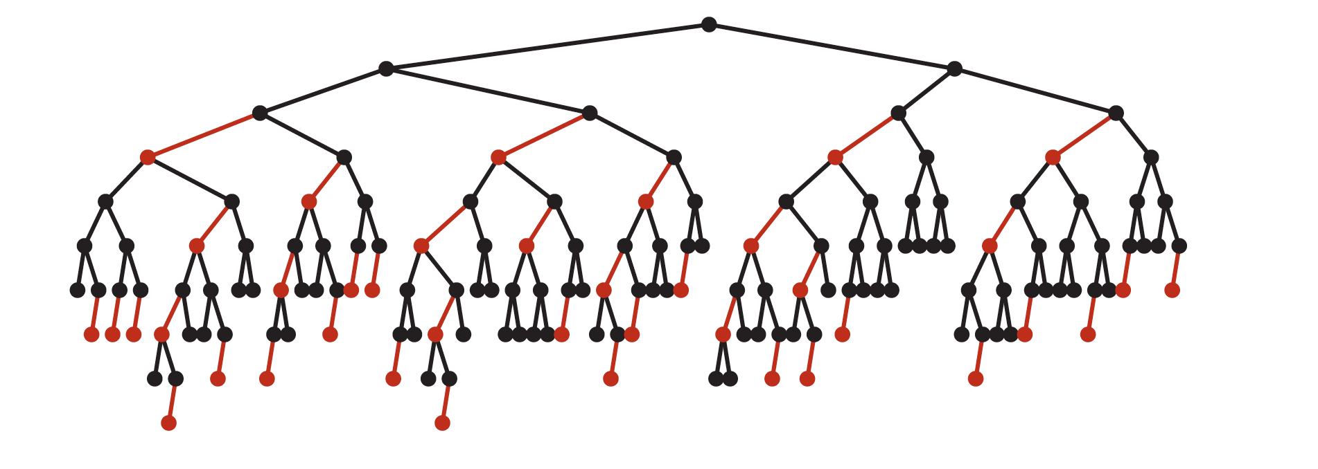
Average height in RBBSTs
Turns out that in practice, RBBSTs look more like this…

Slide 96
Quizzes
Which key order gives us the worst possible height for a Red-Black Tree?
Ascending
Descending
Either
Neither

Slide 97
Quizzes
Which key order gives us the worst possible height for a Red-Black Tree?
Ascending
Descending
Either
Neither
Recall class example where insertion of a new key in either ascending or descending order suddenly transforms the situation from worst-case to best-case!

Slide 98
Quizzes
Which key order gives us the best possible height for a Red-Black Tree?
Ascending
Descending
Either
Neither

Slide 99
Quizzes
Which key order gives us the best possible height for a Red-Black Tree?
Ascending
Descending
Either
Neither

Slide 100
Polymorphic 2-3(-4) trees vs Red-Black
Where a polymorphic implementation of 2-3-4 trees leads to very messy code during node splitting and accesses the heap, a Red-Black tree just rotates nodes and flips colors!
It also allows you to not modify your BST search routine at all!
No matter how simple it would be to re-code a search routine for expanded branching factor trees, it’s not bad to not have to introduce bugs in a routine that will be used 95% of the time!

Slide 101
AVL vs Red-Black
AVL |  | Red-Black
+ | - | + | -
Easier to implement | Spatial overhead | On average, perfect height $\log_{2n}{ }$ | Much harder to implement (hard deletion, anyone?)
Height $⌊\log_{2}{n⌋+1}$ in the worst case |  | Can help us implement both 2-3 and 2-3-4 trees

Slide 102
AVL vs Red-Black
AVL |  | Red-Black
+ | - | + | -
Easier to implement | Spatial overhead | On average, perfect height $\log_{2n}{ }$ | Much harder to implement (hard deletion, anyone?)
Height $⌊\log_{2}{n⌋+1}$ in the worst case |  | Can help us implement both 2-3 and 2-3-4 trees
THIS IS HUGE.
Data will be searched for far more frequently than mutated in any way.

