Slide 1
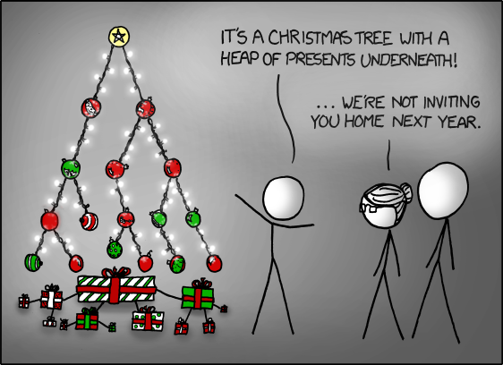
CMSC 420 - 0102
Summer 2017

Slide 2
Welcome!
Instructor: Jason Filippou
Office hours: Mon/Wed 11:00-01:00
TAs: Aya Ismail
Office hours: Tue / Thu 11:00 – 01:00
Location: Here
Time: Now (09-30 – 10:55)
When: not Fridays

Slide 3
Jason
Born: 1988, Athens, Greece
BSc CompSci (2012), University of Athens
MSc CompSci (2014), UMD College Park
Lecturer since May ‘16
Interests:
Machine Learning
Algorithms & Data Structures
Comp Sci Education
Functional and parallel programming in Java 8 / Scala / Spark / Akka Actors
(Former) Probabilistic Logic Programming
…
Courtesy: A friend of Jason’s who would rather remain anonymous.

Slide 4
Why 420?
Popularity
Good for interview
prep
I want the string “420” in my transcript
Other (what)?

Slide 5
The experts say…
You will never need to implement a red-black tree during your interview

Slide 6
The experts say…
You will never need to implement a red-black tree during your interview
Point being:
Complex data structures (R-B / Splay trees, QuadTrees, self-organizing hash tables…) are not prerequisites for a good interviewee.

Slide 7
The instructor says…
Right, as if you’ll ever need to implement quicksort in your job!

Slide 8
The instructor says…
Right, as if you’ll ever need to implement quicksort in your job!
Bottom line:
420 will not help you in job interviews as much as 351
Implement a bunch of algos in 351/451, read interview questions and the job / internship is yours.
420 will help you more in your actual job.
Implementing efficient indices for different kinds of data is always relevant
Spacial/Multi-dimensional structures at the forefront of modern applications

Slide 9
So is this applied 351?

Slide 10
So is this applied 351?
420 and 351 are VERY different.

Slide 11
So is this applied 351?
420 and 351 are VERY different.
But Algorithms and Data Structures are almost “married” to each other.

Slide 12
So is this applied 351?
420 and 351 are VERY different.
But Algorithms and Data Structures are almost “married” to each other.
We’ll spend some time today understanding how.

Slide 13
420 in CS UMD

Slide 14
420 in CS UMD

Slide 15
420 in CS UMD

Slide 16
420 in CS UMD

Slide 17
420 in CS UMD
This is a data structure that we might even be talking about tomorrow :O

Slide 18
“Data Structures” in CS Academia
Most educators, when they talk about a “Data Structures” course, they refer to something like 132.
Graphs, stacks, lists, queues, heaps, trees,…
420 is very different, even from the offerings of such prestigious schools as Stanford and Berkeley.

Slide 19
“Data Structures” in CS Academia
Most educators, when they talk about a “Data Structures” course, they refer to something like 132.
Graphs, stacks, lists, queues, heaps, trees,…
420 is very different, even from the offerings of such prestigious schools as Stanford and Berkeley.
This is primarily owed to… which faculty member?

Slide 20
“Data Structures” in CS Academia
Most educators, when they talk about a “Data Structures” course, they refer to something like 132.
Graphs, stacks, lists, queues, heaps, trees,…
420 is very different, even from the offerings of such prestigious schools as Stanford and Berkeley.
This is primarily owed to… which faculty member?
Michelle Hugue
Evan Golub
Jason Filippou
Somebody else (who?)

Slide 21
“Data Structures” in CS Academia
Most when they talk about a “Data Structures” course, they refer to something like 132.
Graphs, stacks, lists, queues, heaps, trees,…
420 is very different, even from the offerings of such prestigious schools as Stanford and Berkeley.
This is primarily owed to… which faculty member?
Michelle Hugue
Evan Golub
Jason Filippou
Somebody else (who?)
Hanan Samet

Slide 22
The book
Hanan’s written the book on multi-dimensional data structures.
Tremendous influence into shaping all our 420 offerings into a curriculum that covers everything that the best CS schools offer, PLUS a wealth of topics on multi-dimensional data structures.
KD-trees / R-Trees
QuadTrees
Point
Point-Region
Classic
Bucketed
Loose
Region
MX-CIF
Range Trees
Priority Search Trees
…

Slide 23
The book
Hanan’s written the book on multi-dimensional data structures.
Tremendous influence into shaping all our 420 offerings into a curriculum that covers everything that the best CS schools offer, PLUS a wealth of topics on multi-dimensional data structures.
KD-trees / R-Trees
QuadTrees
Point
Point-Region
Classic
Bucketed
Loose
Region
MX-CIF
Range Trees
Priority Search Trees
…
We will cover at least these!

Slide 24
Let’s ask some questions
We will now try to find the intersection between algorithms and data structures and… other things
Recall: 420 is very different from 351, but the study of Data Structures and Algorithms is almost completely complementary.

Slide 25
Questions of algorithms
Given an integer (8 bytes) array A of size N, which among the following sorting algorithms offers the best time complexity?

Slide 26
Questions of algorithms
Given an integer (8 bytes) array A of size N, which among the following sorting algorithms offers the best time complexity?
InsertSort
Mergesort
MSB RadixSort
Selection sort

Slide 27
Questions of algorithms
Given an integer (8 bytes) array A of size N, which among the following sorting algorithms offers the best time complexity?
InsertSort
Mergesort
MSB RadixSort
Selection sort
$𝒪(n⋅logn)$ worst and average time complexity
$𝒪(n$) spatial cost ☹ (not in-place)
In-place (but non-stable) variants have been proposed, but we won’t talk about them

Slide 28
Questions of algorithms
Given a linked list of 8 byte integers of size N, does mergesort achieve the same runtime?
Yes
No

Slide 29
Questions of algorithms
Given a linked list of 8 byte integers of size N, does mergesort achieve the same runtime?
Yes
No
If you do it bottom-up!
For more details with pseudocode, you are directed to the Wikipedia article

Slide 30
Take-home message #1 : changing structures
You moved from an array to a linked list.

Slide 31
Take-home message #1 : changing structures
You moved from an array to a linked list.
Why? What’s the chief reason?

Slide 32
Take-home message #1 : changing structures
You moved from an array to a linked list.
Why? What’s the chief reason?
Non-contiguous storage in memory.

Slide 33
Take-home message #1 : changing structures
You moved from an array to a linked list.
Why? What’s the chief reason?
Non-contiguous storage in memory.
But what if that breaks your existing operations, or makes them less efficient?
You have to make sure this is avoided.
Sometimes (e.g mergesort) this might need a radical change to your algorithm.

Slide 34
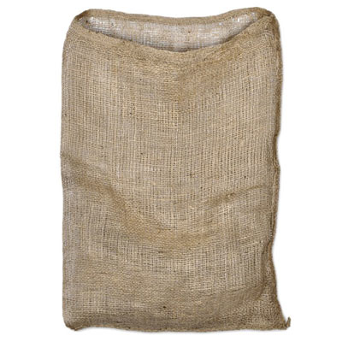
Arrays and Bags…
Perhaps the simplest abstract data structure that we can come up with is a bag
Abstract can mean a lot of things
We think of it as “a conceptual piece of data storage that has to have some properties and time/space constraints for common operations”

Slide 35
Arrays and Bags…
Perhaps the simplest abstract data structure that we can come up with is a bag
Abstract can mean a lot of things
We think of it as “a conceptual piece of data storage that has to have some properties and time/space constraints for common operations”
Requirements:
We want to be able to put stuff in the bag
We want to be able to check if the bag is empty.
We want to check what its size is.
We can “shake” the bag , randomly perturbing the order of its elements (key operation)
We can loop through (iterate over) all of its elements, one at a time.

Slide 36
Arrays and Bags…
Requirements:
We want to be able to put stuff in the bag
We want to be able to check if the bag is empty.
We want to check what its size is.
We can “shake” the bag , randomly perturbing the order of its elements (key operation)
We can loop through (iterate over) all of its elements, one at a time.

Slide 37
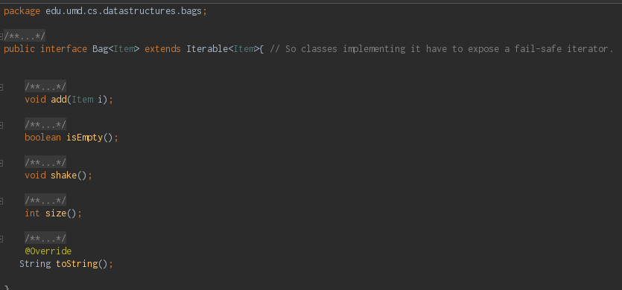
Arrays and Bags…
Requirements:
We want to be able to put stuff in the bag
We want to be able to check if the bag is empty.
We want to check what its size is.
We can “shake” the bag , randomly perturbing the order of its elements (key operation)
We can loop through (iterate over) all of its elements, one at a time.

Slide 38
Arrays and Bags…
Requirements:
We want to be able to put stuff in the bag
We want to be able to check if the bag is empty.
We want to check what its size is.
We can “shake” the bag , randomly perturbing the order of its elements (key operation)
We can loop through (iterate over) all of its elements, one at a time.

Slide 39
Arrays and Bags…
Requirements:
We want to be able to put stuff in the bag
We want to be able to check if the bag is empty.
We want to check what its size is.
We can “shake” the bag , randomly perturbing the order of its elements (key operation)
We can loop through (iterate over) all of its elements, one at a time.
Adding to an interface is fine, as long as you document this addition! ☺

Slide 40
Arrays and Bags…
Let’s switch gears to a Java demo real quick!
Requirements:
We want to be able to put stuff in the bag
We want to be able to check if the bag is empty.
We want to check what its size is.
We can “shake” the bag , randomly perturbing the order of its elements (key operation)
We can loop through (iterate over) all of its elements, one at a time.
Adding to an interface is fine, as long as you document this addition! ☺

Slide 41
Take-home message #2: Hardware Considerations
In this demo we saw a classic difference between CS Theory and (hardware) practice…
Sure, in theory, arrays are constant storage (A[i] requires one to two multiplications and one addition)
But in practice, if they get too large, not all of them can fit in registers, or even cache!
Cache misses make your application (the RandomAccessBag) hurt.
So even for the simplest possible data structure a language gives us (1D array), theory and practice diverge!

Slide 42
Another example: Java Arraylists
Let’s look at the ArrayList’s docs for a moment…

Slide 43
Another example: Java Arraylists
Let’s look at the ArrayList’s docs for a moment…
What’s with this “amortized constant time” required for additions? Since the underlying implementation is an array, we’d expect just constant!

Slide 44
Another example: Java Arraylists
Let’s look at the ArrayList’s docs for a moment…
What’s with this “amortized constant time” required for additions? Since the underlying implementation is an array, we’d expect just constant!
Note the docs for the constructors… default starting capacity at 10. When inserting 11th element, we need linear time to copy over to new internal array. ☹
But! For the next 9 elements, we have constant time! ☺

Slide 45
Another example: Java Arraylists
Let’s look at the ArrayList’s docs for a moment…
What’s with this “amortized constant time” required for additions? Since the underlying implementation is an array, we’d expect just constant!
Note the docs for the constructors… default starting capacity at 10. When inserting 11th element, we need linear time to copy over to new internal array. ☹
But! For the next 9 elements, we have constant time! ☺
So, on average, we have $\frac{19}{10}≈2$ unit cost for inserting elements!
This is an example of a technique called amortized analysis.

Slide 46
Take-home message #3: Amortized Complexity
If most of the time our operation runs very fast, are we willing to accept bad performance once in a while?
Amortized analysis can answer this question.
ArrayLists, Splay Trees and Self-organizing hash tables are all data structures where certain operations have amortized constant complexity!

Slide 47
Reminder: Binary tree traversals
Preorder traversal is…
root
L
R

Slide 48
Reminder: Binary tree traversals
Preorder traversal is…
(a) L r R
(b) r L R
(c) r R L
(d) L R r
root
L
R

Slide 49
Reminder: Binary tree traversals
Preorder traversal is…
(a) L r R
(b) r L R
(c) r R L
(d) L R r
(1)
Mnemonic rule (maybe?): pre-order traversal, as in pre-visit the root before the subtrees
root
(2)
L
R
(3)

Slide 50
Reminder: Binary tree traversals
Inorder traversal is…
(a) R r L
(b) r L R
(c) r R L
(d) L r R
root
L
R

Slide 51
Reminder: Binary tree traversals
Inorder traversal is…
(a) R r L
(b) r L R
(c) r R L
(d) L r R
(2)
Mnemonic rule (maybe?): in-order traversal, as in “visit the root in-between the subtrees”
root
(1)
L
R
(3)

Slide 52
Reminder: Binary tree traversals
Postorder traversal is…
(a) L R r
(b) r R L
(c) R L r
(d) R r L
root
L
R

Slide 53
Reminder: Binary tree traversals
Postorder traversal is…
(a) L R r
(b) r R L
(c) R L r
(d) R r L
(3)
Mnemonic rule (maybe?): post-order traversal, as in “visit the root post-visiting the subtrees”
root
(1)
L
R
(2)

Slide 54
Question for you
R
< R
>=R
Suppose that our binary tree is a binary search tree

Slide 55
Question for you
R
< R
>=R
Suppose that our binary tree is a binary search tree
Which tree traversal is the most useful one for BSTs, and why?
Preorder
Inorder
Postorder

Slide 56
Question for you
R
< R
>=R
Suppose that our binary tree is a binary search tree
Which tree traversal is the most useful one for BSTs, and why?
Preorder
Inorder
Postorder
In BSTs, Inorder is Sorted order! :)

Slide 57
Here’s a BST
M
A
X
x
E
x
x
x
F
x
G
x
x

Slide 58
Here’s a BST
M
Tell me THREE things you don’t like about this tree.
A
X
x
E
x
x
x
F
x
G
x
x

Slide 59
Here’s a BST
M
Here are three things Jason doesn’t like. (1) Very unbalanced, say goodbye to ${≈log}_{2}{n}$ search…. ☹
A
X
x
E
x
x
x
F
x
G
x
x

Slide 60
Here’s a BST
M
Here are three things Jason doesn’t like. (1) Very unbalanced, say goodbye to
$≈\log_{2}{n}$ search…. ☹
(2) Wasting 8 bytes per null pointer ☹
A
X
x
E
x
x
x
F
x
G
x
x

Slide 61
Here’s a BST
M
Here are three things Jason doesn’t like. (1) Very unbalanced, say goodbye to ${≈log}_{2}{n}$ search…. ☹
(2) Wasting 8 bytes per null pointer ☹
(3) Inorder successor of ‘G’ will take 4 stack pops to reach ☹
A
X
x
E
x
x
x
F
x
G
x
x

Slide 62
Here’s a BST
M
Here are three things Jason doesn’t like. (1) Very unbalanced, say goodbye to ${≈log}_{2}{n}$ search…. ☹
(2) Wasting 8 bytes per null pointer ☹
(3) Inorder successor of ‘G’ will take 4 stack pops to reach ☹
A
X
x
E
x
x
x
F
x
G
x
x

Slide 63
Here’s a BST
M
Here are three things Jason doesn’t like. (1) Very unbalanced, say goodbye to ${≈log}_{2}{n}$ search…. ☹
(2) Wasting 8 bytes per null pointer ☹
(3) Inorder successor of ‘G’ will take 4 stack pops to reach ☹
A
X
x
E
x
x
x
F
x
G
x
x

Slide 64
Here’s a BST
M
Here are three things Jason doesn’t like. (1) Very unbalanced, say goodbye to $≈\log_{2}{n}$ search…. ☹
(2) Wasting 8 bytes per null pointer ☹
(3) Inorder successor of ‘G’ will take 4 stack pops to reach ☹
A
X
x
E
x
x
x
F
x
G
x
x

Slide 65
Here’s a BST
M
Here are three things Jason doesn’t like. (1) Very unbalanced, say goodbye to $≈\log_{2}{n}$ search…. ☹
(2) Wasting 8 bytes per null pointer ☹
(3) Inorder successor of ‘G’ will take 4 stack pops to reach ☹
A
X
x
E
x
x
x
F
x
G
x
x

Slide 66
Here’s a BST
M
Here are three things Jason doesn’t like. (1) Very unbalanced, say goodbye to $≈\log_{2}{n}$ search…. ☹
(2) Wasting 8 bytes per null pointer ☹
(3) Inorder successor of ‘G’ will take 4 stack pops to reach ☹
A
X
x
E
x
x
x
F
x
G
All of those issues you will solve in your first programming project!
x
x

Slide 67
Take-home message #4: improvements of basic structures
Even “boring” data structures like binary trees can be majorly improved.
The linked representation of a binary tree wastes space (by default)
Complete binary trees can be represented as an array without NULL references in it…
Prefer this over $2^{h+1}$ null pointers, for a tree of height $h=0,1,2,…$

Slide 68
Some numerical stuff
Here’s a matrix M of 8 byte doubles:
M
2.33 | 8.145 | 67.9823 | 17.02 | 8.1 | 96.480 | -25.05
5.67012 | 4.2 | -100.02 | -5600.1 | 32 | 25.789 | 89.01
521.23 | -0.16 | 45.89 | 49 | 3.21 | -1 | -34.2
0.01 | -32 | 34.578 | -0.07 | 2.899 | 390245 | 87.1
567.98 | 89.56923 | -897.6 | 90 | 0.45923 | -67.45 | 25.6
-40.23 | 17.32 | 0 | -6.43 | 100.56 | 0.01 | 5.23
702.97 | 14.56 | 56.79 | 100 | 12.6 | -0.0001 | -4.1

Slide 69
Some numerical stuff
Here’s a matrix M of 8 byte doubles:
How is this matrix stored in memory (heap) in C/C++/Java?
M
2.33 | 8.145 | 67.9823 | 17.02 | 8.1 | 96.480 | -25.05
5.67012 | 4.2 | -100.02 | -5600.1 | 32 | 25.789 | 89.01
521.23 | -0.16 | 45.89 | 49 | 3.21 | -1 | -34.2
0.01 | -32 | 34.578 | -0.07 | 2.899 | 390245 | 87.1
567.98 | 89.56923 | -897.6 | 90 | 0.45923 | -67.45 | 25.6
-40.23 | 17.32 | 0 | -6.43 | 100.56 | 0.01 | 5.23
702.97 | 14.56 | 56.79 | 100 | 12.6 | -0.0001 | -4.1

Slide 70
Some numerical stuff
Here’s a matrix M of 8 byte doubles :
How is this matrix stored in memory (heap) in C/C++/Java?
M
2.33 | 8.145 | 67.9823 | 17.02 | 8.1 | 96.480 | -25.05
5.67012 | 4.2 | -100.02 | -5600.1 | 32 | 25.789 | 89.01
521.23 | -0.16 | 45.89 | 49 | 3.21 | -1 | -34.2
0.01 | -32 | 34.578 | -0.07 | 2.899 | 390245 | 87.1
567.98 | 89.56923 | -897.6 | 90 | 0.45923 | -67.45 | 25.6
-40.23 | 17.32 | 0 | -6.43 | 100.56 | 0.01 | 5.23
702.97 | 14.56 | 56.79 | 100 | 12.6 | -0.0001 | -4.1
By rows
By columns
Something Else (what?)

Slide 71
Some numerical stuff
Here’s a matrix M of 8 byte doubles :
How is this matrix stored in memory (heap) in C/C++/Java?
M
2.33 | 8.145 | 67.9823 | 17.02 | 8.1 | 96.480 | -25.05
5.67012 | 4.2 | -100.02 | -5600.1 | 32 | 25.789 | 89.01
521.23 | -0.16 | 45.89 | 49 | 3.21 | -1 | -34.2
0.01 | -32 | 34.578 | -0.07 | 2.899 | 390245 | 87.1
567.98 | 89.56923 | -897.6 | 90 | 0.45923 | -67.45 | 25.6
-40.23 | 17.32 | 0 | -6.43 | 100.56 | 0.01 | 5.23
702.97 | 14.56 | 56.79 | 100 | 12.6 | -0.0001 | -4.1
We call this row-major order!
By rows
By columns
Something Else (what?)

Slide 72
How row-major works…
double **M
. . .
double M[0][1]
double M[0][2]
double M[0][6]
double* M[0]
 | 2.33 | 8.145 | 67.9823 | 17.02 | 8.1 | 96.480 | -25.05
 | 5.6701 | 4.2 | -100.02 | -5600.1 | 32 | 25.789 | 89.01
$$⋮$$ | 521.23 | -0.16 | 45.89 | 49 | 3.21 | -1 | -34.2
 | 0.01 | -32 | 34.578 | -0.07 | 2.899 | 390245 | 87.1
 | 567.98 | 89.56923 | -897.6 | 90 | 0.45923 | -67.45 | 25.6
 | -40.23 | 17.32 | 0 | -6.43 | 100.56 | 0.01 | 5.23
double* M[6] | 702.97 | 14.56 | 56.79 | 100 | 12.6 | -0.0001 | -4.1
double* M[1]

Slide 73
How row-major works…
double **M
. . .
. . .
double M[0][1]
double M[0][2]
double M[0][6]
double* M[0]
 | 2.33 | 8.145 | 67.9823 | 17.02 | 8.1 | 96.480 | -25.05
 | 5.6701 | 4.2 | -100.02 | -5600.1 | 32 | 25.789 | 89.01
$$⋮$$ | 521.23 | -0.16 | 45.89 | 49 | 3.21 | -1 | -34.2
 | 0.01 | -32 | 34.578 | -0.07 | 2.899 | 390245 | 87.1
 | 567.98 | 89.56923 | -897.6 | 90 | 0.45923 | -67.45 | 25.6
 | -40.23 | 17.32 | 0 | -6.43 | 100.56 | 0.01 | 5.23
double* M[6] | 702.97 | 14.56 | 56.79 | 100 | 12.6 | -0.0001 | -4.1
double* M[1]
double M[6][1]
double M[6][2]
double M[6][6]
So you need another column for pointers, and another cell for the initial pointer, but nobody ever really tells you that!

Slide 74
How row-major works…
double **M
. . .
. . .
double M[0][1]
double M[0][2]
double M[0][6]
double* M[0]
 | 2.33 | 8.145 | 67.9823 | 17.02 | 8.1 | 96.480 | -25.05
 | 5.6701 | 4.2 | -100.02 | -5600.1 | 32 | 25.789 | 89.01
$$⋮$$ | 521.23 | -0.16 | 45.89 | 49 | 3.21 | -1 | -34.2
 | 0.01 | -32 | 34.578 | -0.07 | 2.899 | 390245 | 87.1
 | 567.98 | 89.56923 | -897.6 | 90 | 0.45923 | -67.45 | 25.6
 | -40.23 | 17.32 | 0 | -6.43 | 100.56 | 0.01 | 5.23
double* M[6] | 702.97 | 14.56 | 56.79 | 100 | 12.6 | -0.0001 | -4.1
double* M[1]
double M[6][1]
double M[6][2]
double M[6][6]
So you need another column for pointers, and another cell for the initial pointer, but nobody ever really tells you that! Assumed array size: 36 * 8 = 288 bytes . Real: 36 * 8 for data + 8*6 for row references + 1 for initial reference = 337 bytes!

Slide 75
How row-major works…
double **M
. . .
. . .
double M[0][1]
double M[0][2]
double M[0][6]
double* M[0]
 | 2.33 | 8.145 | 67.9823 | 17.02 | 8.1 | 96.480 | -25.05
 | 5.6701 | 4.2 | -100.02 | -5600.1 | 32 | 25.789 | 89.01
$$⋮$$ | 521.23 | -0.16 | 45.89 | 49 | 3.21 | -1 | -34.2
 | 0.01 | -32 | 34.578 | -0.07 | 2.899 | 390245 | 87.1
 | 567.98 | 89.56923 | -897.6 | 90 | 0.45923 | -67.45 | 25.6
 | -40.23 | 17.32 | 0 | -6.43 | 100.56 | 0.01 | 5.23
double* M[6] | 702.97 | 14.56 | 56.79 | 100 | 12.6 | -0.0001 | -4.1
double* M[1]
double M[6][1]
double M[6][2]
double M[6][6]
That’s $≈17\%$ on top!
So you need another column for pointers, and another cell for the initial pointer, but nobody ever really tells you that! Assumed array size: 36 * 8 = 288 bytes . Real: 36 * 8 for data + 8*6 for row references + 1 for initial reference = 337 bytes!

Slide 76
The bigger problem…
double **M
 | 2.33 | 8.145 | 67.9823 | 17.02 | 8.1 | 96.480 | -25.05
 | 5.6701 | 4.2 | -100.02 | -5600.1 | 32 | 25.789 | 89.01
$$⋮$$ | 521.23 | -0.16 | 45.89 | 49 | 3.21 | -1 | -34.2
 | 0.01 | -32 | 34.578 | -0.07 | 2.899 | 390245 | 87.1
 | 567.98 | 89.56923 | -897.6 | 90 | 0.45923 | -67.45 | 25.6
 | -40.23 | 17.32 | 0 | -6.43 | 100.56 | 0.01 | 5.23
double* M[6] | 702.97 | 14.56 | 56.79 | 100 | 12.6 | -0.0001 | -4.1
double* M[0]
double* M[1]

Slide 77
The bigger problem…
double **M
 | 2.33 | 8.145 | 67.9823 | 17.02 | 8.1 | 96.480 | -25.05
 | 5.6701 | 4.2 | -100.02 | -5600.1 | 32 | 25.789 | 89.01
$$⋮$$ | 521.23 | -0.16 | 45.89 | 49 | 3.21 | -1 | -34.2
 | 0.01 | -32 | 34.578 | -0.07 | 2.899 | 390245 | 87.1
 | 567.98 | 89.56923 | -897.6 | 90 | 0.45923 | -67.45 | 25.6
 | -40.23 | 17.32 | 0 | -6.43 | 100.56 | 0.01 | 5.23
double* M[6] | 702.97 | 14.56 | 56.79 | 100 | 12.6 | -0.0001 | -4.1
double* M[0]
double* M[1]
L2 Cache ($≈$256 KB)
L3 Cache ($≈$2 MB per core)
L1 Cache ($≈$32 KB)
CPU ($≈50$registers, ALU, FPU…)

Slide 78
The bigger problem…
double **M
 | 2.33 | 8.145 | 67.9823 | 17.02 | 8.1 | 96.480 | -25.05
 | 5.6701 | 4.2 | -100.02 | -5600.1 | 32 | 25.789 | 89.01
$$⋮$$ | 521.23 | -0.16 | 45.89 | 49 | 3.21 | -1 | -34.2
 | 0.01 | -32 | 34.578 | -0.07 | 2.899 | 390245 | 87.1
 | 567.98 | 89.56923 | -897.6 | 90 | 0.45923 | -67.45 | 25.6
 | -40.23 | 17.32 | 0 | -6.43 | 100.56 | 0.01 | 5.23
double* M[6] | 702.97 | 14.56 | 56.79 | 100 | 12.6 | -0.0001 | -4.1
double* M[0]
double* M[1]
L2 Cache ($≈$256 KB)
L3 Cache ($≈$2 MB per core)
L1 Cache ($≈$32 KB)
CPU ($≈50$registers, ALU, FPU…)

Slide 79
The bigger problem…
double **M
 | 2.33 | 8.145 | 67.9823 | 17.02 | 8.1 | 96.480 | -25.05
 | 5.6701 | 4.2 | -100.02 | -5600.1 | 32 | 25.789 | 89.01
$$⋮$$ | 521.23 | -0.16 | 45.89 | 49 | 3.21 | -1 | -34.2
 | 0.01 | -32 | 34.578 | -0.07 | 2.899 | 390245 | 87.1
 | 567.98 | 89.56923 | -897.6 | 90 | 0.45923 | -67.45 | 25.6
 | -40.23 | 17.32 | 0 | -6.43 | 100.56 | 0.01 | 5.23
double* M[6] | 702.97 | 14.56 | 56.79 | 100 | 12.6 | -0.0001 | -4.1
double* M[0]
double* M[1]
L2 Cache ($≈$256 KB)
L3 Cache ($≈$2 MB per core)
L1 Cache ($≈$32 KB)
CPU ($≈50$registers, ALU, FPU…)

Slide 80
The bigger problem…
double **M
 | 2.33 | 8.145 | 67.9823 | 17.02 | 8.1 | 96.480 | -25.05
 | 5.6701 | 4.2 | -100.02 | -5600.1 | 32 | 25.789 | 89.01
$$⋮$$ | 521.23 | -0.16 | 45.89 | 49 | 3.21 | -1 | -34.2
 | 0.01 | -32 | 34.578 | -0.07 | 2.899 | 390245 | 87.1
 | 567.98 | 89.56923 | -897.6 | 90 | 0.45923 | -67.45 | 25.6
 | -40.23 | 17.32 | 0 | -6.43 | 100.56 | 0.01 | 5.23
double* M[6] | 702.97 | 14.56 | 56.79 | 100 | 12.6 | -0.0001 | -4.1
double* M[0]
double* M[1]
L2 Cache ($≈$256 KB)
L3 Cache ($≈$2 MB per core)
L1 Cache ($≈$32 KB)
CPU ($≈50$registers, ALU, FPU…)

Slide 81
The bigger problem…
double **M
 | 2.33 | 8.145 | 67.9823 | 17.02 | 8.1 | 96.480 | -25.05
 | 5.6701 | 4.2 | -100.02 | -5600.1 | 32 | 25.789 | 89.01
$$⋮$$ | 521.23 | -0.16 | 45.89 | 49 | 3.21 | -1 | -34.2
 | 0.01 | -32 | 34.578 | -0.07 | 2.899 | 390245 | 87.1
 | 567.98 | 89.56923 | -897.6 | 90 | 0.45923 | -67.45 | 25.6
 | -40.23 | 17.32 | 0 | -6.43 | 100.56 | 0.01 | 5.23
double* M[6] | 702.97 | 14.56 | 56.79 | 100 | 12.6 | -0.0001 | -4.1
double* M[0]
double* M[1]
L2 Cache ($≈$256 KB)
L3 Cache ($≈$2 MB per core)
L1 Cache ($≈$32 KB)
CPU ($≈50$registers, ALU, FPU…)

Slide 82
The bigger problem…
double **M
 | 2.33 | 8.145 | 67.9823 | 17.02 | 8.1 | 96.480 | -25.05
 | 5.6701 | 4.2 | -100.02 | -5600.1 | 32 | 25.789 | 89.01
$$⋮$$ | 521.23 | -0.16 | 45.89 | 49 | 3.21 | -1 | -34.2
 | 0.01 | -32 | 34.578 | -0.07 | 2.899 | 390245 | 87.1
 | 567.98 | 89.56923 | -897.6 | 90 | 0.45923 | -67.45 | 25.6
 | -40.23 | 17.32 | 0 | -6.43 | 100.56 | 0.01 | 5.23
double* M[6] | 702.97 | 14.56 | 56.79 | 100 | 12.6 | -0.0001 | -4.1
double* M[0]
double* M[1]
L2 Cache ($≈$256 KB)
L3 Cache ($≈$2 MB per core)
L1 Cache ($≈$32 KB)
CPU ($≈50$registers, ALU, FPU…)

Slide 83
The bigger problem…
double **M
 | 2.33 | 8.145 | 67.9823 | 17.02 | 8.1 | 96.480 | -25.05
 | 5.6701 | 4.2 | -100.02 | -5600.1 | 32 | 25.789 | 89.01
$$⋮$$ | 521.23 | -0.16 | 45.89 | 49 | 3.21 | -1 | -34.2
 | 0.01 | -32 | 34.578 | -0.07 | 2.899 | 390245 | 87.1
 | 567.98 | 89.56923 | -897.6 | 90 | 0.45923 | -67.45 | 25.6
 | -40.23 | 17.32 | 0 | -6.43 | 100.56 | 0.01 | 5.23
double* M[6] | 702.97 | 14.56 | 56.79 | 100 | 12.6 | -0.0001 | -4.1
double* M[0]
double* M[1]
L2 Cache ($≈$256 KB)
L3 Cache ($≈$2 MB per core)
L1 Cache ($≈$32 KB)
CPU ($≈50$registers, ALU, FPU…)

Slide 84
The bigger problem…
double **M
 | 2.33 | 8.145 | 67.9823 | 17.02 | 8.1 | 96.480 | -25.05
 | 5.6701 | 4.2 | -100.02 | -5600.1 | 32 | 25.789 | 89.01
$$⋮$$ | 521.23 | -0.16 | 45.89 | 49 | 3.21 | -1 | -34.2
 | 0.01 | -32 | 34.578 | -0.07 | 2.899 | 390245 | 87.1
 | 567.98 | 89.56923 | -897.6 | 90 | 0.45923 | -67.45 | 25.6
 | -40.23 | 17.32 | 0 | -6.43 | 100.56 | 0.01 | 5.23
double* M[6] | 702.97 | 14.56 | 56.79 | 100 | 12.6 | -0.0001 | -4.1
double* M[0]
double* M[1]
L2 Cache ($≈$256 KB)
L3 Cache ($≈$2 MB per core)
L1 Cache ($≈$32 KB)
CPU ($≈50$registers, ALU, FPU…)
Over-utilization
Over-utilization + partial overlap with L2
Over-utilization
Under-utilization + fragmentation

Slide 85
The bigger problem…
double **M
 | 2.33 | 8.145 | 67.9823 | 17.02 | 8.1 | 96.480 | -25.05
 | 5.6701 | 4.2 | -100.02 | -5600.1 | 32 | 25.789 | 89.01
$$⋮$$ | 521.23 | -0.16 | 45.89 | 49 | 3.21 | -1 | -34.2
 | 0.01 | -32 | 34.578 | -0.07 | 2.899 | 390245 | 87.1
 | 567.98 | 89.56923 | -897.6 | 90 | 0.45923 | -67.45 | 25.6
 | -40.23 | 17.32 | 0 | -6.43 | 100.56 | 0.01 | 5.23
double* M[6] | 702.97 | 14.56 | 56.79 | 100 | 12.6 | -0.0001 | -4.1
double* M[0]
double* M[1]
L2 Cache ($≈$256 KB)
L3 Cache ($≈$2 MB per core)
L1 Cache ($≈$32 KB)
CPU ($≈50$registers, ALU, FPU…)
Over-utilization
Over-utilization + partial overlap with L2
Over-utilization
Under-utilization + fragmentation

Slide 86
We talked storage; what about operations?
Which among the following Java sum calculations will run faster?
long sum = 0;
for(int i = 0; i < 1000; i++)
for(int j = 0; j < 1000; j++)
sum += A[i][j];
long sum = 0;
for(int i = 0; i < 1000; i++)
for(int j = 0; j < 1000; j++)
sum += A[j][i];
They will both need about the same amount of CPU cycles to run.

Slide 87
We talked storage; what about operations?
Which among the following Java sum calculations will run faster?
This “classic” loop leverages row-major order!
long sum = 0;
for(int i = 0; i < 1000; i++)
for(int j = 0; j < 1000; j++)
sum += A[i][j];
long sum = 0;
for(int i = 0; i < 1000; i++)
for(int j = 0; j < 1000; j++)
sum += A[j][i];
They will both need about the same amount of CPU cycles to run.

Slide 88
We talked storage; what about operations?
Which among the following Java sum calculations will run faster?
This “classic” loop leverages row-major order!
Time for another Java demo!
long sum = 0;
for(int i = 0; i < 1000; i++)
for(int j = 0; j < 1000; j++)
sum += A[i][j];
long sum = 0;
for(int i = 0; i < 1000; i++)
for(int j = 0; j < 1000; j++)
sum += A[j][i];
They will both need about the same amount of CPU cycles to run.

Slide 89
Any languages that do column-major order?
Yes (which?)
No (why?)

Slide 90
Any languages that do column-major order?
Yes (which?)
No (why?)
MATLAB, GNU Octave, LISP…
Semantics of M[i][j] the same
Only storage different, with whatever that implies about operations…

Slide 91
Any languages that do column-major order?
Yes (which?)
No (why?)
MATLAB, GNU Octave, LISP…
Semantics of M[i][j] the same
Only storage different, with whatever that implies about operations…
Time for a MATLAB demo!

Slide 92
But wait…
So, any given language will either have row or column - major order…

Slide 93
But wait…
So, any given language will either have row or column - major order…
Which means…. That if I want to multiply matrices…

Slide 94
But wait…
So, any given language will either have row or column - major order…
Which means…. That if I want to multiply matrices…
I’m pretty much screwed?
Yes
No

Slide 95
But wait…
So, any given language will either have row or column - major order…
Which means…. That if I want to multiply matrices…
I’m pretty much screwed?
Multiplication of matrices via blocks!
We might talk about this closer to the end, but in the meantime some recent Larry Davis slides have been uploaded for you under Files on ELMS.
NEVER!
Yes
No
THIS IS SCIENCE!

Slide 96
Take-home message #5: programming language intricacies affect design
Modern languages have HUGE and very complex compilers / interpreters, and teams of developers working at the lowest levels (as close to the hardware as possible).
If you want to be such a developer, the teaching staff applauds your choice.
Unless you know what you’re doing, never attempt to do the compiler’s job for it!
Modern compilers can do their job better than you can.
Optimization flags -01, -02, -03, -Wall, for gcc
JIT does stuff like loop unrolling, optimized tail recursion…
register keyword in C!

Slide 97
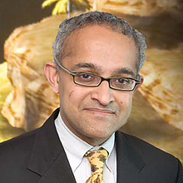
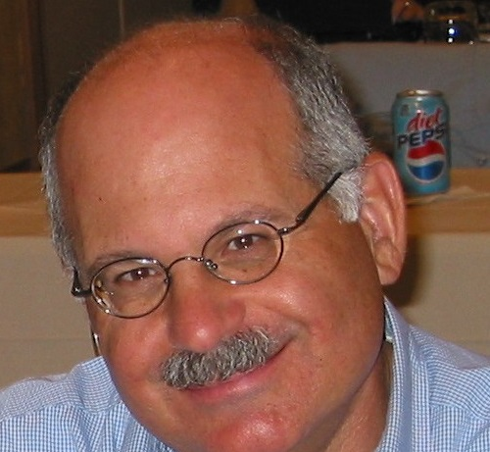
What other people cover (FYI)
Hanan: 60% Data Structures, 40% LISP Programming (!). Grace cluster submission of C/C++/LISP projects
Meesh: Huge industry – quality Java project, honed over decades. Submit components with lax deadlines. Self-professed impossible exams, worst dropped.
V.S: Semester-long project. Fair exams. No technical details about project known ☹
Larry: Perhaps widest array of topics; includes similarity searching, locality-sensitive hashing, region quadtrees, associative rule mining.
2 midterms, 1 final, 3 easy / medium Java projects.

Slide 98
What we’ll cover
Building dictionaries: Abstract data structures that store <Key, Value> pairs
Balanced binary trees
B-Trees
Hashing (under the java.util.Hashmap hood)
Data structures to support efficient operations on string data
String compression (LZW)
String storage (tries & patricia tries, suffix trees, suffix arrays)
String matching (Naïve, Knuth – Morris - Pratt, Boyer-Moore, Rubin-Karp) (this is a maybe)
Multi-dimensional data structures to model 2D, 3D, …, ND and perform similarity tasks.
KD-Trees, R- Trees
Quadtrees: Fink’s, P-R (classic, bucketed, loose), MX-CIF, Region
MinHash for document similarity
Locality Sensitive Hashing (LSH)
Elective topics:
Priority queue implementations
Binomial and Fibonacci heaps
What’s the deal with matrix storage?
Distributed data structures…. (see syllabus for more)

Slide 99
Notable things we won’t cover
B* / B+ trees (extension of B-Trees to disk)
According to Nick Roussopoulos, the most successful data structure ever!
Treaps (random balanced binary trees)
Gunnot-Monroe algorithm for self-organizing collision chain 1D hash tables.
Robson Traversal: A stackless traversal of binary trees with constant storage
For the last two algorithms, examine a relevant Honor’s project!

Slide 100
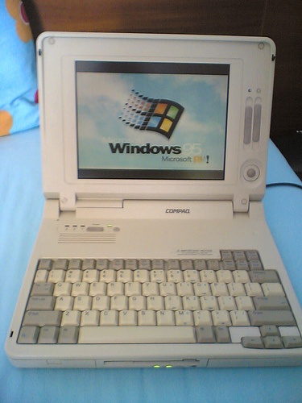
What you’ll need:
“Showing up is half the battle” ~ Bill Gasarch
Beyond that…
Laptops allowed, yet unnecessary

Slide 101
The boring stuff : Webpages
ELMS: Static information (syllabus), files and your gradebook.
Recordings, resources, programming project handouts, breakdown of lectures,…
Piazza: We talk. Teaching staff announces future materials, resources, you post your questions and your resources…
Submit server: You submit your projects. Refer to the programming project handouts for specifics of how you can do this.
Jason’s GitHub: Where / when appropriate, I will be posting skeleton code for your projects on my GitHub so that you can download it and fill-in the class implementations.
Sometimes, some code demos will also be shared on the GitHub repo for you.
E.g, today’s demos

Slide 102
The boring stuff: Assessment
2 within-semester exams, non-cumulative
1 final exam, cumulative
3-4 programming assignments in Java
Auto-graded on submit server
Review syllabus for our student-friendly programming deadline policy™

Slide 103
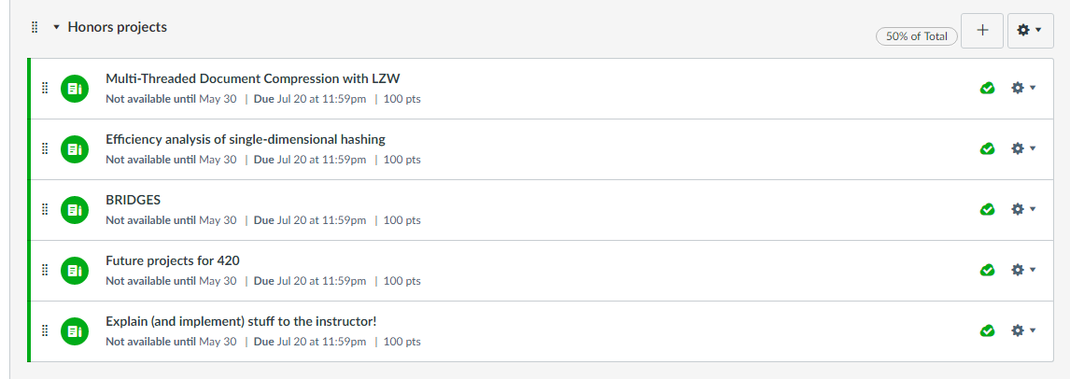
Honor’s / Extra Credit assignments
There’s a wide array of Honor’s options available
If not an Honor’s student, submissions acceptable for Extra Credit.
Advice: Commit to them early (like, today), and only if you’re a strong, fast coder. Later on in the session, there’s not gonna be time.

Slide 104
That’s all! Ask me anything.

