Slide 1
movement(s) of ideas
2017-2018 Black Movement(s) Series
African American History, Culture, & Digital Humanities (AADHum)
October 9 - November 13, 2017

Slide 2
ideas...
are contingent upon language
have histories
are dynamic in texture and “elasticity” over time

Slide 3
Encoding ideas
How to craft a TEI header to identify a digital text or corpus of texts
How to encode the body of a text to create a digital surrogate embedded with analysis and critical interpretation
How to create an accessible online repository of XML files
How to publish a static site from a TEI document
Guides & materials: https://umd.instructure.com/courses/1224150

Slide 4
How does encoding support or hinder our efforts to centralize blackness & black people in the conception and design
of our digital projects?
(Encoding for #blackDH)

Slide 5
Tyechia L. Thompson, PhD
https://github.com/tyechialynn/DBK1967
https://tyechialynn.github.io/DBK1967/

Slide 6
Melissa Brown, Doctoral Candidate
https://github.com/aadhum/AADHUM-Module-1
https://missmcb.github.io/DBK1967

Slide 7
Will Thomas, Doctoral Student
https://github.com/wrt2dc/fourteen
https://wrt2dc.github.io/fourteen

Slide 8
Jessica H. Lu, Doctoral Candidate
https://github.com/lujessica/DBKFreedomSchool
https://lujessica.github.io/DBKFreedomSchool

Slide 9
What’s next?
TAPAS Project: for project storage and TEI support
AADHum 2017-2018 Black Movements Digital Humanities Incubators: for building-up from TEI to develop rich digital projects
HILT 2018: for more digital training, inspiration, and support
TEI Conferences and collaborations: to challenge TEI standards to evolve to address needs to centralize blackness, black people, and black lives

Slide 10
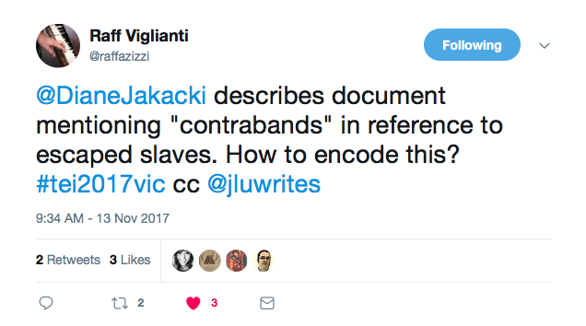

Slide 11
