Slide 1
movement(s) of ideas
2017-2018 Black Movement(s) Series
African American History, Culture, & Digital Humanities (AADHum)
October 9 - November 13, 2017

Slide 2
https://umd.instructure.com/courses/1224150

Slide 3
How does encoding support or hinder our efforts to centralize blackness & black people in the conception and design
of our digital projects?
(Encoding for #blackDH)

Slide 4
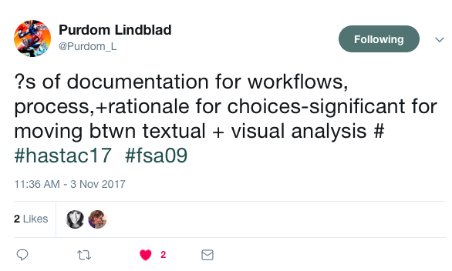
Documentation

Slide 5
Documentation
ODD: “One Document Does It All”
Within the TEI header:
respStmts: responsibility statements
encodingDesc: allows prose to define and explain editorial choices, transcription, language, etc.
<note>: can provide clarifications in particular areas
Keep a running Google doc throughout the encoding process

Slide 6
Working and Publishing via Git & GitHub
Git (a version control system) + GitHub (a social network of Git repositories)
Add: add new files and track subsequent version
Commit: save changes to a new file version
Push: store files and their versions (commits) to an online repository
Repository: collection of files and their multiple versions
Clone: recreate an online repository on your own computer
Pull: get new changes from an online repository

Slide 7
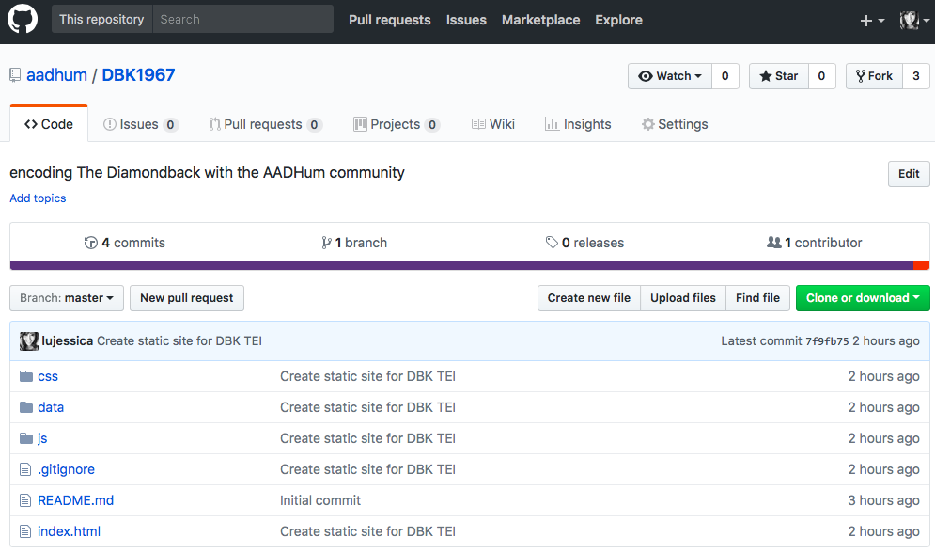

Slide 8
Follow the step-by-step instructions in “Publishing Your TEI as a Static Site”
Use your pink neon stickies when you need support!

Slide 9
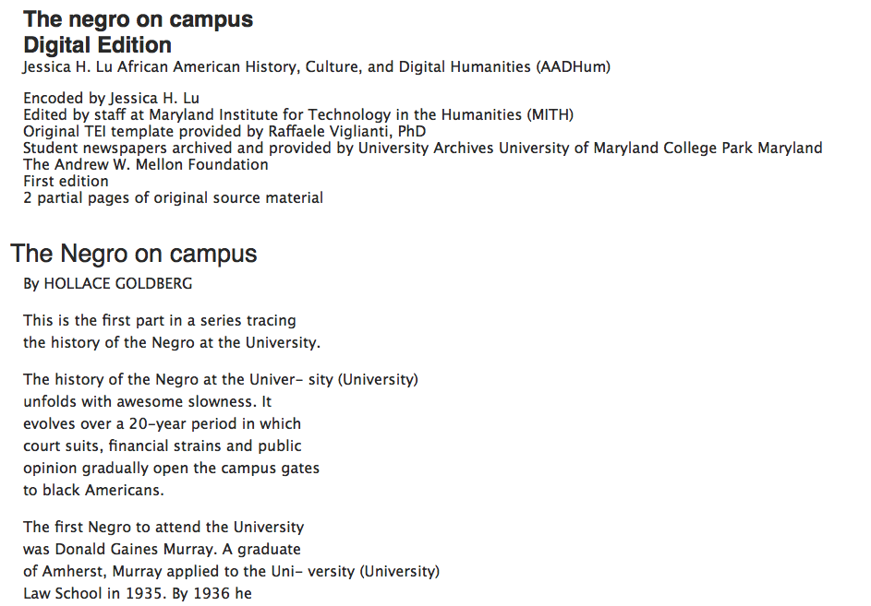

Slide 10
For our final Monday:
Practice publishing your TEI as a static site.
Try CSS styling!
Encode a document that is particularly relevant to your own research
Create a GitHub repository for your own project
Direct questions or concerns to aadhum@umd.edu!

