Slide 1
movement(s) of ideas
2017-2018 Black Movement(s) Series
African American History, Culture, & Digital Humanities (AADHum)
October 9 - November 13, 2017

Slide 2
@UMD_AADHum
#aadhum
#blackDH
#digiDBK

Slide 3
http://tei-c.org
What is the difference between
emph and hi ?

Slide 4
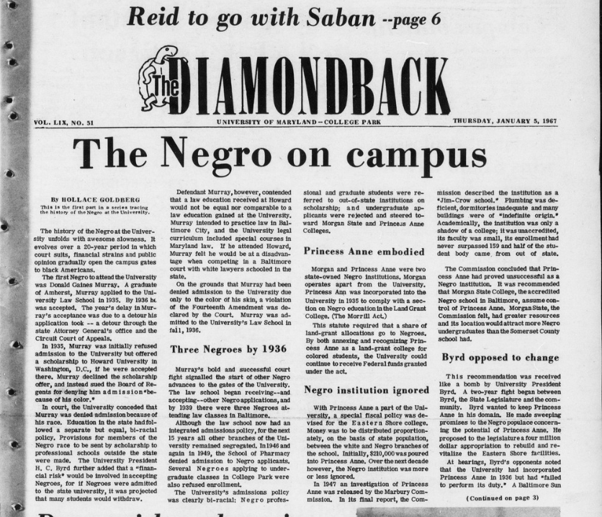
https://go.umd.edu/DBK1967

Slide 5
Navigate to our Canvas course space via https://go.umd.edu/AADHumIncubator OR https://umd.instructure.com/courses/1224150/
Select “Modules” in the left-hand sidebar
Choose one of the DBK Selections
Download and save your selected XML file
Open your saved XML file using Atom

Slide 6
The Diamondback, January 1967
January 5: “The negro on campus”
January 6: “Negroes on campus: Integration at College Park”
January 9: “Negroes on white campus: Apprehension limits racial interaction”
January 9: “‘Average’ freshman: ‘Class of ’70’ described”
January 11: “The negro on campus: Racial issues down since 1954”
January 12: “A lonely walk?: Negroes view campus with mixed emotions”
January 13: “Interdating: The negro point of view”

Slide 7
Behind the scenes...
Crafted headers for each article
Procured the OCR-ed text files
Optical character recognition (manual or electronic) converts an image of typed, written, or printed text into a plain text
“Cleaned up” the OCR

Slide 8
Encoding the Text Body
Consider your tentative goals
Discovery? Access? Sustainability? Analysis? Representation?
Develop a personal system to stay organized and focused
Formatting and structure
Editorial changes and corrections
Elements
Analysis

Slide 9
Formatting
How do you markup:
Paragraphs and line breaks?
Column breaks?
Page jumps?
Alignment?

Slide 10
Editorial Changes
How do you markup:
Misspellings / corrections?
Preserved words
Hints: <corr> and <choice>

Slide 11
Textual elements
How do you markup:
Dates and events?
People and their names?
Organizations?
Locations?
Help: consider Named Entity Recognition

Slide 12
Analysis
How do you markup:
Relationships within the text?
Ideas?
Hints: “ref,” “corresp”, <relation>, <seg>

Slide 13
How does encoding support or hinder our efforts to centralize blackness & black people in the conception and design
of our digital projects?
https://go.umd.edu/encodingAADHUM

Slide 14
Movement(s) of Ideas
Session 4: Pick Your Practice: Encoding & Python “office hours”
Session 5: building and publishing a digital edition, ethics of collaboration and documentation
Session 6: project-share, next steps for developing digital projects and supporting communities of #blackDH encoders

Slide 15
For next Monday:
Pick your practice!
Want to continue building your encoding skills? Join Jessica in Taliaferro Hall, Room 1104, with your laptop, ATOM software, and any desired texts
Want to learn more about basic Python programming? Join Raff in the MITH Conference Room (our regular location), 0301 Hornbake Library
Direct questions or concerns to aadhum@umd.edu!

