Slide 1
movement(s) of ideas
2017-2018 Black Movement(s) Series
African American History, Culture, & Digital Humanities (AADHum)
October 9 - November 13, 2017

Slide 2
@UMD_AADHum
#aadhum
#blackDH
#digiDBK

Slide 3
http://go.umd.edu/AADHumIncubator
(Or, https://umd.instructure.com/courses/1224150/)
http://atom.io

Slide 4
Extensible Markup Language (XML)
markup: information added to a document that identifies its parts and how they relate to one another
XML: a computer-readable markup language using nested tags (similar to HTML) to identify and organize the various parts of a document
Extensible: allows you to create your own tags (within a chosen XML standard)
Translatable: can be used irrespective of how it will ultimately be displayed / presented
Standard: developed by the World Wide Web Consortium (W3C)
If it can be written down, it can be encoded using XML.
Notes:
XML is not a programming language, since it does not execute any computational or algorithmic functions.

Slide 5
Extensible Markup Language (XML)
Tags are used to define an element or part of a document
Start tags are used to mark the beginning of an element or part
Ex: <title>
End tags are required to mark the end of an element or part
Ex: </title>
Empty tags are used for elements that have no content
Ex: <lb/>
Nesting arranges a document in terms of a hierarchical organization, wherein sub-elements are contained (or nested) within an element

Slide 6
Text Encoding Initiative (TEI)
A community-driven markup standard for encoding text
Machine-readable
Explicit identification of a document’s parts
Ex: mise-en-page (italics) vs. Mise-en-page (foreign)
Has developed into an international consortium that develops and maintains TEI as a standard XML language for digital encoding
Current guidelines: P5
Header
Text body
Element references
Notes:
Brief intro to TEI
Originated around 1949, in an effort to conduct analysis on the works of Thomas Aquinas at Vassar College
International consortium
Community driven: what the TEI can model is based on the often shifting needs of the community. Has moved beyond primary usage of literary and linguistic texts.
A useful way for me to understand what TEI is about is discussing the difference between indicating how some text looks (HTML, in italics) v why it looks that way (XML, a foreign word)

Slide 7
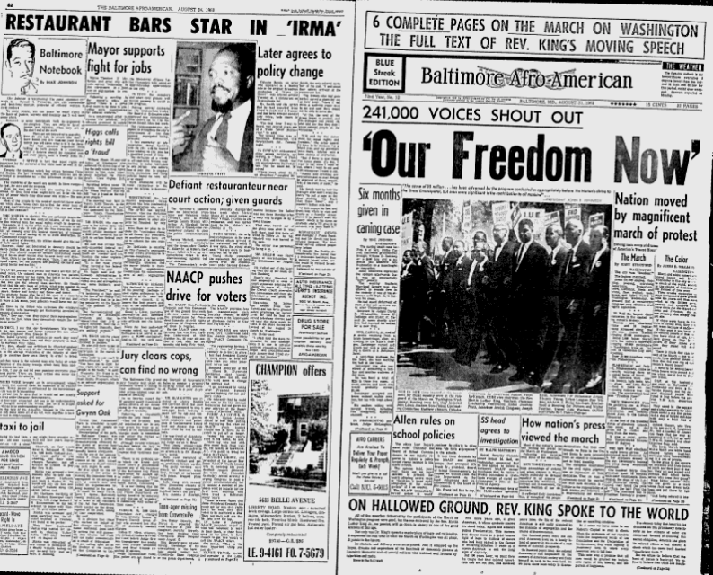
http://go.umd.edu/aadhumAFRO

Slide 8
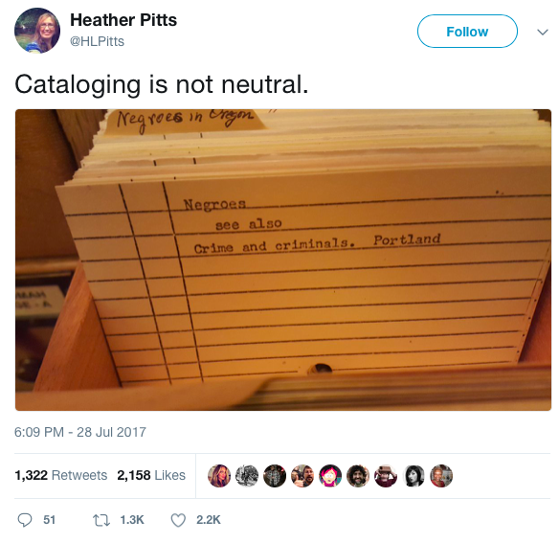
What role can the TEI header play in addressing exercises of power in cataloguing practices?

Slide 9
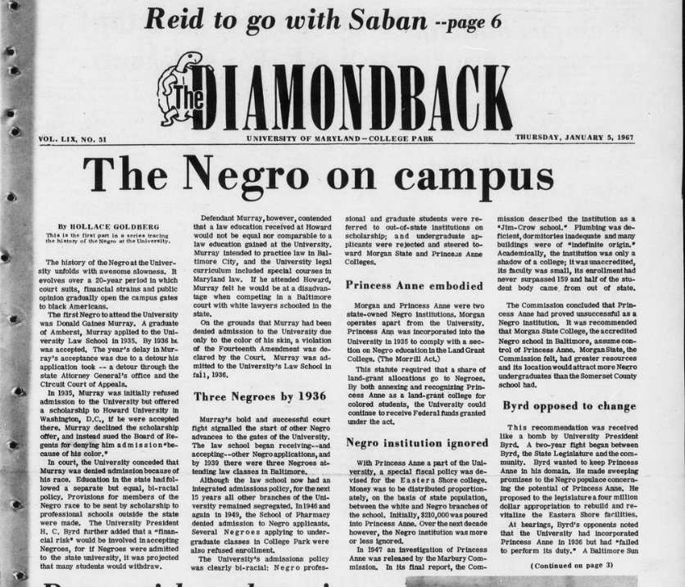
http://go.umd.edu/DBK1967

Slide 10
Movement(s) of Ideas
Session 3: encoding text body, searching the TEI guidelines, considering the limits of TEI for “marking up” African American historical texts
Session 4: Pick Your Practice: Encoding & Python “office hours”
Session 5: building and publishing a digital edition, ethics of collaboration and documentation
Session 6: project-share, next steps for developing digital projects and supporting communities of #blackDH encoders

Slide 11
For next Monday:
Complete a basic header for a selected DBK January 1967 article
Practice crafting a more advanced header for your selected DBK article
If choosing to work with a non-DBK article, bring a transcribed text (electronic version) of your choice.
Come prepared with a powered-up laptop and your free Atom software
Direct questions or concerns to aadhum@umd.edu!

