Slide 1
movement(s) of ideas
2017-2018 Black Movement(s) Series
African American History, Culture, & Digital Humanities (AADHum)
October 9 - November 13, 2017

Slide 2
@UMD_AADHum
#aadhum
#blackDH
#digiDBK

Slide 3
What ideas do we study, and how?
Why do ideas matter?

Slide 4
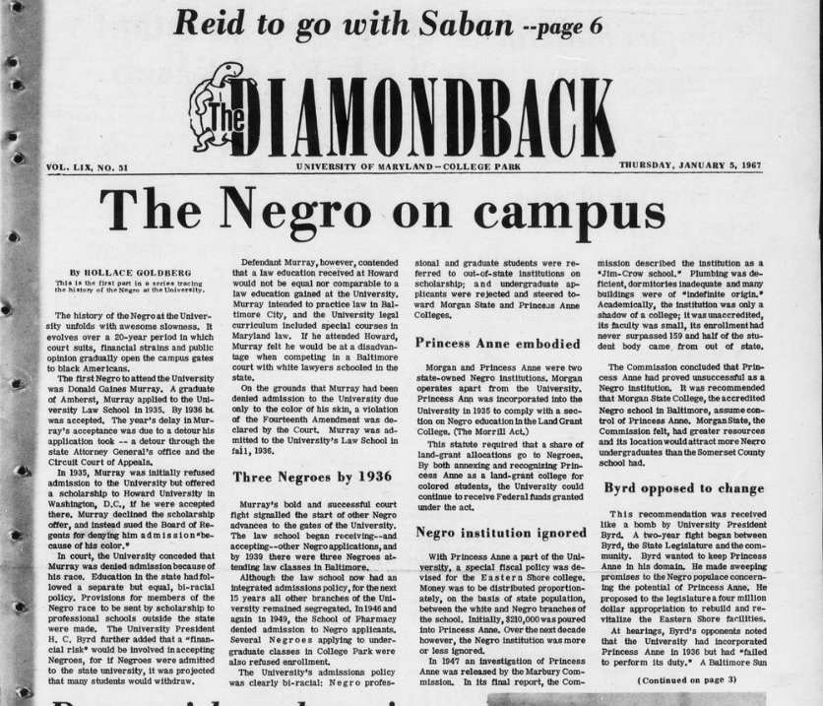

Slide 5
#digiDBK #aadhum
What guides our engagement with these texts?
What strategies do we use when approaching, interacting with, and making meaning of this archive?

Slide 6
#digiDBK #aadhum
What other approaches are available to us to understand a large corpus?
Example: topic modeling

Slide 7
From Probabilistic Topic Models, David Blei, 2012. doi:10.1145/2133806.2133826
Notes:
One way to think about how the process of topic modeling works is to imagine working through an article with a set of highlighters. As you read through the article, you use a different color for the key words of themes within the paper as you come across them. When you were done, you could copy out the words as grouped by the color you assigned them. That list of words is a topic, and each color represents a different topic. Note: this description is inspired by the following illustration from David Blei’s article

Slide 8
1. court, state, said, school, freedom
2. world, united, people, freedom, states
3. editor, manager, editorial, managing, chief
4. state, said, education, freedom, president
5. faculty, freedom, said, president, administration
6. said, freedom, time, life, president
7. people, freedom, like, world, editor
8. press, said, freedom, people, service
9. freedom, state, hall, years, time
10. said, vietnam, freedom, draft, president
Topic modeling on documents containing the word “freedom” in the Diamondback corpus
Notes:
Searching for “freedom” returns 2,325 results; what can help us make sense of all of these results without having to read each one? One way is to send the documents that contain the word "freedom" to a topic modelling algorithm to see what "topics" (or groups of words identified by the algorithm) emerge, for example:
These topics could be used to go back to the search box and refine your search, e.g. by then searching for "freedom AND vietnam", or run the topic modeling again on documents containing both "freedom" and "people" and see what new topics come up.
In short, this is a tool to delve into the text corpus from a bird's eye view. While this won’t be the focus of this incubator, we plan on distributing a guide on how to do something like this step-by-step and if you’re interested in learning more, we can help you get started during the lab session on week 4.

Slide 9
ideas...
are contingent upon language
have histories
are dynamic in texture and “elasticity” over time

Slide 10
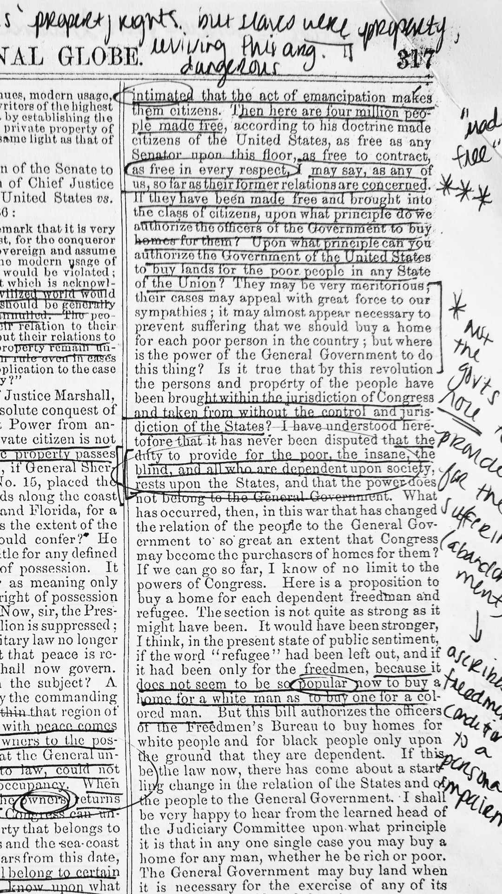

Slide 11
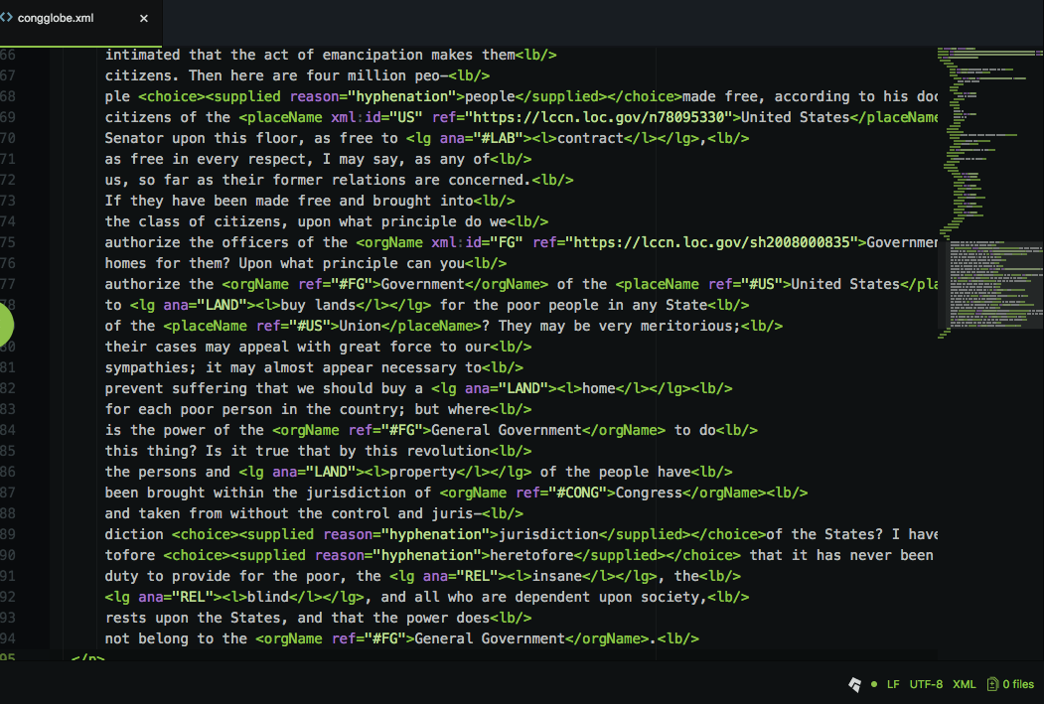

Slide 12
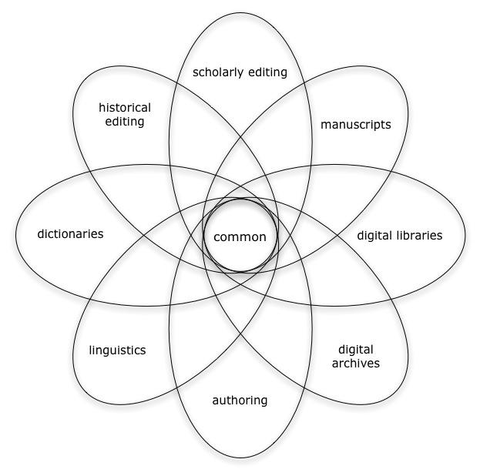
Text Encoding Initiative
A community-driven standard for
encoding text
Descriptive approach:
From Overview of the TEI, Bauman and Flanders 2007
mise-en-page (italics)
mise-en-page (foreign)
vs
Notes:
Brief intro to TEI
International consortium
Community driven: what the TEI can model is based on the often shifting needs of the community
A useful way for me to understand what TEI is about is discussing the difference between indicating how some text looks (in italics) v why it looks that way (a foreign word)

Slide 14
How can digital tools and methods enrich our understanding of ideas and African American history and culture?
How can centering black people and African American histories challenge and/or enrich digital tools and methods?

Slide 15
Movement(s) of Ideas
Ideas are dense, dynamic, and constituted through language
We can approach local newspapers as rich texts for ideational analysis
We will explore the potential and limitations of encoding as one method of tracing ideas’ movements through text and time

Slide 16
Movement(s) of Ideas
Session 2: introduction to the TEI standard for encoding, basics of TEI headers, role of power in cataloguing practices
Session 3: encoding text body, searching the TEI guidelines, considering the limits of TEI for “marking up” African American historical texts
Session 4: Pick Your Practice: Encoding & Python “office hours”
Session 5: building and publishing a digital edition, ethics of collaboration and documentation
Session 6: project-share, next steps for developing digital projects and supporting communities of #blackDH encoders

Slide 17
For next Monday:
Browse January 1967 issues of The Diamondback
Review the Atom Download and Configuration Guide, available at http://go.umd.edu/AADHumIncubator
Come prepared with a powered-up laptop and your free Atom software
Direct questions or concerns to aadhum@umd.edu!

