Slide 1
Arrays
Basic arrays, binary search, selection sort by amelia bateman

Slide 2
to follow along in code…
Use Eclipse and set break points in order to inspect your arrays in order to see their current values
Import java.util.Arrays (or java.util.*)
This is not necessary for using arrays, but is necessary for printing arrays using toString
System.out.println(Arrays.toString(arr));
Once we see looping, write a loop which prints each element

Slide 3
Recall arraylists
Expanding size
ArrayList x = new ArrayList();
Generics: ArrayList<String> x = new ArrayList<String>();
Methods: add, remove, get, size

Slide 4
Arrays versus arraylists
Array | ArrayList
Fixed size, declared upon creation | Expands as needed
Memory and computation efficient | Less efficient (slightly)
Stores Objects or primitives | Can only store Objects
Stores only one data type | Can store any objects (if not using generics)

Slide 5
Array creation
dataType[] name = new dataType[length];
int[] x = new int[5]; //[ _ , _ , _ , _ , _ ]?
Recall default values: int->0, double->0.0, Object->null
x: [0,0,0,0,0]

Slide 6
Array creation: literals
dataType[] name = {val1, val2, …};
int[] x = {1,2,3}; //[1,2,3]
String[] strs = {“hi”, “there”}; //[“hi”, “there”]
Be careful with types!
Attempting to use the wrong literal yields incompatible types error

Slide 7
Using arrays: setting values
Set: use index directly
int[] x = new int[5]; //[0,0,0,0,0] x[1] = 16; //[0,16,0,0,0]
String[] strs = new String[2]; //[null, null] strs[0] = new String(“a”); //[“a”, null] strs[1] = “b”; //[“a”, “b”]

Slide 8
using arrays: getting values
Retrieve value at an index directly, with no get method
int[] nums = [0,1,2,3]; int x = nums[3]; //x=3
No need to cast, since type is known

Slide 9
Using arrays: remove
No such thing! Not comparable to ArrayList.remove(), anyway
Length is unchangeable, so no removing elements completely
Can loop through array (see next slide) and reset undesirable values

Slide 10
using arrays: length and looping
arr.length is an attribute, not a method like size()
Index of last elements? arr.length – 1
for(int i=0; i<arr.length; i++)

Slide 11
Using arrays: looping example
Looping to set values in an array. Want events up to 100.
int[] arr = new int[51]; for(int i=0; i<arr.length; i++){ arr[i]=i*2; } for(int i=0; i<arr.length; i++){ System.out.print(arr[i] + “ “; }

Slide 12
2D arrays
Array of arrays, has simplified notation
int[][] flag = new int[5][4];
What does this look like in memory?
Is it 5 rows and 4 columns or vice versa? Depends on how you think about it!
If you draw the first array (5) horizontally, there are 5 columns and 4 rows
Code example

Slide 13
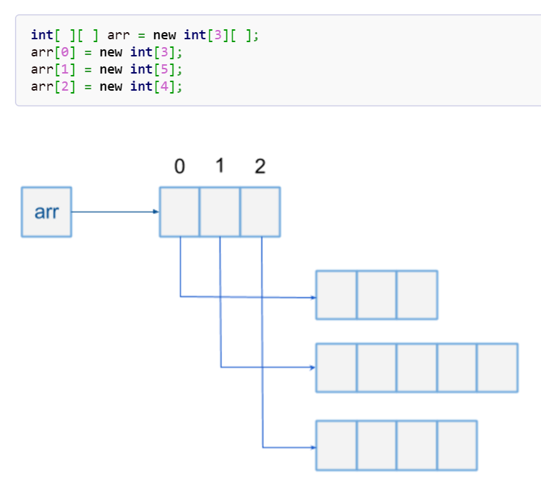
Jagged array
Like 2D array, but does not have to be an even rectangle

Slide 14
application: binary search
Problem: find a specific element in a sorted array
Analogy: when searching a phone book, open to the middle. Then open to the middle of whichever half is correct. Repeat until successful
Why not just search the entire thing? Runtime efficiency

Slide 15
Pseudocode
min=0, max=0 if(max < min) -> stop and report failure mid = average(min, max) if(arr[mid] = target) -> success if(arr[mid] < target]) -> min=mid+1 if(arr[mid] > target) -> max=mid-1 Loop back to start

Slide 16
Application: selection sort

